Slide 1

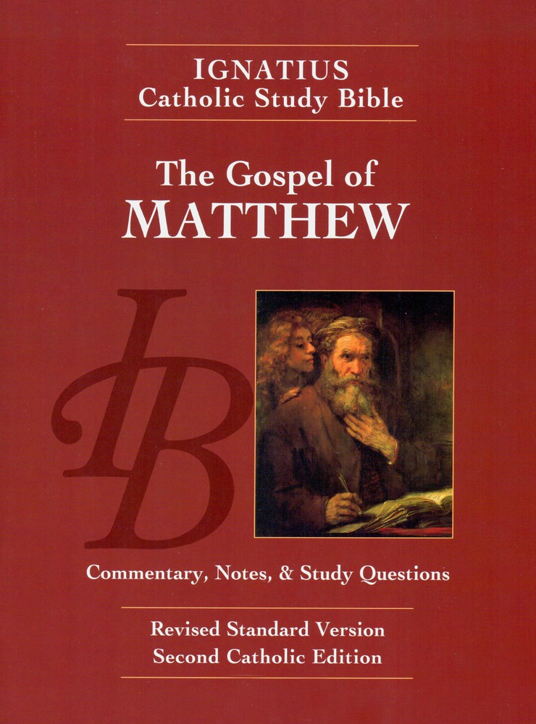

Slide 2

Lesson 1: Introduction
Why the Ignatius Catholic Study Bible?
Excellent Scholarship (Ignatius Press, Scott Hahn, and Curtis Mitch)
Faithful notes and commentary
Excellent translation of the Bible (very similar to the English Standard Version)
Will make an excellent resource for every Christian's home library

Slide 3
The Synoptics:
What are they?
The word synoptic comes from the Greek word which means to look the same. Of the four Gospels, three "look" the same
Written as eyewitness chronological accounts of the life of Jesus
Share many of the same stories, the same sayings and teachings and same timeline
Which three Gospels are synoptic?

Slide 4
St. Matthew
St. Mark
St. Luke

Slide 5
κατα λυκυς
Written by Luke, a gentile physician and companion of St. Paul. Personally acquainted with the Blessed Virgin Mary. This is the eyewitness account of Mary and Paul.
The longest Gospel account, Luke included more detail and description than the other two synoptic accounts. (hint, St. Luke wrote more of the New Testament than any other writer.

Slide 6
κατα μαρκυς
Marks gospel is the shortest Gospel. His bare writing style and consistent us of the word immediately gives this Gospel a very hurried feel.
As a traveling companion to St. Peter, St. Mark's Gospel is the eyewitness account of St. Peter.

Slide 7
Κατα Ματταθιας
St. Matthew was one of the twelve Apostles, and one of the first chosen by Jesus. (more about that next week.)
St. Matthew's Gospel is a very Jewish Gospel account, written for Jews from a Jewish perspective.
For many centuries, the Gospel According to St. Matthew was used as a catechism to train converts in the Christian faith.

Slide 8
Κατα ιονας
According to John
John's account is not Synoptic because he presents his material according to a theological and mystical arrangement rather than a chronological arrangement
As one of the twelve Apostles, his account is also an eyewitness account, presented differently to accomplish a different purpose
According to tradition, John wrote this Gospel after he wrote the Book of Revelation. His Gospel account is heavily influenced by his experience of heaven and the beatific vision.

Slide 9
Canonization
When were these books accepted as Holy Scripture?
Matthews Gospel was probably the first to be accepted and widely used, followed by Marks and Lukes. John's Gospel was written near the end of the first century, in John's old age.
There was never any dispute in the church about these four Gospels, including the authorship.(Example: Hebrews claims no author and has been disputed since its appearance. There are other so-called Gospels, but they have never been accepted. These four have never been rejected or disputed.)

Slide 10
The Primacy
of the Gospels
The Gospels have always reigned supreme in the Christian Scriptures.
They are always printed first in the New Testament because they are the foundational documents of the Church (just as the first five Books of the Old Testament were Foundational to ancient Judaism.)
In the Eucharist, the Gospels are always read, they alone are sensed, lifted up, processed, bathed in incense, and blessed with the sign of the cross.

Slide 11
What does Primacy of the Gospels mean?
We read them first. These present the material which is foundational to our faith.
The Gospels offer the interpretive lens through which all other books of Scripture are judged, interpreted, and expounded. Even Romans and Collosians are subordinate to the Gospels.
When considering the doctrines of the faith, including Church tradition, the Gospel's are the first standard of truth and revelation which must be satisfied. (Nothing is allowed contrary to the Gospels)

Slide 12
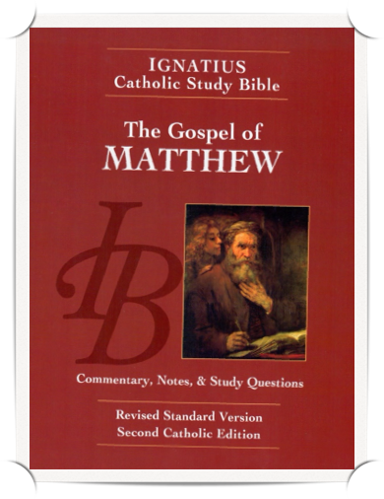
Homework
Read Introduction to the Gospel According to Saint Matthew,
pp. 13-15
Study the Outline of The Gospel According to Saint Matthew, p 16
Notice the cycle of narrative (story of Jesus' life) and Discourse (teaching of Jesus.)
Flip through the Gospel and familiarize yourself with the content of these cycles. (Ex: 1st Narrative = Infancy and John the Baptist; 1st Discourse = Sermon on the Mount.

