Slide 1

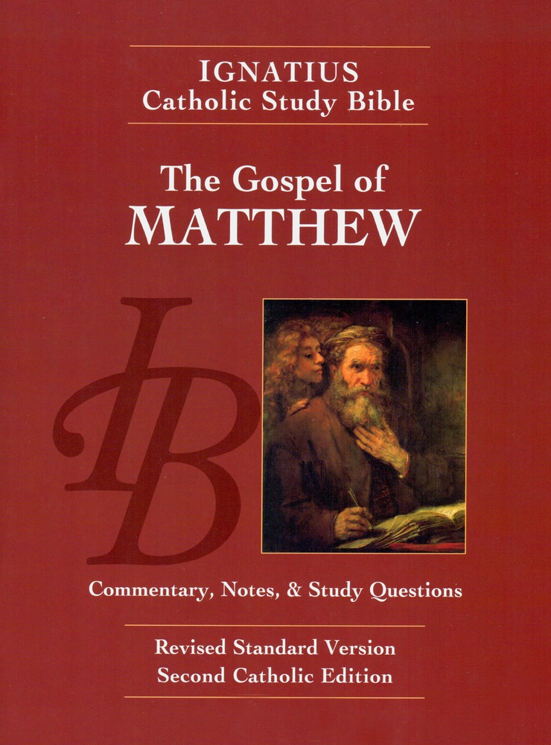
Sunday Bible College
Chapter 10:1-15
The Twelve Disciples
and their Mission
Holy Trinity
Anglican Church
Fernandina Beach, Florida

Slide 2

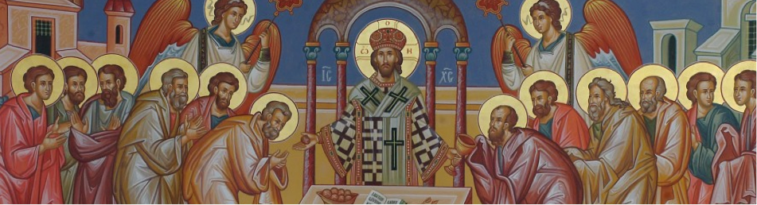
Choosing the Twelve
Read St. Matthew 10:1-4

Slide 3

The Twelve Disciples
10:1-4
Why twelve? Is there any special significance to that number?
Compare the order of the names in this list to the other lists of the Apostles. What stands out? Mark 3:16-19 St. Luke 6:13-16 Acts 1:13
What did Jesus give to these Apostles?

Slide 4
The Mission of the Twelve
10:5-15
He sent them out to preach. What was the message they were to deliver? see verse 7
What is the meaning of verse 8.b, "you recieved without pay, give without pay?" In context, how are the Disciples supposed to accomplish their mission without starvation?
What is the fate of those who listen and receive the message of the Kingdom?
What is the fate of those who will not listen to the Disciples?

