Slide 1

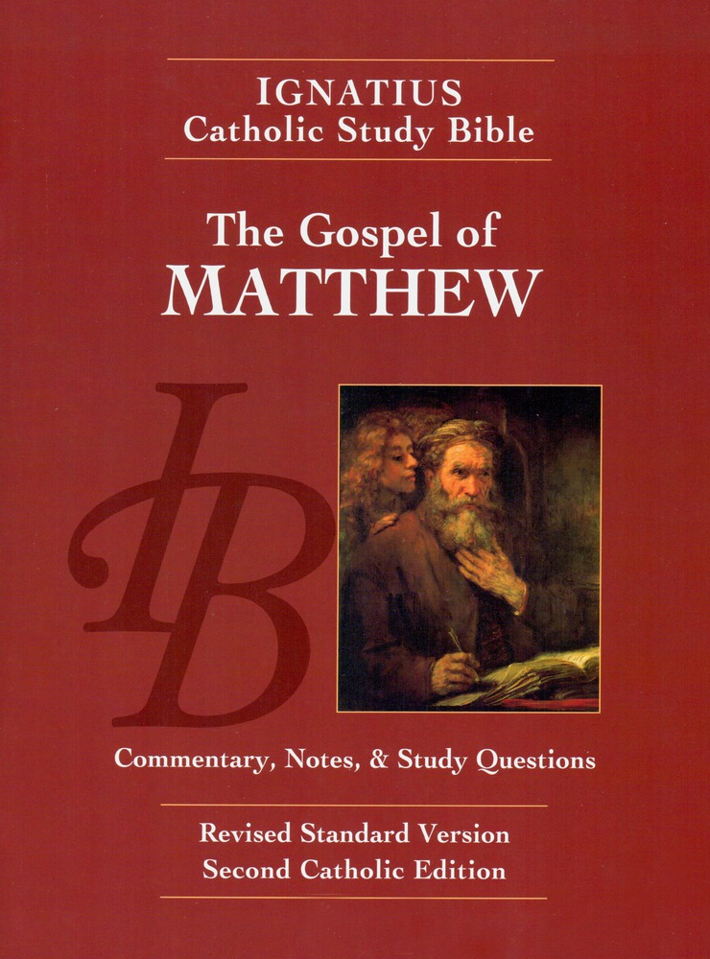
Sunday Bible College
Chapter 10:16-33
The Second Discourse:
Teaching the 12 Apostles
Holy Trinity
Anglican Church
Fernandina Beach, Florida

Slide 2

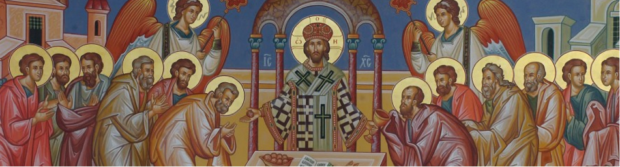
Choosing the Twelve
Read St. Matthew 10:16-25

Slide 3

Coming Persecutions
10:16-25
This is the real begging of the second great discourse or teaching message given by Jesus as recorded in Matthew.
The first was the Sermon on the Mount. This is a message to his Disciples, to his inner circle who are being trained to carry his message abroad
"Be wise as serpents, harmless as doves."
Persecution is normal, expect it.
"He who endures to the end will be saved."

Slide 4
Coming Persecutions
10:16-25
"If they persecute you in one town, flee to the next." - there is a limit to the time of repentance.
Once again, we hear that Jesus is called Beelzebul. And if they call the Son of God the "Lord of Flies", what will they say of those who follow him?

Slide 5
Choosing the Twelve
Read St. Matthew 10:26-33

Slide 6
Whom to Fear
10:26-35
This powerful argument or teaching from Christ invites the Disciples to establish their priorities according to Wisdom and not practical concerns. The practical minded man or woman says we should fear the person who want to ruin us. But the wise knows that after this life we will answer to one who can ruin or restore.
Christians place their priorities on the life to come, not on this transitory life. In other words, we don't fear losing the temporary, we fear losing the eternal.
How does this priority effect the way a Christian lives on Monday morning?

