Slide 1

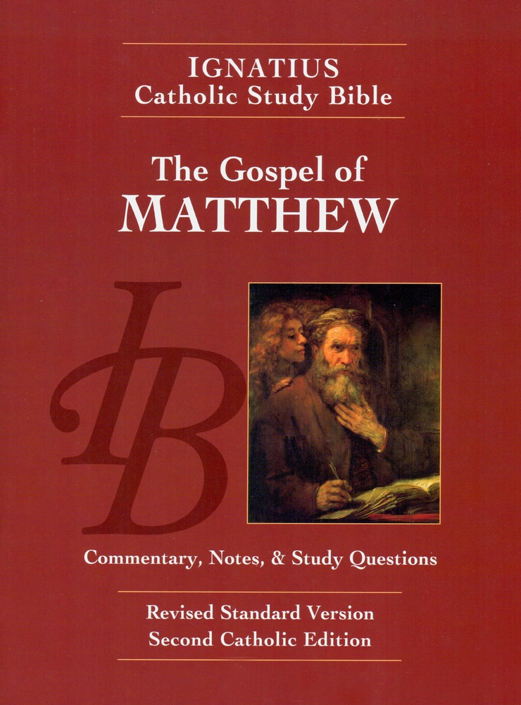
Sunday Bible College
Chapter 10
The Second Discourse:
Teaching the 12 Apostles
Holy Trinity
Anglican Church
Fernandina Beach, Florida

Slide 2

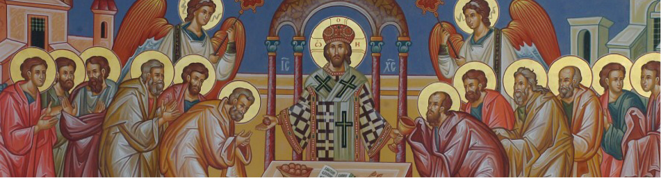
Choosing the Twelve
Read St. Matthew 10:16-25

Slide 3

Coming Persecutions
10:16-25
This is the real begging of the second great discourse or teaching message given by Jesus as recorded in Matthew.
The first was the Sermon on the Mount. This is a message to his Disciples, to his inner circle who are being trained to carry his message abroad
"Be wise as serpents, harmless as doves."
Persecution is normal, expect it.
"He who endures to the end will be saved."

Slide 4
Coming Persecutions
10:16-25
"If they persecute you in one town, flee to the next." - there is a limit to the time of repentance.
Once again, we hear that Jesus is called Beelzebul. And if they call the Son of God the "Lord of Flies", what will they say of those who follow him?

Slide 5
Choosing the Twelve
Read St. Matthew 10:26-33

Slide 6
Whom to Fear
10:26-35
This powerful argument or teaching from Christ invites the Disciples to establish their priorities according to Wisdom and not practical concerns. The practical minded man or woman says we should fear the person who want to ruin us. But the wise knows that after this life we will answer to one who can ruin or restore.
Christians place their priorities on the life to come, not on this transitory life. In other words, we don't fear losing the temporary, we fear losing the eternal.
How does this priority effect the way a Christian lives on Monday morning?

Slide 7
Taking Up One's Cross
10:34-39
Conversely
Vs 40 Receiving the Apostle is receiving Christ, and receiving the one sent from God is rewarded...
Receive Christ
Receive the Prophet
Receive the righteous man
Offer cold water to "little ones"...
RECEIVE THE REWARD THEY RECEIVE!
The Little Ones are the Disciples, the Apostles. Note: the word Christian is Greek for "Little Christ". We are called to be little Christs in the world.

Slide 8
Rewards
10:40-42
To whom is Jesus speaking in this passage? Primarily the 12 Apostles.
Recall the ministry Jesus calls them to do (verses 10ff)
1. Go to the lost (at this point, the lost in Israel)
2. Preach the Gospel (Repent, the kingdom of heaven is at hand!)
3. Offer the Sacraments (healing unction)
4. Pronounce blessings
5. Exercise discernment (shake off the dust)

Slide 9
Rewards
10:40-42
To whom does Jesu offer rewards in this section?
First, to the Apostles. As they exercise their ministry on the authority of Jesus, they are to be rewarded both temporally (houses to stay in, water and provisions for the work) and eternally (from "Him who sent me")
Second, to those who "receive" the Apostles and to those who provide for their work.
What are they to receive? The prophecies of Christ, the righteousness of Christ, and the Father of Christ.

Slide 10
Rewards
10:40-42
The Takeaway
The call of the Apostle is to be so united to Christ and so perfectly aligned with Christ's mission and ministry that to receive the Apostle is to receive Christ and his Father. Conversely to reject an Apostle is to reject Christ and his father.
This is a radical commitment.
How is this Apostolic ministry visible today?

