Slide 1

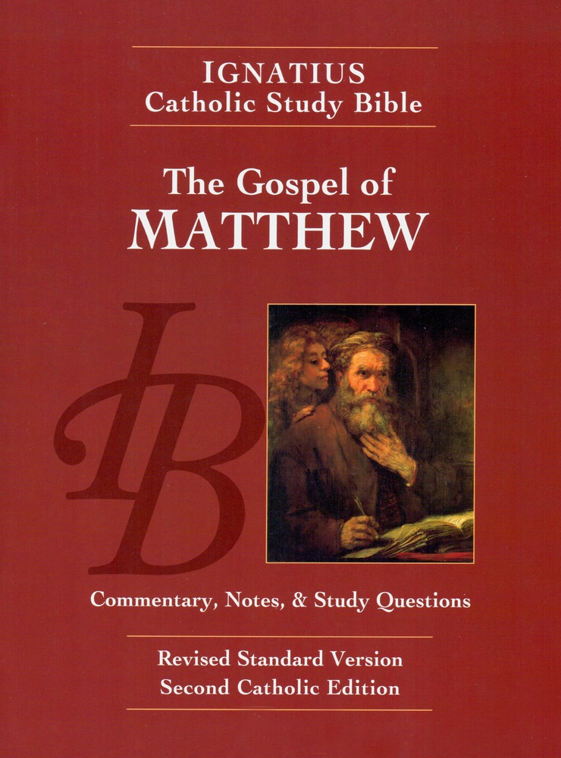
Sunday Bible College
Chapter 11
Preaching and Teaching in the Cities
Holy Trinity
Anglican Church
Fernandina Beach, Florida

Slide 2

John the Baptist
11:1-19
Are you "he who is to come" or do we look for another?
The Jews were looking for a specific prophet whose arrival had been prophesied in the Old Testament.
Compare to Deuteronomy 18:15-20
The people once sent messengers to ask John if he was the one. See John 1:19-21
Sunday Bible College at Holy Trinity Anglican Church: ICSB The Gospel of Matthew

Slide 3
John the Baptist
11:1-19
Go and tell John what you see and hear.
Jesus does not expect John to believe without evidence. He does not expect anyone to believe without seeing and hearing. He only ever condemns those who see and hear yet still refuse to believe.
Who does Jesus say that John the Baptist is? The greatest prophet born of a woman The least in the kingdom of Heaven
The irony of humility with God...
Sunday Bible College at Holy Trinity Anglican Church: ICSB The Gospel of Matthew

Slide 4
Jesus Teaches in Towns and Cities
St. Matthew 11:20-24
The Woes
Woe to you Chorizan! Woe to you Bethsaida! Woe to you Capernaum!
What is Woe?
Sunday Bible College at Holy Trinity Anglican Church: ICSB The Gospel of Matthew

Slide 5
Jesus Teaches in Towns and Cities
St. Matthew 11:20-24
The Woes
What is Woe? It is not a curse, rather it is the devastating and pathetic destruction we bring on ourselves. It is the hopeless bereavement of a life without God. Therefore, Jesus does not curse these cities, he merely names the woe they have brought on themselves.
Sunday Bible College at Holy Trinity Anglican Church: ICSB The Gospel of Matthew

Slide 6
Jesus Teaches in Towns and Cities
St. Matthew 11:20-24
The Woes
What was the fault in Chorizan, Bethsaida, and Caernaum which causes Jesus to pronounce Woe? God had been extraordinarily gracious to these cities, sending them his own Son accompanied by miracles, signs and wonders to offer them salvation, but they preferred their sin to God's salvation.
For Tyre and Sydon, see Isaiah 23:1-4. For Sodom and Gamorah, see Genesis 13:13, and 18:20, 19:1-13
Sunday Bible College at Holy Trinity Anglican Church: ICSB The Gospel of Matthew

Slide 7
Jesus Teaches in Towns and Cities
St. Matthew 11:20-30
The Irony of Jesus' Ministry
He comes to his own, the most educated people in the world, and yet they will not see him for what he is.
Note - Big connection to the Propers for the Fourth Sunday in Lent - Who is it that does receive Jesus, and benefit from his ministry? Those who are weary and heavy laden.
Bonus: Where do these words appear in the Liturgy?
Sunday Bible College at Holy Trinity Anglican Church: ICSB The Gospel of Matthew

