Slide 1

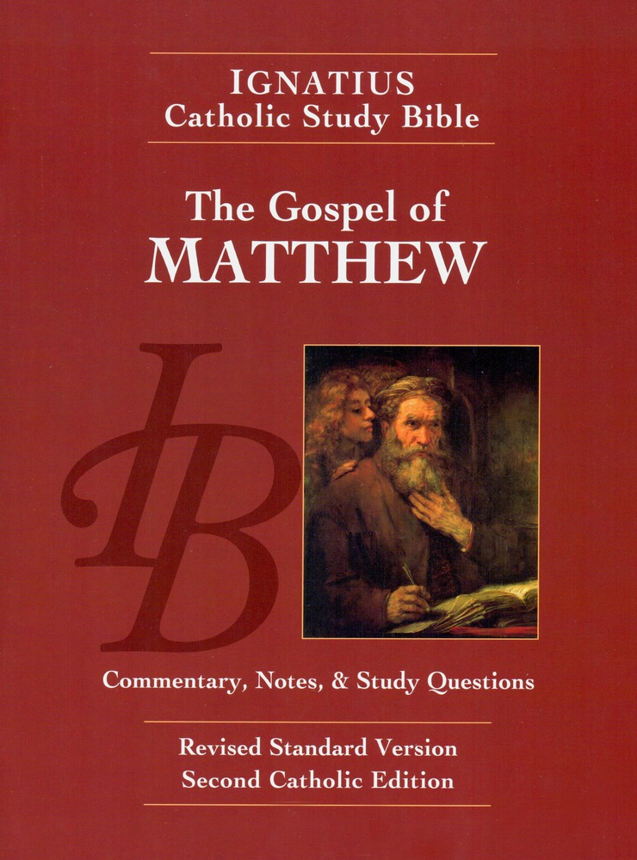
Sunday Bible College
Chapter 12
Narrative
Holy Trinity
Anglican Church
Fernandina Beach, Florida

Slide 2
Plucking Grain on the Sabbath Day
St. Matthew 12:1-8
David and the Show-Bread Leviticus 24; 1 Samuel 21:1-6 David and his companions wer both clean (holy, undefiled) and doing the work of God
The Priests profane the Sabbath and are guiltless The priests are both clean and doing God's work in the presence of God
Something greater than the Temple is here! As God in his Temple made its precincts clean, and the Sabbath was most perfectly lived in the worship of the Temple, so Jesus cleanses and makes holy all things and all things exist to serve Him.
Sunday Bible College at Holy Trinity Anglican Church: ICSB The Gospel of Matthew

Slide 3
The Man with a Withered Hand
St. Matthew 12:9-14
Is it lawful to heal on the Sabbath? Again, Jesus sets aright the purpose and the function of the Sabbath - that man should glory in the presence of God!
The Pharisees took councel how to destroy him! The Pharisees used the law to control people, to manipulate others for their own purposes: Jesus used the Law to lead people to God and the holiness.
Sunday Bible College at Holy Trinity Anglican Church: ICSB The Gospel of Matthew

Slide 4
God's Chosen Servant
St. Matthew 12:15-21
Jesus withdraws from his enemies.
Those who follow him are healed.
He has no regard for fame
Matthew again quotes from Isaiah 42:1-4 He will not break a bruised reed or quench a smoldering wick
Sunday Bible College at Holy Trinity Anglican Church: ICSB The Gospel of Matthew

Slide 5
Holy Week Connection
As the Sabbath was created to draw men to God and teach us to revel in the glory of God's "drawing near to us" So the festivities of Holy Week exist soly to draw us to God, to teach us to be still in his presence and to glory / revel in the Salvation God has granted us in the Passion, death and resurrection of his beloved Son.
Sunday Bible College at Holy Trinity Anglican Church: ICSB The Gospel of Matthew

Slide 6
Holy Week Connection
Will we be like the Pharisees and seek ways to rid ourselves of Christ, of the influence he has on us?
Or will we be those who follow him into the difficult "desert", seeking health from an unpopular and unwanted Savior?
How far will we go? How long will we stay?How much will we risk to be near God?
Sunday Bible College at Holy Trinity Anglican Church: ICSB The Gospel of Matthew

Slide 7
Jesus and Beelzabul
St. Matthew 12:22-32
We have seen this accusation before. And it is not surprising that this old canard keeps raising its head.
Still, there are things we can learn from this recurring accustaion. Perhaps chiefly, we can learn the dangers of legalism (the Pharisees) which makes people blind to the truth.
Sunday Bible College at Holy Trinity Anglican Church: ICSB The Gospel of Matthew

Slide 8
A Tree and Its Fruit
St. Matthew 12:33-37
The tree is known by its fruit.
This is a life principal that we ought to fully understand and incorporate.
As Christians we are to be discerning between Good and evil.
The easiest and most reliable way to tell the difference between the two is through the fruit, the product of the action.
And ultimately, the worth of the fruit of our life is to be judged by God.
Sunday Bible College at Holy Trinity Anglican Church: ICSB The Gospel of Matthew

Slide 9
The Sign of Jonah
St. Matthew 12:38-42
Rich symbolism and typology from the Old Testament
Jonah was a prophet sent to preach repentence to his greatest enemy. The sign that he should be heard was that he had been redeemed from death in the deep sea in order to deliver his message.
Jesus would show the same sign as the reason he should be believed.
Sunday Bible College at Holy Trinity Anglican Church: ICSB The Gospel of Matthew

Slide 10
JESUS AND THE OLD TESTAMENT
Excursus found on ICSB workbook p. 38
St. Matthew often shows how familiar Old Testament events and persons were "Types" of Christ. A "Type" is a real event or person which prophetically points to the person and work of Jesus Christ.
One example: In the Old Testament, Adam was the first man who by his diobedience condemned mankind to slavery under sin by his disobedience. In Jesus we find the "new Adam" who by his obedience frees mankind from that slavery.
Sunday Bible College at Holy Trinity Anglican Church: ICSB The Gospel of Matthew

Slide 11
JESUS AND THE OLD TESTAMENT
Excursus found on ICSB workbook p. 38
New Moses
New David
New Temple
New Israel
New Solomon
New Jonah
Sunday Bible College at Holy Trinity Anglican Church: ICSB The Gospel of Matthew

Slide 12
JESUS AND THE OLD TESTAMENT
Excursus found on ICSB workbook p. 38
New Moses
Moses gave the Law at Mount Sinai / Jesus gives the Law at Sermon on the Mount
New David
New Temple
New Israel
New Solomon
New Jonah
Sunday Bible College at Holy Trinity Anglican Church: ICSB The Gospel of Matthew

Slide 13
JESUS AND THE OLD TESTAMENT
Excursus found on ICSB workbook p. 38
New Moses
Moses gave the Law at Mount Sinai / Jesus gives the Law at Sermon on the Mount
New David
David was the ideal king who gave rest from Israel's enemies / Jesus is the ideal King giveing rest from its sins
New Temple
New Israel
New Solomon
New Jonah
Sunday Bible College at Holy Trinity Anglican Church: ICSB The Gospel of Matthew

Slide 14
JESUS AND THE OLD TESTAMENT
Excursus found on ICSB workbook p. 38
New Moses
Moses gave the Law at Mount Sinai / Jesus gives the Law at Sermon on the Mount
New David
David was the ideal king who gave rest from Israel's enemies / Jesus is the ideal King giveing rest from its sins
New Temple
The Temple housed God in the midst of his people / Jesus is God dwelling among us "tabernacling" in our flesh
New Israel
New Solomon
New Jonah
Sunday Bible College at Holy Trinity Anglican Church: ICSB The Gospel of Matthew

Slide 15
JESUS AND THE OLD TESTAMENT
Excursus found on ICSB workbook p. 38
New Moses
Moses gave the Law at Mount Sinai / Jesus gives the Law at Sermon on the Mount
New David
David was the ideal king who gave rest from Israel's enemies / Jesus is the ideal King giveing rest from its sins
New Temple
The Temple housed God in the midst of his people / Jesus is God dwelling among us "tabernacling" in our flesh
New Israel
Israel struggled with God in the dessert and rebelled / Jesus struggles against Satan in the dessert and prevails.
New Solomon
New Jonah
Sunday Bible College at Holy Trinity Anglican Church: ICSB The Gospel of Matthew

Slide 16
JESUS AND THE OLD TESTAMENT
Excursus found on ICSB workbook p. 38
New Moses
Moses gave the Law at Mount Sinai / Jesus gives the Law at Sermon on the Mount
New David
David was the ideal king who gave rest from Israel's enemies / Jesus is the ideal King giveing rest from its sins
New Temple
The Temple housed God in the midst of his people / Jesus is God dwelling among us "tabernacling" in our flesh
New Israel
Israel struggled with God in the dessert and rebelled / Jesus struggles against Satan in the dessert and prevails.
New Solomon
Solomon, son of David, built the Temple and recieved wisdom to reign / Jesus, Son of David, is Wisdom in the flesh and builds the Temple, the Church.
New Jonah
Sunday Bible College at Holy Trinity Anglican Church: ICSB The Gospel of Matthew

Slide 17
JESUS AND THE OLD TESTAMENT
Excursus found on ICSB workbook p. 38
New Moses
Moses gave the Law at Mount Sinai / Jesus gives the Law at Sermon on the Mount
New David
David was the ideal king who gave rest from Israel's enemies / Jesus is the ideal King giveing rest from its sins
New Temple
The Temple housed God in the midst of his people / Jesus is God dwelling among us "tabernacling" in our flesh
New Israel
Israel struggled with God in the dessert and rebelled / Jesus struggles against Satan in the dessert and prevails.
New Solomon
Solomon, son of David, built the Temple and recieved wisdom to reign / Jesus, Son of David, is Wisdom in the flesh and builds the Temple, the Church.
New Jonah
Jonah endures a storm at sea, is dead three days in the deep, and rises to save the gentiles / Jesus calms the storm, is three days in the tomb and rises to save mankind.
Sunday Bible College at Holy Trinity Anglican Church: ICSB The Gospel of Matthew

Slide 18
The Return of the Unclean Spirit
St. Matthew 12:43-45
Sunday Bible College at Holy Trinity Anglican Church: ICSB The Gospel of Matthew

Slide 19
The True Kindred of Jesus
St. Matthew 12:46-50
Sunday Bible College at Holy Trinity Anglican Church: ICSB The Gospel of Matthew

