Slide 1

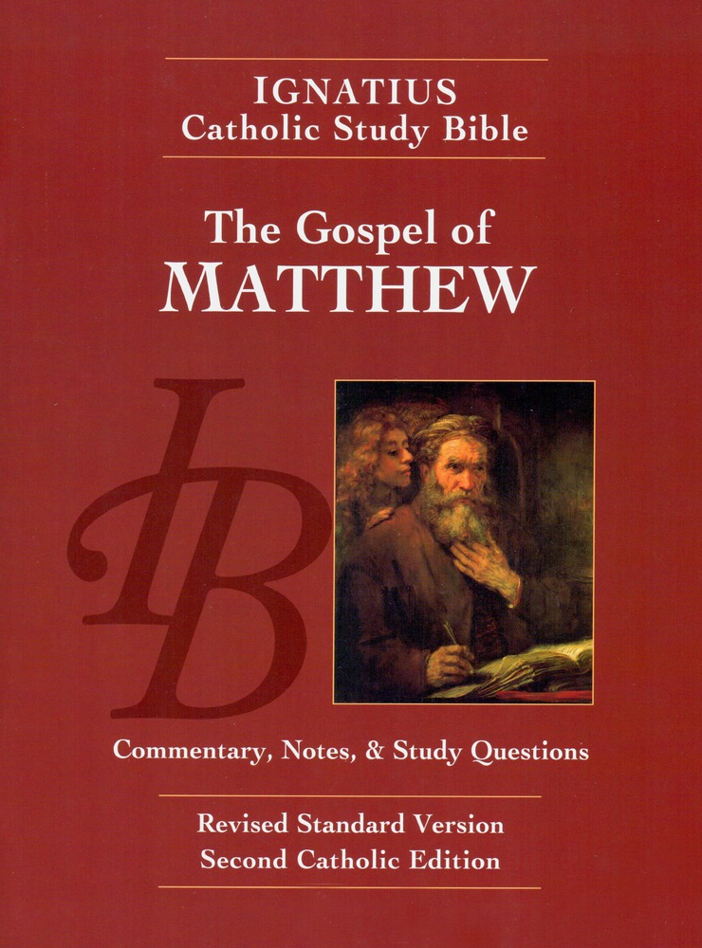
Sunday Bible College
Chapter 13
The Parables
Holy Trinity
Anglican Church
Fernandina Beach, Florida

Slide 2
What is a parable?
Greek: A spoken or literary comparison between two things for illustration.
The word parable is used 48 time in Matthew Mark and Luke.
Jesus uses parables for two reasons: 1. For the Humble, parables use earthly truths to sketch out heavenly realities 2. For the proud, parables are obstruction and stumbling blocks, concealing the truth.
Sunday Bible College at Holy Trinity Anglican Church: ICSB The Gospel of Matthew

Slide 3
Parable # 1: The Sower Matthew 13:1-23
1. The Parable of the sower, the seed, the land, and the yield.
2. The purpose of Parables: to reveal and to conceal.
3. The meaning of this parable: The Father, the Son, the human heart and fruits of righteousness.
Sunday Bible College at Holy Trinity Anglican Church: ICSB The Gospel of Matthew

Slide 4
How to Prepare the Soil of the Heart. Matthew 13:24-30
What damages the soil? The Seven Deadly Sins!
Lust
Greed
Gluttony
Envy
Anger
Pride
Sloth
Sunday Bible College at Holy Trinity Anglican Church: ICSB The Gospel of Matthew

Slide 5
How to Prepare the Soil of the Heart. Matthew 13:24-30
Lust - Proverbs 6:27
is disordered desire for or inordinate enjoyment of sexual pleasure.
Sunday Bible College at Holy Trinity Anglican Church: ICSB The Gospel of Matthew

Slide 6
How to Prepare the Soil of the Heart. Matthew 13:24-30
Greed - Exodus 20:17
an obsessive desire for ever more material goods and the attendant power.
a fearful need to store up surplus goods for a vaguely defined time of want.
a desire for more earthly goods for their own sake.
Sunday Bible College at Holy Trinity Anglican Church: ICSB The Gospel of Matthew

Slide 7
How to Prepare the Soil of the Heart. Matthew 13:24-30
Gluttony - Proverbs 23:2
Wanting more pleasure from something than it was made for.
Wanting it exactly our way (delicacy).
Demanding too much from people (excessive desire for other people's time or presence.)
Sunday Bible College at Holy Trinity Anglican Church: ICSB The Gospel of Matthew

Slide 8
How to Prepare the Soil of the Heart. Matthew 13:24-30
Envy - St. James 3:16
a feeling of discontented or resentful longing aroused by someone else's possessions, qualities, or luck. *Often presents as depression.
Sunday Bible College at Holy Trinity Anglican Church: ICSB The Gospel of Matthew

Slide 9
How to Prepare the Soil of the Heart. Matthew 13:24-30
Anger (Wrath) - St. James 1:19-20
a rage and desire for vengeance which is out of proportion to the offense suffered.
Sunday Bible College at Holy Trinity Anglican Church: ICSB The Gospel of Matthew

Slide 10
How to Prepare the Soil of the Heart. Matthew 13:24-30
Pride - Proverbs 16:18
exaggerated pleasure in self (accomplishments or qualities) which finds its greatest fulfillment in the praise of others.
Sunday Bible College at Holy Trinity Anglican Church: ICSB The Gospel of Matthew

Slide 11
How to Prepare the Soil of the Heart. Matthew 13:24-30
Sloth (Acedia) - Proverbs 24:30-34
unwillingness to do one's duty; avoidance of work; refusal to accept tasks assigned by rightful authority.
Sunday Bible College at Holy Trinity Anglican Church: ICSB The Gospel of Matthew

Slide 12
Excursus: How Many Sacraments do Anglicans Recognize?
Article of Religion XXV: (quoted in part) There are two Sacraments ordained of Christ our Lord in the Gospel, that is to say, Baptism, and the Supper of the Lord.
Those five commonly called Sacraments, that is to say, Confirmation, Penance, Orders, Matrimony, and Extreme Unction, are not to be counted for Sacraments of the Gospel, being such as have grown partly of the corrupt following of the Apostles, partly are states of life allowed in the Scriptures; but yet have not like nature of Sacraments with Baptism, and the Lord’s Supper, for that they have not any visible sign or ceremony ordained of God.

Slide 13
Excursus: How Many Sacraments do Anglicans Recognize?
In Elizabethan English "Commonly Called" does not cast doubt. Rather Commonly means that this is understood by all to be Sacraments. (Used similarly in title Book of Common Prayer)

Slide 14
Excursus: How Many Sacraments do Anglicans Recognize?
The operative phrase is "are not to be counted for Sacraments of the Gospel."
Anglicans recognize two kinds of Sacraments: Gospel Sacraments, which apply to all people as generally necessary for salvation, and instituted by Christ Jesus for this purpose. And General Sacraments which are good and holy but apply only to those who are called to such

Slide 15
Excursus: How Many Sacraments do Anglicans Recognize?
Article 25 is not intended to rob the CHurch of all the sacraments, but to correct the medieval Roman doctrines which misdefined sacraments.
Example, salvation for baptized Christians who did not receive unction before death was cast into doubt. This would make Unction a sacrament of the Gospel, becessary to salvation. Anglicans teach that Unction is good and Holy and a means of grace when rightly cleansed of its medieval corruptions.

Slide 16
How to Prepare the Soil of the Heart. Matthew 13:24-30
What prepares the soil to be fertile? The Seven Cardinal VIRTUES
“a virtue is an habitual and firm disposition to do the good. It allows the person not only to perform good acts, but to give the best of himself."
Sunday Bible College at Holy Trinity Anglican Church: ICSB The Gospel of Matthew

Slide 17
How to Prepare the Soil of the Heart. Matthew 13:24-30
What prepares the soil to be fertile? The Seven Cardinal VIRTUES
The virtues combat and vanquish vices. (Vice is the absence of virtue!)
Sunday Bible College at Holy Trinity Anglican Church: ICSB The Gospel of Matthew

Slide 18
How to Prepare the Soil of the Heart. Matthew 13:24-30
The Seven Cardinal VIRTUES
Chastity - It overcomes the sin of lust.
Generosity - It overcomes the sin of Greed.
Temperance - It overcomes the sin of Gluttony.
Brotherly Love - It overcomes the sin of Envy.
Meekness - It overcomes the sin of Anger.
Humility - It overcomes the sin of Pride.
Diligence - It overcomes the sin of sloth.
Sunday Bible College at Holy Trinity Anglican Church: ICSB The Gospel of Matthew

Slide 19
How to Prepare the Soil of the Heart. Matthew 13:24-30
The Cardinal Virtue of Chastity
The right ordering of the sexual appetite
Remembering God's original commision to mankind "to be fruitful and multiply," sexual desire and activity is a part of the created order and is godly. But sex was also perverted by the fall, by the loss of chastity, the right ordering of mankinds sexual nature. If we would defeat lust, we must restore order and discipline through Chastity.
Chastity means sexual relations take place between a man and his wife always with a glodly attitude toward the reasons and purpose of marriage and the marriage bed.
Chastity also means refraining from all sexual relations outside marriage.
Sunday Bible College at Holy Trinity Anglican Church: ICSB The Gospel of Matthew

Slide 20
How to Prepare the Soil of the Heart. Matthew 13:24-30
The Cardinal Virtue of Chastity
The right ordering of the sexual appetite
There are two ways to be Chaste.
Chastity means sexual relations take place between a man and his wife always with a glodly attitude toward the reasons and purpose of marriage and the marriage bed.
Chastity also means refraining from all sexual relations outside marriage.
Sunday Bible College at Holy Trinity Anglican Church: ICSB The Gospel of Matthew

Slide 21
How to Prepare the Soil of the Heart. Matthew 13:24-30
The Cardinal Virtue of Generosity - overcoming Greed.
The right ordering of stewardship
Generosity:
James 1:27 Proverbs 19:17
Sunday Bible College at Holy Trinity Anglican Church: ICSB The Gospel of Matthew

Slide 22
How to Prepare the Soil of the Heart. Matthew 13:24-30
Temperance overcoming Gluttony
Temperance = self restraint (preventing oneself from doing what one ought not to do) together with self control (doing what one ought without excess or disorder)
Sunday Bible College at Holy Trinity Anglican Church: ICSB The Gospel of Matthew

Slide 23
How to Prepare the Soil of the Heart. Matthew 13:24-30
Brotherly Love overcoming Envy.
Brotherly love: voluntary sacrifice of self for the good of the other.
Romans 12:10
Sunday Bible College at Holy Trinity Anglican Church: ICSB The Gospel of Matthew

Slide 24
How to Prepare the Soil of the Heart. Matthew 13:24-30
Meekness overcoming Wrath
Meekness: the quality of being utterly submitted to the will of God.
1 Peter 3:4 Titus 3:2 Matthew 5:5 The meek shall inherit the earth...
Sunday Bible College at Holy Trinity Anglican Church: ICSB The Gospel of Matthew

Slide 25
How to Prepare the Soil of the Heart. Matthew 13:24-30
Humility overcomes the sin of Pride
Humility = a right view of oneself in light of God's perspective.
James 4:6
Sunday Bible College at Holy Trinity Anglican Church: ICSB The Gospel of Matthew

Slide 26
How to Prepare the Soil of the Heart. Matthew 13:24-30
Diligence overcomes the sin of sloth.
Diligence = careful and persistent effort to perform all rightful duties
Proverbs 10:4 & 13:4 2 Peter 1:10
Sunday Bible College at Holy Trinity Anglican Church: ICSB The Gospel of Matthew

Slide 27
Parable # 2: Weeds and Wheat Matthew 13:24-30
What does the wheat represent? Humanity in its original planting was good and fruitful
What do the weeds represent? Humanity as infected with the disease of sin, which denies goodness and prevents fruitfulness
Sunday Bible College at Holy Trinity Anglican Church: ICSB The Gospel of Matthew

Slide 28
Parable # 2: Weeds and Wheat Matthew 13:24-30
On what basis do the servants wish to judge between wheat and weed? Outward appearance
On what basis does the householder judge between wheat and weed? actual fruit!
Therefore, on what basis will we be judged as good or evil? Not by appearance but by the substantive actions of our lives.
Sunday Bible College at Holy Trinity Anglican Church: ICSB The Gospel of Matthew

Slide 29
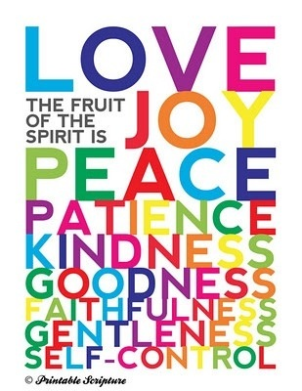
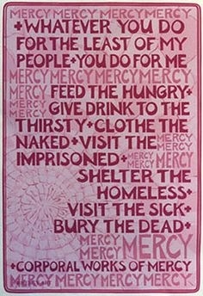
Parable # 2: Weeds and Wheat Matthew 13:24-30
So what is the "fruit" God looks to find in us?
Sunday Bible College at Holy Trinity Anglican Church: ICSB The Gospel of Matthew

Slide 30
Parable # 2: Weeds and Wheat Matthew 13:24-30
When is the judgment given? Harvest.
Who executes the judgment once rendered? The Reapers.
Sunday Bible College at Holy Trinity Anglican Church: ICSB The Gospel of Matthew

Slide 31
Parable # 3: Mustard Seed Matthew 13:31-32
This parable emphasizes the great things which will come from the faith of the tiny church - twelve Apostles and one of them a traitor, will become a resting place for the people (birds) of every nation.
Sunday Bible College at Holy Trinity Anglican Church: ICSB The Gospel of Matthew

Slide 32
Parable #4: Leaven
Matthew 13:33
Leavening agents cause flour to rise when cooking. Most commonly, Baking Soda, baking powder or yeast may be used. Bakers know that once these rising agents have been added to flour it can't be removes. It effects the entire batch. Likewise, when the world is invaded by the Kingdom of God, the world will be changed, never to be the same again.
Sunday Bible College at Holy Trinity Anglican Church: ICSB The Gospel of Matthew

Slide 33
Why Does Jesus Use Parables? Matthew 13:34-35
To confuse us?
To make Profound things understandable?
To fulfill prophecy? (Matthew's great concern)
To confound the worldly wise?
Sunday Bible College at Holy Trinity Anglican Church: ICSB The Gospel of Matthew

Slide 34
Jesus Explains the Weeds Matthew 13:34-35
The sower is the Son of Man The field is the world The good seed are the sons of the kingdom The weeds are the sons of the evil one The enemy who sowed themis the devil The harvest is the close of the age The reapers are the angels Judgement is based on sin and evildoing The furnace of fire is Gehenna (eternal hell)
Sunday Bible College at Holy Trinity Anglican Church: ICSB The Gospel of Matthew

Slide 35
Three Parables of the Kingdom Matthew 13:44-50
The Kingdom is like a sudden treasure - for which a man gives all.
The Kingdom is like a yearned for pearl - for which a man gives all.
The Kingdom is like a hard won bounty - worthy of the most careful attention.
Sunday Bible College at Holy Trinity Anglican Church: ICSB The Gospel of Matthew

Slide 36
Rejection at Nazareth Matthew 13:53-58
Here beginneth the next section of Matthew -
Note the familiar phrase, "When Jesus had finished these parables, he went away from there." vs 53
Sunday Bible College at Holy Trinity Anglican Church: ICSB The Gospel of Matthew

Slide 37
Rejection at Nazareth Matthew 13:53-58
Interesting Concepts in the Background
This is the only verse in Matthew where Joseph is called a Carpenter.
Compare this passage
Mark 6:2-3 “Where did this man get these things? What is the wisdom given to him? How are such mighty works done by his hands? Is not this the carpenter, the son of Mary
Luke 4:22 And they said, “Is not this Joseph's son?”
Sunday Bible College at Holy Trinity Anglican Church: ICSB The Gospel of Matthew

Slide 38
Rejection at Nazareth Matthew 13:53-58
Interesting Concepts in the Background
Did Jesus Have Brothers and Sisters and, Therefore, Was Mary a Perpetual Virgin?
Sunday Bible College at Holy Trinity Anglican Church: ICSB The Gospel of Matthew

Slide 39
Rejection at Nazareth Matthew 13:53-58
Did Jesus Have Brothers and Sisters and, Therefore, Was Mary a Perpetual Virgin?
See note of page 39 concerning Mt 12:46
1. These Brethren are never called the children of Mary, although Jesus is.
Sunday Bible College at Holy Trinity Anglican Church: ICSB The Gospel of Matthew

Slide 40
Rejection at Nazareth Matthew 13:53-58
Did Jesus Have Brothers and Sisters and, Therefore, Was Mary a Perpetual Virgin?
See note of page 39 concerning Mt 12:46
2. Two of these brethren of Jesus, James and Joseph are sons of a different Mary.
Mt 27:56 "among whom were Mary Magdalene and Mary the mother of James and Joseph and the mother of the sons of Zebedee." Note: the BVM stood at the foot of the cross with John, these women watched "from a distance."
Sunday Bible College at Holy Trinity Anglican Church: ICSB The Gospel of Matthew

Slide 41
Rejection at Nazareth Matthew 13:53-58
Did Jesus Have Brothers and Sisters and, Therefore, Was Mary a Perpetual Virgin?
See note of page 39 concerning Mt 12:46
3. It is culturally and scripturally unlikely that Jesus would entrust Mary to the care of John if she had natural sons to care for her.
Sunday Bible College at Holy Trinity Anglican Church: ICSB The Gospel of Matthew

Slide 42
Rejection at Nazareth Matthew 13:53-58
Did Jesus Have Brothers and Sisters and, Therefore, Was Mary a Perpetual Virgin?
See note of page 39 concerning Mt 12:46
4. In the ancient Hebrew (the original language of the composition of Matthew's Gospel) there was no word for cousin, nephew or other close relatives. The word used to describe these relationships was brother or sister (translated as Greek adelphoi, another general term). It is akin to the usage of the older English word Brethren.
Sunday Bible College at Holy Trinity Anglican Church: ICSB The Gospel of Matthew

Slide 43
Rejection at Nazareth Matthew 13:53-58
Interesting Concepts in the Background
it seems "familiarity breeds contempt," even towards Jesus Christ
A Prophet is not without honor except in his own country and his own house."
The result of contempt: He did not do many works there.
Sunday Bible College at Holy Trinity Anglican Church: ICSB The Gospel of Matthew

Slide 44
Rejection at Nazareth Matthew 13:53-58
Interesting Concepts in the Background
The problem isn't lack of faith, The PROBLEM is UNBELIEF!
Jesus always uses this term for those who have knowledge of the Scriptures and have witnessed the truth in their own experience and yet actively (willfully) refuse to believe.
See St. John 3:16-21
Sunday Bible College at Holy Trinity Anglican Church: ICSB The Gospel of Matthew

Slide 45
John 3:16-19 ESV
John 3:16 “For God so loved the world, that he gave his only Son, that whoever believes in him should not perish but have eternal life. 17 For God did not send his Son into the world to condemn the world, but in order that the world might be saved through him. 18 Whoever believes in him is not condemned, but whoever does not believe is condemned already, because he has not believed in the name of the only Son of God. 19 And this is the judgment: the light has come into the world, and people loved the darkness rather than the light because their works were evil.

