Slide 1

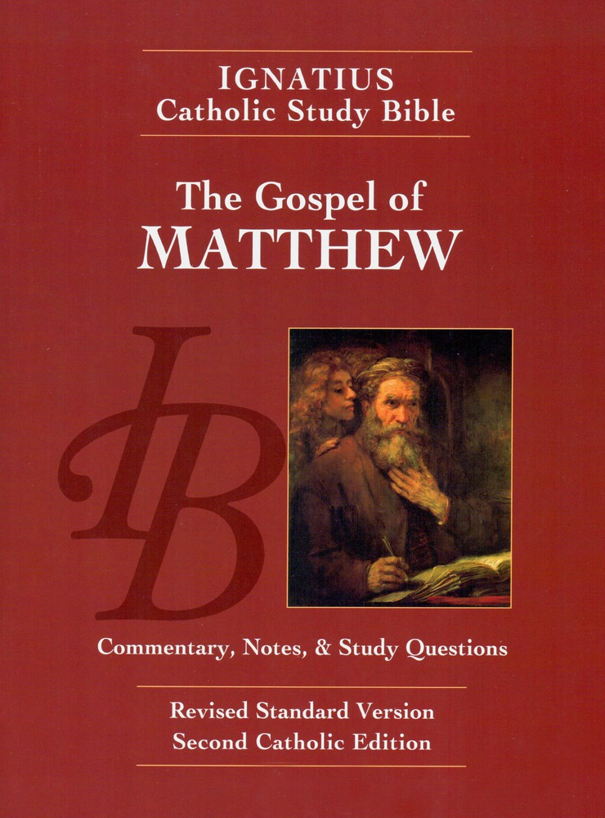
Sunday Bible College
Chapter 14
Death of John Baptist
Feeding Five Thousand
Walk on the Sea
Healings at Gennesaret
Holy Trinity
Anglican Church
Fernandina Beach, Florida

Slide 2
Death of John the Baptist
Matthew 14:1-12
How many Herods are in the Bible?
Sunday Bible College at Holy Trinity Anglican Church: ICSB The Gospel of Matthew

Slide 3
Death of John the Baptist
Matthew 14:1-12
How many Herods are in the Bible?
At least four different men are called Herod in Scripture.
King Herod the Great
Herod Archelaus (Ethnarch of Samaria)
Herod Antipas (Tetrarch of Galilee)
Herod Philip (Tetrarch of Caesarea Philippi)
Sunday Bible College at Holy Trinity Anglican Church: ICSB The Gospel of Matthew

Slide 4
Death of John the Baptist
Matthew 14:1-12
Reasons for Herod's deep insecurity:
Was disinherited by his father when he tried to have the King poisoned.
Was made ruler only by order of Caesar after the intervention of the elite on his behalf - the same elite he entertained in his feast.
Was not granted title of King but of Tetrarch (ruler of a fourth)
His family had converted to Judaism but it was always seen as a political move to shore up power, and he was deeply unpopular with the people.
Sunday Bible College at Holy Trinity Anglican Church: ICSB The Gospel of Matthew

Slide 5
Death of John the Baptist
Matthew 14:1-12
"The story of the murder of John is a story of the world of power, sex and intrigue. It is the story of our world - the one for which Jesus is the alternative."
Stanley Hauerwas, Matthew, Brazos Commentaries, p.137
Sunday Bible College at Holy Trinity Anglican Church: ICSB The Gospel of Matthew

Slide 6


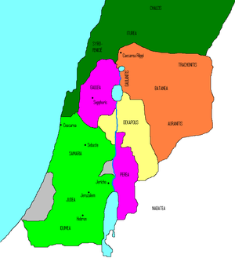
Death of John the Baptist
Matthew 14:1-12
The Kingdom of Herod the Great, after his death, divided into four parts by Caesar Augustus
Light Green = Herod Archaleus
Purple = Herod Antipas
Yellow = The independent cites of the Decapolis
Orange = Herod Philip I
Sunday Bible College at Holy Trinity Anglican Church: ICSB The Gospel of Matthew

Slide 7
Death of John the Baptist
Matthew 14:1-12
Herod Antipas
Tried to marry Herod Philip's wife Herodius (Salome was Philips daughter)
Arrested John for objecting
This is the same "Herod" who later remanded Jesus into the hands of Pontius Pilate
Sunday Bible College at Holy Trinity Anglican Church: ICSB The Gospel of Matthew

Slide 8
Death of John the Baptist
Matthew 14:1-12
Please note the following Facts
1. Herod was afraid of loosing his power.
2. Herod made a rash promise (out of drunkeness) which he could not keep since:
a. He was not a king and had no kingdom to halve with anyone.
b. His authority derived from Caesar and only Caesar could appoint a new ruler.
Sunday Bible College at Holy Trinity Anglican Church: ICSB The Gospel of Matthew

Slide 9
Death of John the Baptist
Matthew 14:1-12
5. He divorced his wife to marry his brother's wife. Solome, who danced before him, was his brother's daughter.
6. Since he ruled at Caesar's pleasure Herod Antipas knew that any unrest in his region would bring the wrath of Rome.
(FUN FACT: long after the resurrection of Jesus, Antipas and Herodius finally fell afoul of Caesar and died in exile.)
Sunday Bible College at Holy Trinity Anglican Church: ICSB The Gospel of Matthew

Slide 10
Death of John the Baptist
Matthew 14:1-12
What are we supposed to get from this bit of gruesome history?
Sunday Bible College at Holy Trinity Anglican Church: ICSB The Gospel of Matthew

Slide 11
Death of John the Baptist
Matthew 14:1-12
What are we supposed to get from this bit of gruesome history?
Matthew is put in mind of this story because of Herod's reaction to learning of Jesus.
Something about Jesus, so loving, meek and mild, had a way of making people panic.
Sunday Bible College at Holy Trinity Anglican Church: ICSB The Gospel of Matthew

Slide 12
Death of John the Baptist
Matthew 14:1-12
What are we supposed to get from this bit of gruesome history?
Herod is the very opposite of Jesus.
Jesus is Son of David and rightful heir to the throne of his kingdom.
Jesus acts in the confidence of his
Father's perfect blessing
Jesus does not grasp his glory and power but sacrifices them for the sake of his people
Sunday Bible College at Holy Trinity Anglican Church: ICSB The Gospel of Matthew

Slide 13
Death of John the Baptist
Matthew 14:1-12
In chapter four, when Jesus heard that John had been arrested, he went away to be alone and to pray.
Here, in chapter 14, when John's disciples bury him, they immediately go tell Jesus.
And Jesus got in a boat and went away to a lonely place.
Sunday Bible College at Holy Trinity Anglican Church: ICSB The Gospel of Matthew

Slide 14
Death of John the Baptist
Matthew 14:1-12
But, as before, the people will not leave him alone, but follow him to his lonely place.
Where Jesus prepares a feast for his people.
Hint, Hint: This is no accident. Matthew wants us to compare the feast of Herod with the Feast of Jesus - which we will do in our next lesson.
Sunday Bible College at Holy Trinity Anglican Church: ICSB The Gospel of Matthew

Slide 15
Jesus Feeds Five Thousand+
Matthew 14:13-21
Keep it is context:
Matthew remembers the birthday feast of Herod the Tetrarch, in order to present its opposite
Christ providing a feast for five thousand men plus women and children
Sunday Bible College at Holy Trinity Anglican Church: ICSB The Gospel of Matthew

Slide 16
Jesus Feeds Five Thousand+
Matthew 14:13-21
Herod's motive is to use the occasion of his celebration-of-self to shore up his power base.
  (Fun Fact: at that time, Jews considered birthday celebrations a pagan tradition, too selfish to be accepted.)
Jesus is moved with compassion to meet the needs of the people.
Sunday Bible College at Holy Trinity Anglican Church: ICSB The Gospel of Matthew

Slide 17
Jesus Feeds Five Thousand+
Matthew 14:13-21
Herod must call people to come to his celebration
Jesus tries to be alone but the people seek him out wherever he goes.
Herod's party was a frenzied drunken boisterous affair
Jesus instructs the crowds to recline in rest
Sunday Bible College at Holy Trinity Anglican Church: ICSB The Gospel of Matthew

Slide 18
Jesus Feeds Five Thousand+
Matthew 14:13-21
Significantly, Herod's feast ends with death and great sorrow, v9 "And Herod was sorry."
Jesus' feast ends with the strengthening renewal of the people, v20 "and they all ate and were satisfied."
Sunday Bible College at Holy Trinity Anglican Church: ICSB The Gospel of Matthew

Slide 19
Jesus Feeds Five Thousand+
Matthew 14:13-21
Lessons we should draw in comparison
The World is Self Centered and Self Serving;
Christ loves - sacrificing self for the benefits of the other.
The World is moved by power;
Christ is moved by compassion.
The World leads inevitably toward destruction;
Christ satisfies.
The world offers frenzied fear and sorrow;
Christ offers rest for the soul
Sunday Bible College at Holy Trinity Anglican Church: ICSB The Gospel of Matthew

Slide 20
Jesus Feeds Five Thousand+
Matthew 14:13-21
The Miracle of
the Multiplication of Loaves and Fishes
This miracle did not occur in a vacuum. The pious Jews who witnessed this miracle would have remembered several similar instances from Scripture, when the prophet of God multiplied food in a miraculous way.
Sunday Bible College at Holy Trinity Anglican Church: ICSB The Gospel of Matthew

Slide 21
Jesus Feeds Five Thousand+
Matthew 14:13-21
Moses in the Dessert
Exodus 16:4-21
Elijah
1 Kings 17:8-16
Elisha
2 Kings 4:42-44
Sunday Bible College at Holy Trinity Anglican Church: ICSB The Gospel of Matthew

Slide 22
Jesus Feeds Five Thousand+
Matthew 14:13-21
For us, who have experienced the Eucharist, this event points back to the Old Testament but also points ahead to the Last Supper.
In both instances:
take place at the same time of day: evening
the people assume the same reclining posture
Jesus performs the same manual acts with the bread and in the same sequence: took, blessed, broke, gave
Jesus hands the prepared bread to the same recipients: the Apostles
Sunday Bible College at Holy Trinity Anglican Church: ICSB The Gospel of Matthew

Slide 23
Jesus Feeds Five Thousand+
Matthew 14:13-21
More rich symbolism
Why is there leftover bread and meat?
Just as the too little bread becomes an overabundance, so God is able to make the too little body of Jesus become enough to feed the whole world to abundance!
Sunday Bible College at Holy Trinity Anglican Church: ICSB The Gospel of Matthew

Slide 24
Jesus Feeds Five Thousand+
Matthew 14:13-21
More rich symbolism
Why are there 12 Baskets?
1. Jesus is calling the twelve tribes of Israel to follow him into the Kingdom of God.
2. Each of the 12 Apostles is blessed with his own abundance of grace to perform the work of the Gospel.
Sunday Bible College at Holy Trinity Anglican Church: ICSB The Gospel of Matthew

Slide 25
Jesus Feeds Five Thousand+
Matthew 14:13-21
Now, Some Important Doctrine!
Why does Jesus always hand the bread to the Disciples for distribution to the people? Why not hand it out to the people who would have delighted to receive it from the hand of the Messiah?
Sunday Bible College at Holy Trinity Anglican Church: ICSB The Gospel of Matthew

Slide 26
Jesus Feeds Five Thousand+
Matthew 14:13-21
Jesus always distributes his grace
using his appointed means
through the ministers
of his Church.
ALWAYS!
Sunday Bible College at Holy Trinity Anglican Church: ICSB The Gospel of Matthew

Slide 27

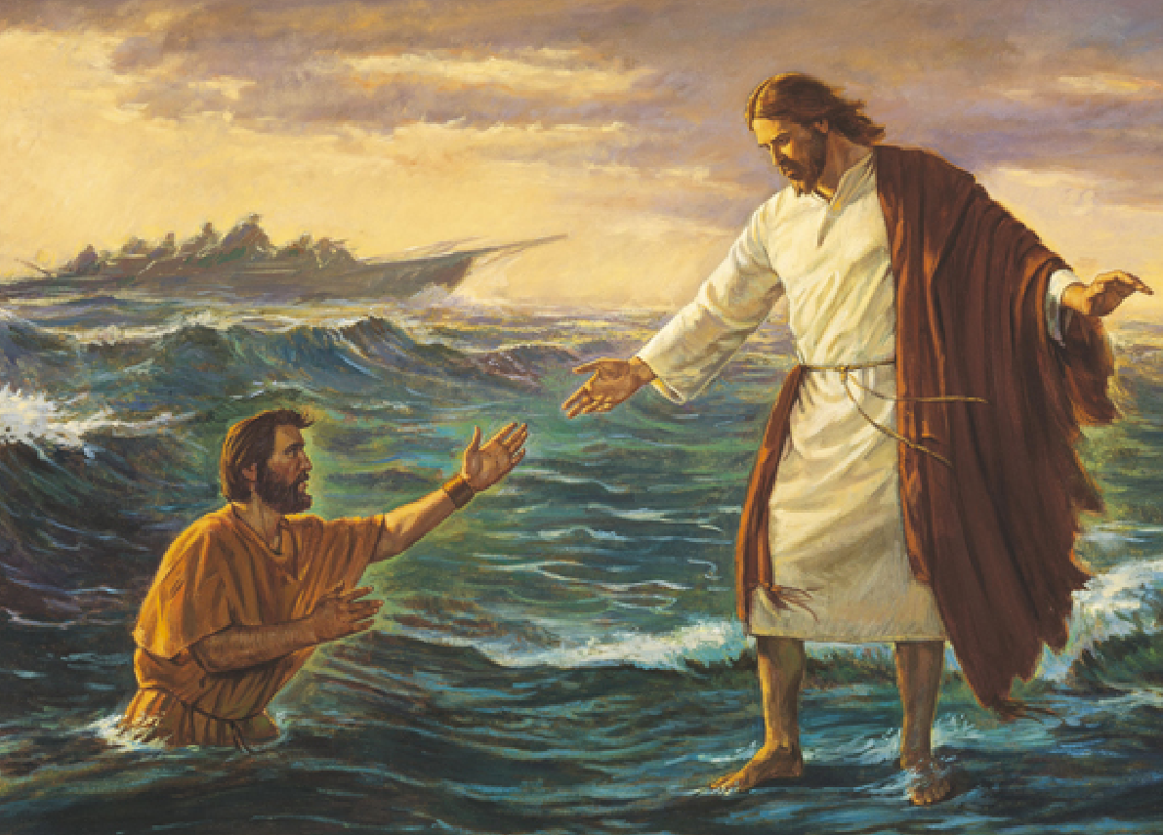
Jesus Walks on the Sea
Matthew 14:22-33

Slide 28
Jesus Walks on the Sea
Matthew 14:22-33
Before you read it:
By now, we are used to the idea of always asking certain questions when we read the Gospel, two of which are:
1. What Old Testament passages are related to this Gospel passage?
2. What New Testament events does this passage prepare us to understand?
Sunday Bible College at Holy Trinity Anglican Church: ICSB The Gospel of Matthew

Slide 29
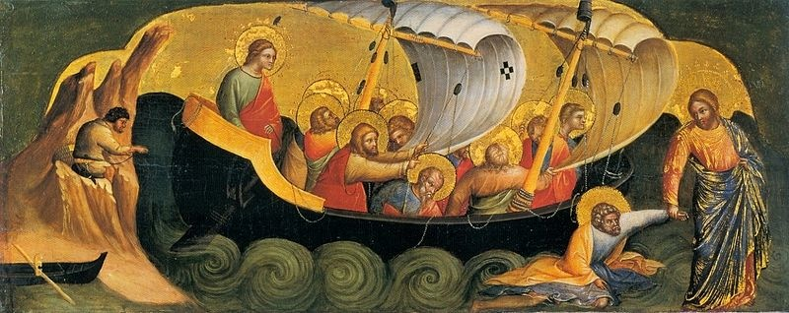
Jesus Walks on the Sea
Matthew 14:22-33
Read the Passage
Sunday Bible College at Holy Trinity Anglican Church: ICSB The Gospel of Matthew

Slide 30
Jesus Walks on the Sea
Matthew 14:22-33
1. What Old Testament passages are related to this Gospel passage?
A boat cast upon stormy waters with a few souls aboard and God far away and in the heavens - Noah's Ark
Sunday Bible College at Holy Trinity Anglican Church: ICSB The Gospel of Matthew

Slide 31
Jesus Walks on the Sea
Matthew 14:22-33
1. What Old Testament passages are related to this Gospel passage?
A great leader of the people, their God appointed savior, comes to them through great waters,
Sunday Bible College at Holy Trinity Anglican Church: ICSB The Gospel of Matthew

Slide 32
Jesus Walks on the Sea
Matthew 14:22-33
1. What Old Testament passages are related to this Gospel passage?
Ps. 77:16–20
16 When the waters saw you, O God, when the waters saw you,
they were afraid; indeed, the deep trembled.
17 The clouds poured out water; the skies gave forth thunder;
your arrows flashed on every side.
18 The crash of your thunder was in the whirlwind; your lightnings
lighted up the world; the earth trembled and shook.
19 Your way was through the sea, your path through the great waters;
yet your footprints were unseen.
20 You led your people like a flock by the hand of Moses and Aaron.
Sunday Bible College at Holy Trinity Anglican Church: ICSB The Gospel of Matthew

Slide 33
Jesus Walks on the Sea
Matthew 14:22-33
1. What Old Testament passages are related to this Gospel passage?
Hab. 3:15
You trampled the sea with your horses,
the surging of mighty waters.
(In the day of troubles / judgment, God comes riding his horse across the waters. This is an image of God, riding the cherubim through the firmament of heaven into our world to judge - from unseen and intangible to seen and tangible.)
Sunday Bible College at Holy Trinity Anglican Church: ICSB The Gospel of Matthew

Slide 34
Jesus Walks on the Sea
Matthew 14:22-33
2. What New Testament events does this passage help us to understand?
Jesus climbs a mountain to pray
The Transfiguration
Jesus is high and lifted up, seemingly gone from the sight of his people, interceding on their behalf while they encounter trials and begin to lose faith.
The Ascension
The people of God, buffeted by this world and racked by fear, see their Savior coming to them in a most unexpected and miraculous way.
The Second Coming / Return / Parousia of Christ
Sunday Bible College at Holy Trinity Anglican Church: ICSB The Gospel of Matthew

Slide 35
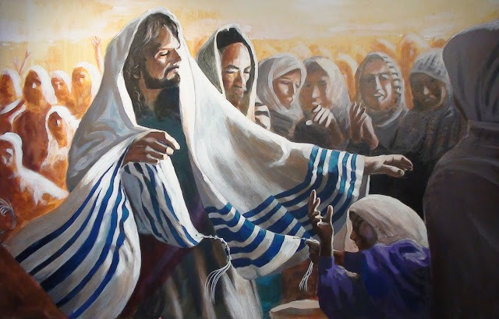
Jesus Heals in Geneseret
Matthew 14:34-36
Sunday Bible College at Holy Trinity Anglican Church: ICSB The Gospel of Matthew

