Slide 1
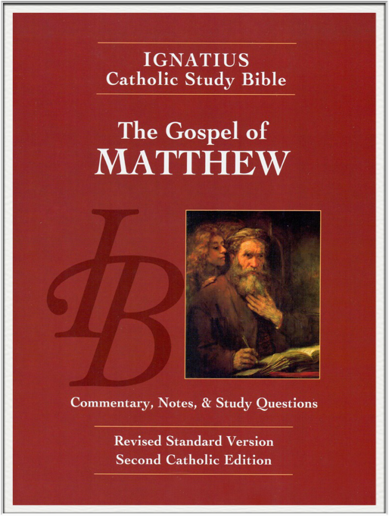
Sunday Bible College
Chapter 16
Demand for a Sign
The Leaven of the
Pharisees and Sadducees
Peter's Confession
Prophecy of the Resurrection
The Cross and Self-denial
Holy Trinity
Anglican Church
Fernandina Beach, Florida

Slide 2
Context for Chapter 16
In Chapter 14, of the Jews
Jesus hears the news of the death of John the Baptist, retreats to a private place but is followed by Jewish crowds of over 5,000. He feeds them miraculously and sends them walking home. Walking on water, Peter confesses Christ before the other Apostles.
In Chapter 15, of the Gentiles
As Jesus walks toward Judea, he heals many of his fellow Jews only to be confronted by their unbelief and legalistic stubbornness. So, Jesus retreats to a foreign place away from the Jews. There he declares faith to them, heals them of many diseases, and as he walks toward Jerusalem he feeds these gentile thousands in like manner to the way he fed the Jews thousands.

Slide 3
Context for Chapter 16
In Chapter 16, return to
the Lost Sheep of Israel
At the close of Chapter 15, Jesus sends the crowd away, gets in aa boat and sails for Magdala, sometimes translated as Magadan as in most modern translations. Magdala was the home town of Mary Magdalene. Magdala also marked a return to Jewish territory. Jesus has returned from the Gentiles to his own people. After the amazing miracles of the feeding of 5000 jews and 4000 gentiles, how will his own people receive him?

Slide 4
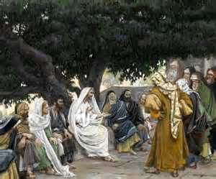
Demand for a Sign
Matthew 16:1-4

Slide 5
Demand for a Sign
Matthew 16:1-4
Jesus' response shows that there is no lack of signs for them to interpret. There is no lack of evidence for his deity.
However, there remains one more sign which will be given. The sign of Jonah.
As Jonah was three days dead in the belly of the whale, but his grave spit him out and he saved Nineveh by God's grace and mercy, so Jesus will rise after three days dead in his tomb annd save mankind.

Slide 6
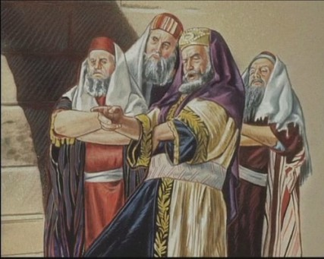
The Leaven of the Pharisees and Sadducees
Matthew 16:5-12

Slide 7
The Leaven of the Pharisees and Sadducees
Matthew 16:5-12
The key to understanding what God is teaching us with this passage is found in verse 12, "Then they understood that Jesus did not tell them to beware of the leaven of bread, but of the teaching of the Pharisees and Sadducees."
1. All believers are to be careful of who they hear and study. You are accountable for the teaching you pay heed.
2. The Apostolic ministry is primarily that of teaching truth and preaching the Gospel. (Care for the dying, the poor and the aged are the primary responsibilities of ______________.)

Slide 8
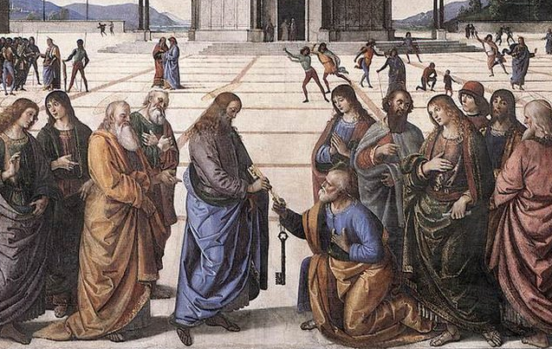
The Confession of Peter
Matthew 16:13-20

Slide 9
The Confession of Peter
Matthew 16:13-20
1. "You are the Christ, the Son of the living God."
2. "I tell you, you are Peter..." (see Word Study p. 47)
3. "On this rock I will build my Church."
4. "I give you the keys of the Kingdom
Whatever you bind on earth
shall be bound in heaven
Whatever you loose on earth
shall be loosed in heaven

Slide 10
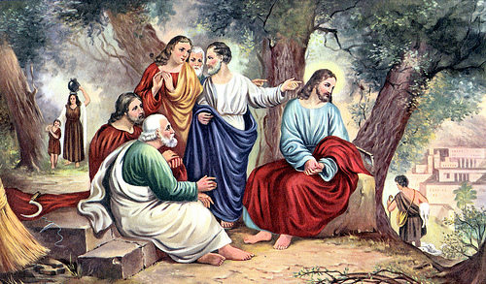
Jesus Foretells his Death and Resurrection
Matthew 16:21-23

Slide 11
Jesus Foretells his Death and Resurrection
Matthew 16:21-23
1. Note how Jesus is preparing them to see him as a Temple Sacrifice: at Jerusalem, by thee hands of the priests, etc.
2. When Peter rebukes him, Jesus calls him Satan.
Satan means "opposer". Peter was capable of making the greatest confessions of faith in one moment and the next moment he was capable of acting like Satan in perfect opposition to God's will.
Are we capable of the same?

Slide 12

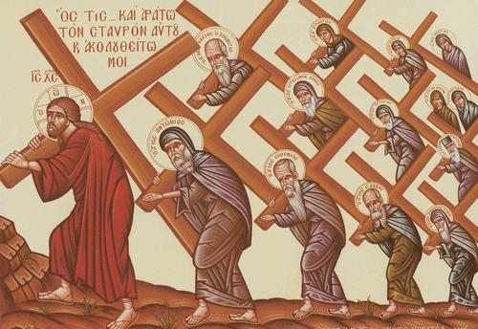
The Cross and Self-denial
Matthew 16:24-28

Slide 13
The Cross and Self-denial
Matthew 16:24-28
The way of Christ Jesus is the way of self-denial, and self sacrifice. He will give himself freely for all.
He asks of his followers what he himself has modeled: self-giving self-denial
As a note in this month of Angels and Saints, see how Jesus will return - with his angels at his side to repay every man for what he has done.

