Slide 1
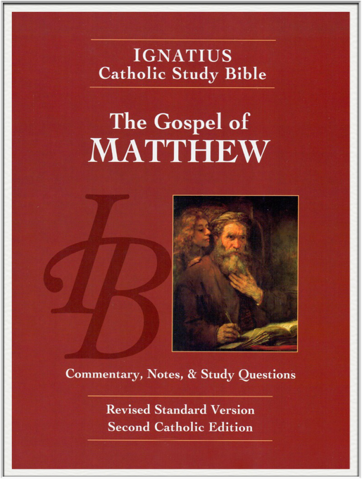
Sunday Bible College
Chapter 17
The Transfiguration
Jesus Cures an Epileptic Boy
Jesus Again Foretells His Death
and Resurrection
Jesus and the Temple Tax
Holy Trinity
Anglican Church
Fernandina Beach, Florida

Slide 2
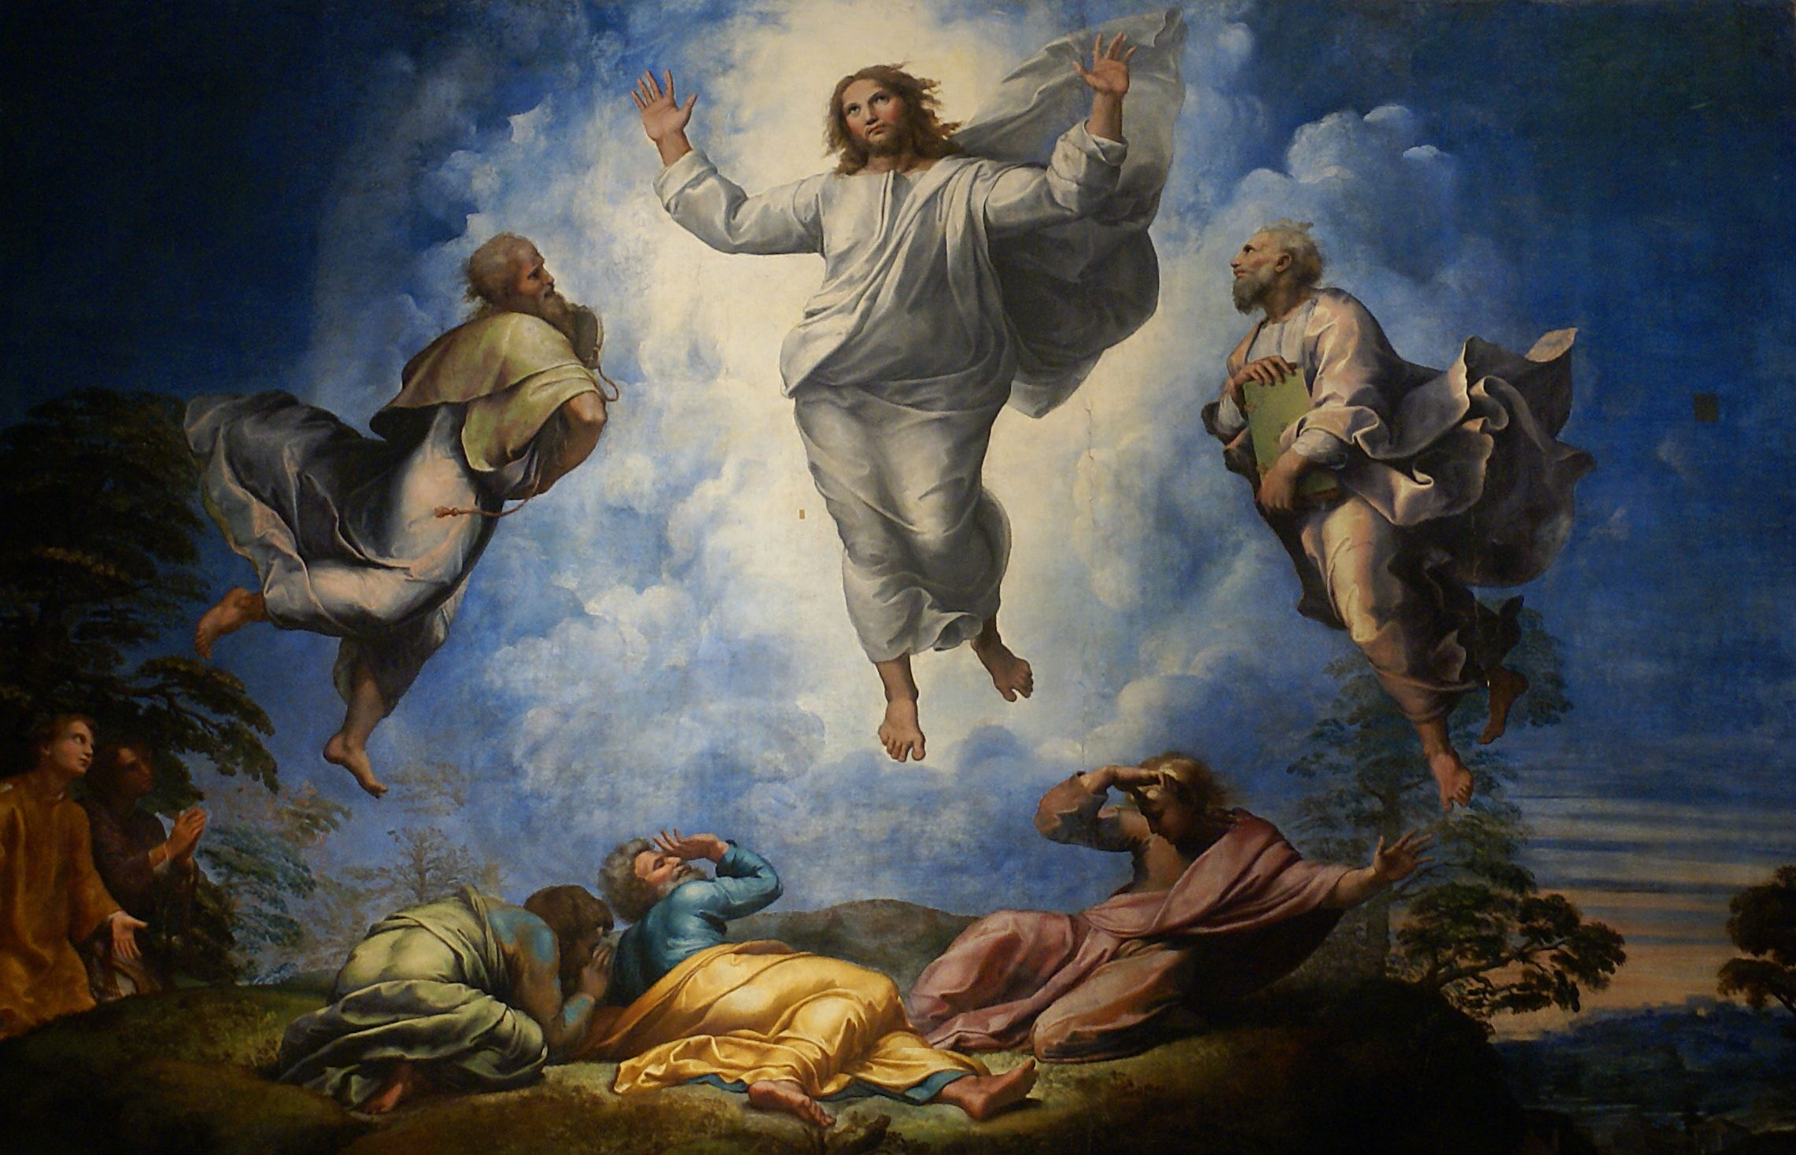
The Transfiguration
Matthew 17:1-12

Slide 3
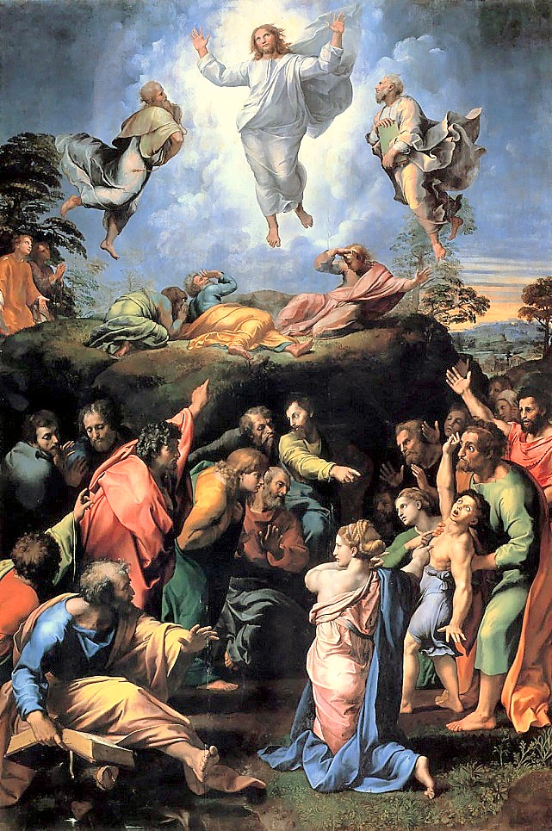
Considered the last painting of the great Renaissance painter Raphael.
The Transfiguration

Slide 4
The Transfiguration
Moses on the Mountain, Exodus 24:12-18

Slide 5
The Transfiguration
Elijah on the Mountain, 1 Kings 19:9-18

Slide 6
The Transfiguration
Why Moses?
Moses was the great Law Giver, establisher of the Nation of Israel. He was also the great Deliverer, who led the people out of Egypt. He was also the great Prophet, who taught the people how to worship God, especially concerning the acceptable sacrifice which God would accept.
Furthermore, it was prophesied in Holy Scripture that God would send another Prophet like Moses to lead his people from the bondage of sin. See

Slide 7
The Transfiguration
Why Moses?
Moses' appearance bears testimony that Christ is the new Law Giver and Prophet of the New Testament who has come to fulfill the prophecy concerning that new prophet who would teach the people to worship God in spirit and truth.
By the testimony of Moses
Jesus is greater than Moses

Slide 8
The Transfiguration
Why Elijah?
Elijah was considered Israel's greatest Prophet, he was the great Healer of Israel, he Resurrected the Dead, he Cleansed the Altar of God, and restored True Worship in Israel.
What's more, Scripture promised that Elijah would return to bear witness to the Messiah. (
By the testimony of Elijah
Jesus is greater than Elijah

Slide 9
The Transfiguration
Powerful and Rich Symbolism
The Transfiguration is filled with so much symbolism that it could rightly be the subject of a years worth of sermons.
The meaning of Christ's companions Peter, James and John
The Glory Cloud on the Mountain
Peter's suggestion of Booths and the Feast of Booths
The Command for Silence until after the passion
The Identification of St. John with Elijah
This and more is truly meaningful

Slide 10
The Transfiguration
Keeping the Main thing the Main Thing!
But the most important thing that happened on the Mount of the Transfiguration is this:
He [Peter] was still speaking when, behold, a bright cloud overshadowed them, and a voice from the cloud said, “This is my beloved Son, with whom I am well pleased; listen to him.” When the disciples heard this, they fell on their faces and were terrified. But Jesus came and touched them, saying, “Rise, and have no fear.” And when they lifted up their eyes, they saw no one but Jesus only. Matthew 17: 5-8 ESV

Slide 11
The Transfiguration
Keeping the Main thing the Main Thing!
Compare to Hebrews 1:1-2
"Long ago, at many times and in many ways, God spoke to our fathers by the prophets, but in these last days he has spoken to us by his Son, whom he appointed the heir of all things, through whom also he created the world."

Slide 12
The Transfiguration
The Importance of the Transfiguration in the Lives of Those Present
2 Peter 1:16-18 ESV
"For we did not follow cleverly devised myths when we made known to you the power and coming of our Lord Jesus Christ, but we were eyewitnesses of his majesty. For when he received honor and glory from God the Father, and the voice was borne to him by the Majestic Glory, “This is my beloved Son, with whom I am well pleased,” we ourselves heard this very voice borne from heaven, for we were with him on the holy mountain."

Slide 13
Jesus heals an Epileptic Boy
-or- Jesus heals a Boy with a Demon
Matthew 17:14-21

Slide 14
Jesus heals an Epileptic Boy
-or- Jesus heals a Boy with a Demon
Matthew 17:15 & 18 ESV
The Problem
[the boy's father] said, “Lord, have mercy on my son, for he is an epileptic and he suffers terribly. For often he falls into the fire, and often into the water.
The Solution
And Jesus rebuked the demon, and it came out of him, and the boy was healed instantly.

Slide 15
Jesus heals an Epileptic Boy
-or- Jesus heals a Boy with a Demon
Matthew 17:16, 17 & 20 ESV
A New Problem
And I brought him to your disciples, and they could not heal him.”
Jesus' Diagnosis
“O faithless and twisted generation, how long am I to be with you? How long am I to bear with you? Bring him here to me.”
The Solution
...truly, I say to you, if you have faith like a grain of mustard seed,

Slide 16
Jesus heals an Epileptic Boy
-or- Jesus heals a Boy with a Demon
Matthew 17:21

Slide 17
Jesus heals an Epileptic Boy
-or- Jesus heals a Boy with a Demon
Matthew 17:21
Why is there no verse 21 ?!?
This is where it begins to matter which ancient text type is used for translation.
New Testament
Byzantine - or - Alexandrian
(Greece) (Egypt)

Slide 18
Jesus heals an Epileptic Boy
-or- Jesus heals a Boy with a Demon
Matthew 17:21
ESV
footnote where verse 21 should be:
Some manuscripts insert verse 21: But this kind never comes out except by prayer and fasting.
New King James Version
21 However, this kind does not go out except by prayer and fasting.”[e]
[e] NU-Text omits this verse.

Slide 19
Jesus heals an Epileptic Boy
-or- Jesus heals a Boy with a Demon
Byzantine - or - Alexandrian
(Greece) (Egypt)
King James Version
New King James Version
Revised Standard Version
English Standard Version
New International Version
Holman Christian Standard
The New Living Translation
The New American Standard
The Voice
The New American Bible, (Roman Catholic)
The New Jerusalem Bible

Slide 20
Jesus heals an Epileptic Boy
-or- Jesus heals a Boy with a Demon
Byzantine - or - Alexandrian
(Greece) (Egypt)
King James Version (2)
New King James Version (3)
Revised Standard Version
English Standard Version (5)
New International Version (1)
Holman Christian Standard (6)
The New Living Translation (4)
The New American Standard (8)
The Voice (7)
The New American Bible, (Roman Catholic)
The New Jerusalem Bible

Slide 21
Jesus heals an Epileptic Boy
-or- Jesus heals a Boy with a Demon
Byzantine - or - Alexandrian
(Greece) (Egypt)
Does it matter?

Slide 22
Jesus heals an Epileptic Boy
Byzantine - or - Alexandrian
(Greece) (Egypt)
Does it matter?
It matters to verse 21, prayer and fasting.
It also matters to passages such as John 8, the woman caught in adultery.
And a handful of other passages.
It matters to King James Only Christians
However...
-or- Jesus heals a Boy with a Demon

Slide 23
Jesus heals an Epileptic Boy
-or- Jesus heals a Boy with a Demon
Byzantine - or - Alexandrian
(Greece) (Egypt)
Does it matter?
It doesn't matter to overall theology.
No Christian truth is compromised or changed.
No new doctrine arises from the switch.
Nevertheless, it is important to know so that you understand why the king James Bible might say something other bibles leave out. And so that you know how to deal with the discrepancies.

