Slide 1
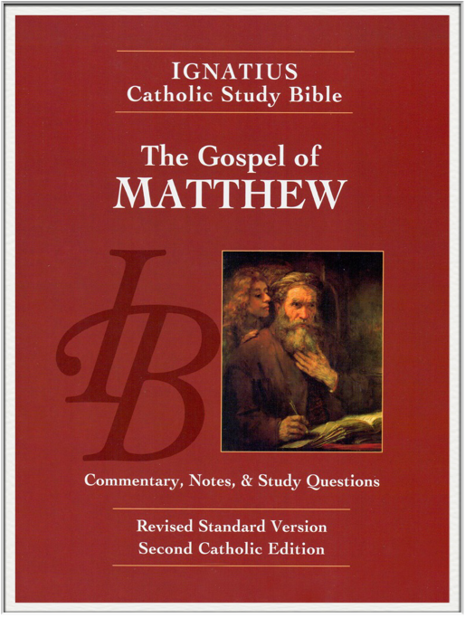
Sunday Bible College
Chapter 17
The Transfiguration
Jesus Cures an Epileptic Boy
Jesus Again Foretells His Death
and Resurrection
Jesus and the Temple Tax
Holy Trinity
Anglican Church
Fernandina Beach, Florida

Slide 2
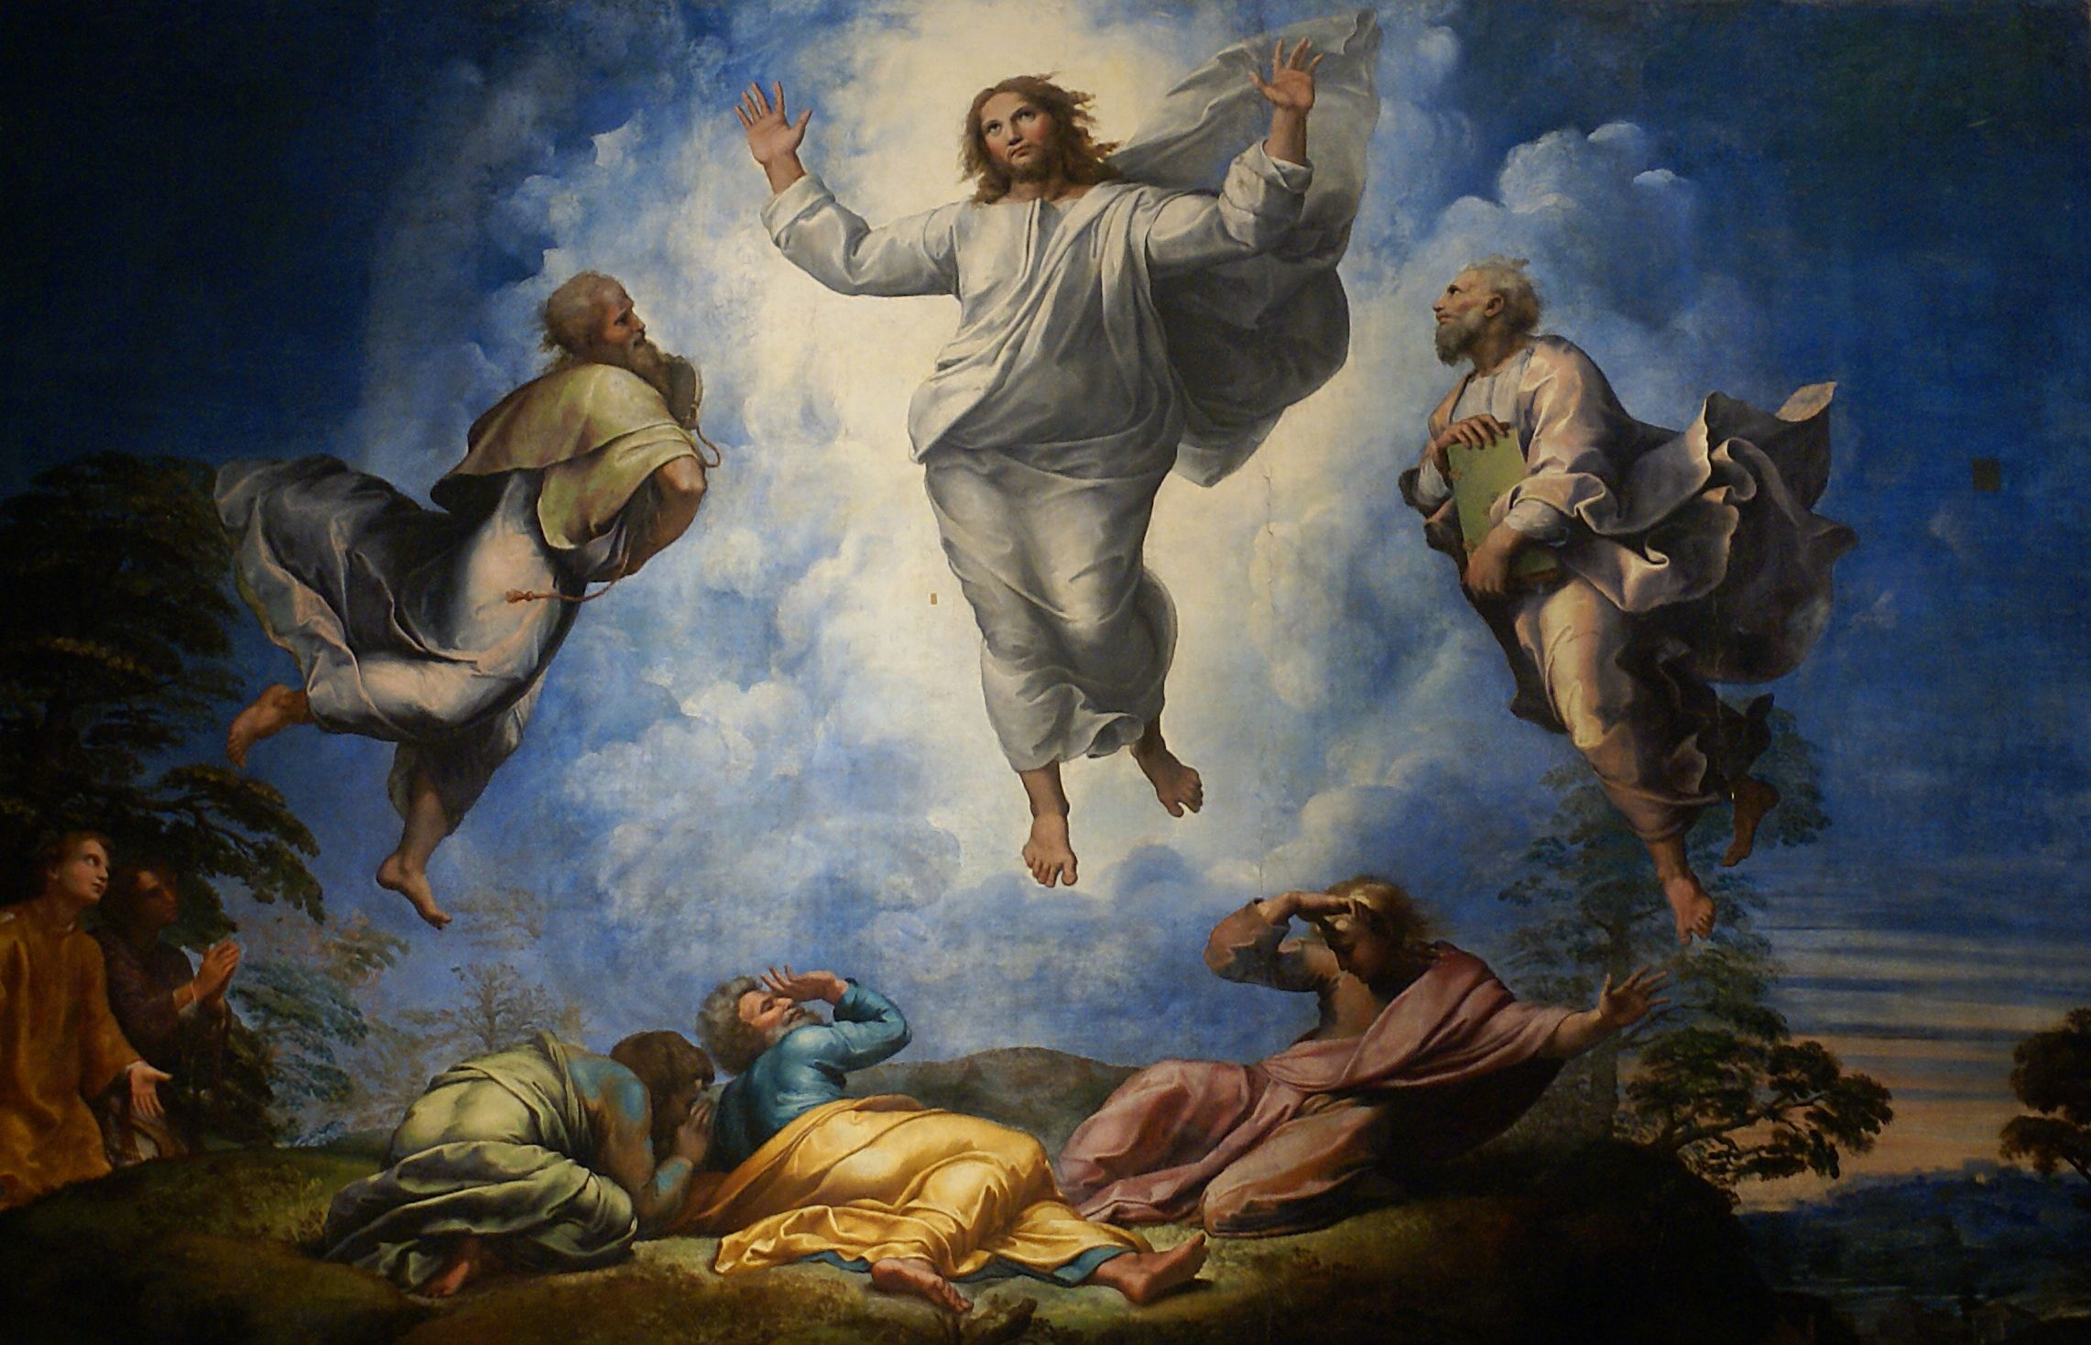
The Transfiguration
Matthew 17:1-12

Slide 3
The Transfiguration
Why Elijah?
Elijah was considered Israel's greatest Prophet, he was the great Healer of Israel, he Resurrected the Dead, he Cleansed the Altar of God, and restored True Worship in Israel.
What's more, Scripture promised that Elijah would return to bear witness to the Messiah. (
By the testimony of Elijah
Jesus is greater than Elijah

Slide 4
The Transfiguration
Why Moses?
Moses was the great Law Giver, establisher of the Nation of Israel. He was also the great Deliverer, who led the people out of Egypt. He was also the great Prophet, who taught the people how to worship God, especially concerning the acceptable sacrifice which God would accept.
Furthermore, it was prophesied in Holy Scripture that God would send another Prophet like Moses to lead his people from the bondage of sin. See

Slide 5
The Transfiguration
Why Moses?
Moses' appearance bears testimony that Christ is the new Law Giver and Prophet of the New Testament who has come to fulfill the prophecy concerning that new prophet who would teach the people to worship God in spirit and truth.
By the testimony of Moses
Jesus is greater than Moses

Slide 6
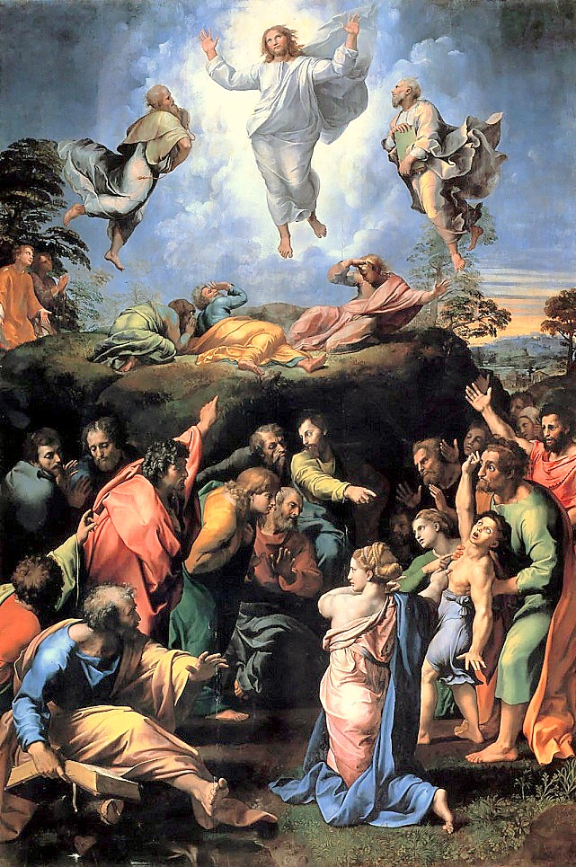
Considered the last painting of the great Renaissance painter Raphael.
The Transfiguration

Slide 7
The Transfiguration
Moses on the Mountain, Exodus 24:12-18

Slide 8
The Transfiguration
Elijah on the Mountain, 1 Kings 19:9-18

Slide 9
The Transfiguration
Powerful and Rich Symbolism
The Transfiguration is filled with so much symbolism that it could rightly be the subject of a years worth of sermons.
The meaning of Christ's companions Peter, James and John
The Glory Cloud on the Mountain
Peter's suggestion of Booths and the Feast of Booths
The Command for Silence until after the passion
The Identification of St. John with Elijah
This and more is truly meaningful

Slide 10
The Transfiguration
Keeping the Main thing the Main Thing!
But the most important thing that happened on the Mount of the Transfiguration is this:
He [Peter] was still speaking when, behold, a bright cloud overshadowed them, and a voice from the cloud said, “This is my beloved Son, with whom I am well pleased; listen to him.” When the disciples heard this, they fell on their faces and were terrified. But Jesus came and touched them, saying, “Rise, and have no fear.” And when they lifted up their eyes, they saw no one but Jesus only. Matthew 17: 5-8 ESV

Slide 11
The Transfiguration
Keeping the Main thing the Main Thing!
Compare to Hebrews 1:1-2
"Long ago, at many times and in many ways, God spoke to our fathers by the prophets, but in these last days he has spoken to us by his Son, whom he appointed the heir of all things, through whom also he created the world."

Slide 12
The Transfiguration
The Importance of the Transfiguration in the Lives of Those Present
2 Peter 1:16-18 ESV
"For we did not follow cleverly devised myths when we made known to you the power and coming of our Lord Jesus Christ, but we were eyewitnesses of his majesty. For when he received honor and glory from God the Father, and the voice was borne to him by the Majestic Glory, “This is my beloved Son, with whom I am well pleased,” we ourselves heard this very voice borne from heaven, for we were with him on the holy mountain."

Slide 13
Jesus heals an Epileptic Boy
-or- Jesus heals a Boy with a Demon
Matthew 17:14-21

Slide 14
Jesus heals an Epileptic Boy
-or- Jesus heals a Boy with a Demon
Matthew 17:15 & 18 ESV
The Problem
[the boy's father] said, “Lord, have mercy on my son, for he is an epileptic and he suffers terribly. For often he falls into the fire, and often into the water.
The Solution
And Jesus rebuked the demon, and it came out of him, and the boy was healed instantly.

Slide 15
Jesus heals an Epileptic Boy
-or- Jesus heals a Boy with a Demon
Matthew 17:16, 17 & 20 ESV
A New Problem
And I brought him to your disciples, and they could not heal him.”
Jesus' Diagnosis
“O faithless and twisted generation, how long am I to be with you? How long am I to bear with you? Bring him here to me.”
The Solution
...truly, I say to you, if you have faith like a grain of mustard seed,

Slide 16
Jesus heals an Epileptic Boy
-or- Jesus heals a Boy with a Demon
Matthew 17:21

Slide 17
Jesus heals an Epileptic Boy
-or- Jesus heals a Boy with a Demon
Matthew 17:21
Why is there no verse 21 ?!?
This is where it begins to matter which ancient text type is used for translation.
New Testament
Byzantine - or - Alexandrian
(Greece) (Egypt)

Slide 18
Jesus heals an Epileptic Boy
-or- Jesus heals a Boy with a Demon
Matthew 17:21
ESV
footnote where verse 21 should be:
Some manuscripts insert verse 21: But this kind never comes out except by prayer and fasting.
New King James Version
21 However, this kind does not go out except by prayer and fasting.”[e]
[e] NU-Text omits this verse.

Slide 19
Jesus heals an Epileptic Boy
-or- Jesus heals a Boy with a Demon
Byzantine - or - Alexandrian
(Greece) (Egypt)
King James Version
New King James Version
Revised Standard Version
English Standard Version
New International Version
Holman Christian Standard
The New Living Translation
The New American Standard
The Voice
The New American Bible, (Roman Catholic)
The New Jerusalem Bible

Slide 20
Jesus heals an Epileptic Boy
-or- Jesus heals a Boy with a Demon
Byzantine - or - Alexandrian
(Greece) (Egypt)
King James Version (2)
New King James Version (3)
Revised Standard Version
English Standard Version (5)
New International Version (1)
Holman Christian Standard (6)
The New Living Translation (4)
The New American Standard (8)
The Voice (7)
The New American Bible, (Roman Catholic)
The New Jerusalem Bible

Slide 21
Jesus heals an Epileptic Boy
-or- Jesus heals a Boy with a Demon
Byzantine - or - Alexandrian
(Greece) (Egypt)
Does it matter?

Slide 22
Jesus heals an Epileptic Boy
Byzantine - or - Alexandrian
(Greece) (Egypt)
Does it matter?
It matters to verse 21, prayer and fasting.
It also matters to passages such as John 8, the woman caught in adultery.
And a handful of other passages.
It matters to King James Only Christians
However...
-or- Jesus heals a Boy with a Demon

Slide 23
Jesus heals an Epileptic Boy
-or- Jesus heals a Boy with a Demon
Byzantine - or - Alexandrian
(Greece) (Egypt)
Does it matter?
It doesn't matter to overall theology.
No Christian truth is compromised or changed.
No new doctrine arises from the switch.
Nevertheless, it is important to know so that you understand why the king James Bible might say something other bibles leave out. And so that you know how to deal with the discrepancies.

Slide 24
Jesus Again Foretells His Death
and Resurrection
Matthew 17:22-23
As we read this passage, keep in mind:
This is the second time Jesus predicted his death and resurrection. (Matthew 16:21-23)
Note the reaction of the disciples who hear him.

Slide 25
Jesus Again Foretells His Death
and Resurrection
Matthew 17:22-23
In this passage Jesus is connecting several concepts from the Old Testament. Most importantly, he is connecting the promised Messiah with the suffering servant of Isaiah 53.
Read Isaiah 53

Slide 26
Jesus Again Foretells His Death
and Resurrection
Isaiah 53 (Matt. 17:22-23)
Who has believed what he has heard from us?
And to whom has the arm of the Lord been revealed?
For he grew up before him like a young plant,
and like a root out of dry ground;
he had no form or majesty that we should look at him,
and no beauty that we should desire him.
He was despised and rejected by men;
a man of sorrows, and acquainted with grief;
and as one from whom men hide their faces
he was despised, and we esteemed him not.

Slide 27
Jesus Again Foretells His Death
and Resurrection
Isaiah 53 (Matt. 17:22-23)
Surely he has borne our griefs
and carried our sorrows;
yet we esteemed him stricken,
smitten by God, and afflicted.
But he was pierced for our transgressions;
he was crushed for our iniquities;
upon him was the chastisement that brought us peace,
and with his wounds we are healed.
All we like sheep have gone astray;
we have turned—every one—to his own way;
and the Lord has laid on him
the iniquity of us all.

Slide 28
Jesus Again Foretells His Death
and Resurrection
Isaiah 53 (Matt. 17:22-23)
He was oppressed, and he was afflicted,
yet he opened not his mouth;
like a lamb that is led to the slaughter,
and like a sheep that before its shearers is silent,
so he opened not his mouth.
By oppression and judgment he was taken away;
and as for his generation, who considered
that he was cut off out of the land of the living,
stricken for the transgression of my people?
And they made his grave with the wicked
and with a rich man in his death,
although he had done no violence,
and there was no deceit in his mouth.

Slide 29
Jesus Again Foretells His Death
and Resurrection
Isaiah 53 (Matt. 17:22-23)
Yet it was the will of the Lord to crush him;
he has put him to grief;
when his soul makes an offering for guilt,
he shall see his offspring; he shall prolong his days;
the will of the Lord shall prosper in his hand.
Out of the anguish of his soul he shall see and be satisfied;
by his knowledge shall the righteous one, my servant,
make many to be accounted righteous,
and he shall bear their iniquities.

Slide 30
Jesus Again Foretells His Death
and Resurrection
Isaiah 53 (Matt. 17:22-23)
Therefore I will divide him a portion with the many,
and he shall divide the spoil with the strong,
because he poured out his soul to death
and was numbered with the transgressors;
yet he bore the sin of many,
and makes intercession for the transgressors.

Slide 31
Jesus Again Foretells His Death
and Resurrection
Isaiah 53 (Matt. 17:22-23)
By making these connections we can begin to see why the disciples would be so distressed by the words of Jesus. They had never before thought of the Messiah as the same person mentioned in Isaiah 53.
And apparently, as several study bibles point out, neither had any of the Jewish traditions.
Their distress was so great that apparently they missed the promise of the resurrection. They couldn't get past death to see the great hope.

Slide 32
Jesus Again Foretells His Death
and Resurrection
Isaiah 53 (Matt. 17:22-23)
Are we prone to this same difficulty?
Do we sometimes become so fixated on certain aspects of the faith that we miss a more important point?
Do we sometimes become so overcome by our fears that we can't see the hope?
Is there lingering doubt causing us to be distressed?
What is the proper way to deal with these obesessions, fears, doubts, etc?

Slide 33
Jesus and the Temple Tax
Matthew 17:24-end
What was the Temple Tax?
See Exodus 30:11-16
The Temple tax was instituted under Moses and required a half shekel from every male counted as an Israelite, to be paid annually as part of the Atonement sacrifice, and was for "the atonement of the soul." It was to be used for the upkeep of the Tabernacle (tent) and for the conduct of the worship.

Slide 34
Jesus and the Temple Tax
Matthew 17:24-end
Why didn't Jesus and his disciples need to pay this Temple Tax?
Because, as the Son of God, Jesus had no sin to be atoned. As sons adopted by grace, the disciples were atoned by Jesus and not the Temple Sacrifices.
Why did they pay the tax anyway?
In order not to give offense - to whom? To those "others" who are not yet sons. For examples of how this principal works, see Romans 14:13-21 and Acts 16:3 & 21:26

Slide 35
True Greatness
Matthew 18:1-4
What does it mean to become like a little child?
Immature
Unformed
Naive
Irresponsible
Humble
Whoever humbles himself like this child... vs 4

Slide 36
True Greatness
Matthew 18:1-4
What is humility?
The New Mirriam-Webster Dictionary
: the quality or state of not thinking you are better than other people : the quality or state of being humble.
blehhhck.

Slide 37
True Greatness
Matthew 18:1-4
The 1828 Webster Dictionary
HUMIL'ITY, n. [L. humilitas.]1. In ethics, freedom from pride and arrogance; humbleness of mind; a modest estimate of one's own worth. In theology, humility consists in lowliness of mind; a deep sense of one's own unworthiness in the sight of God, self-abasement, penitence for sin, and submission to the divine will. Before honor is humility.
Prov.15. Serving the Lord with all humility of mind.
Acts.20.2. Act of submission. With these humilities they satisfied the young king.

