Slide 1
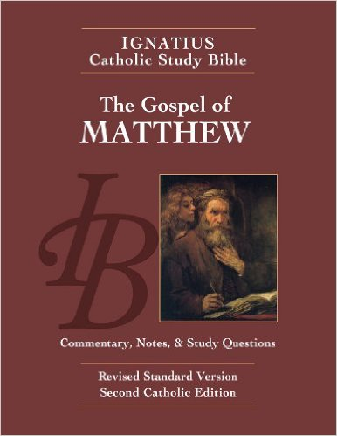
Sunday Bible College
Chapter 18
True Greatness
Temptations to Sin
Parable of the Lost Sheep
Binding and Loosing Sins
Repeated Forgiveness
Parable of the Unmerciful Servant
Holy Trinity
Anglican Church
Fernandina Beach, Florida

Slide 2
Temptation to Sin
Matthew 18:5-9
Woe to the world!

Slide 3
Temptation to Sin
Matthew 18:5-9
Woe to those who tempting others to sin.

Slide 4
Temptation to Sin
Matthew 18:5-9
Wisdom leads us to avoid all occasion of sin.
"if your hand or your foot causes you to sin, cut it off and throw it away...
if your eye causes you to sin, tear it out and throw it away...

Slide 5
Temptation to Sin
Matthew 18:5-9
"[These are figurative statements] not literal commands of self mutilation. Jesus uses alarming images to underscore the severity of ..sin; extreme measures are needed to avoid occasions of sin, the sins themselves and the eternal punishment they lead to."
ICSB workbook pg. 26 note for verse 5:29

Slide 6
Temptation to Sin
Matthew 18:5-9
What are the seven deadly sins?
Lust Anger
Greed Pride
Gluttony Sloth
Envy

Slide 7
Temptation to Sin
Matthew 18:5-9
What are OCCASIONS of these sins?
Lust Anger
Greed Pride
Gluttony Sloth
Envy

Slide 8
Temptation to Sin
Matthew 18:5-9
How do we combat these sins and avoid their occasions?

Slide 9
Temptation to Sin
Matthew 18:5-9
By pursuing Virtue, by the power of the Holy Spirit.
Chastity Meekness
Liberality Humility
Temperance
Brotherly Love
Diligence - It overcomes the sin of sloth.

Slide 10
Parable of the Lost Sheep
Matthew 18:10-14
1. A key verse in understanding the existence and ministry of angels, sometimes called Guardian Angels.
See Tobit 12:15; Job 33:32-34; Ps 34:7, 91:11, Acts 12:15; Hebrews 1:15
From its beginning until death, human life is surrounded by their watchful care and intercession.202 "Beside each believer stands an angel as protector and shepherd leading him to life."203 Already here on earth the Christian life shares by faith in the blessed company of angels and men united in God. CCC 336

Slide 11
Parable of the Lost Sheep
Matthew 18:10-14
2. This passage also is foundational to the Christian understanding of the value of the human person.
Our Creator values each human person worthy of search and rescue.

Slide 12
Parable of the Lost Sheep
Matthew 18:10-14
2. The Allegory of St's Hilary and Anselm,
The 99 sheep on the hill are the myriad angels in heaven who have never sinned.
The 1 sheep that is lost is mankind, lost through the fall.
The hill is heaven, the presence of God.
Christ leaves the hill in the incarnation, descending all the way to the Valley of the shadow of death, to lift mankind back up the hill - into heaven.
There, the angels rejoice at the restoration of mankind.
(compare this to the "lost Parables" and the angel rejoicing. Lk 15)

Slide 13
Binding and Loosing of Sins
Matthew 18:15-20
A Pastoral approach to reconciliation
1. One on one discussion
2. Intervention with trusted witnesses
3. Reconciliation through the public ministry of the Church
4. Excommunication
  (not punitive but a recognition of unresolved sin which has caused a real separation, in hopes of future reconciliation and restoration.)

Slide 14
Binding and Loosing of Sins
Matthew 18:18
"Truly, I say to you, whatever you bind on earth shall be bound in heaven, and whatever you loose on earth
shall be loosed in heaven."
To whom is Jesus speaking?
In context, what is being bound or loosed?

Slide 15
Binding and Loosing of Sins
Matthew 18:19
"Again I say to you, if two of you agree on earth about anything they ask, it will be done for them by my Father in heaven. 20 For where two or three are gathered in my name, there am I among them.""
See the prayer of St. Chrysostum.
    Pew BCP p. 21
    1928 BCP p. 20

