Slide 1

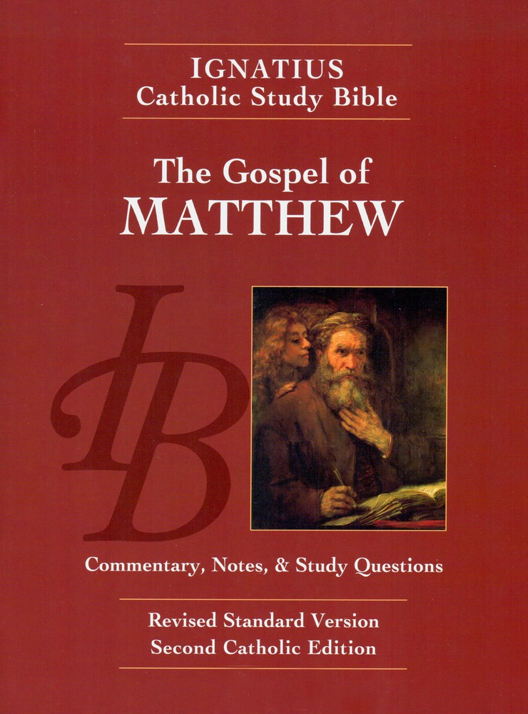
Sunday Bible College
Lesson 2
Holy Trinity
Anglican Church
Fernandina Beach, Florida

Slide 2
κατα ματταθιον
According to Matthew
Questions to ask when reading a book of the Bible
What do we know about the author?
What is the genre of the literature?
Are there clues to help interpret the meaning?
Who was the original audience and why
Internal structures that illuminate the meaning
Literary devices essential to interpretation?

Slide 3
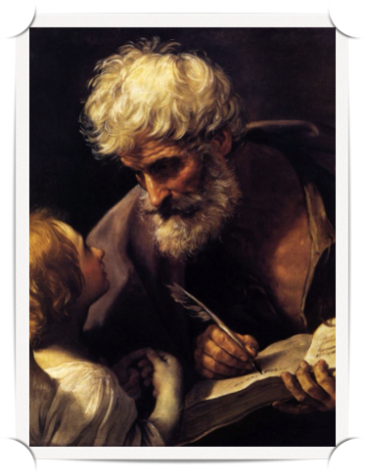
Author
Matthew Levi
St. Matt 9:9-13 & 10:1-3
St. Mark 2:13-17
St. Luke 5:27-32

Slide 4

How do we know it was Matthew who wrote it?
Unanimous ancient witness. Ex. Ignatius of Antioch (AD 67-107) earliest to reference this Gospel and attested that Matthew was the author.
The author was clearly steeped in Jewish and local history and customs.
The author was fluent in both Hebrew / Aramaic and Greek (As a publican from Palestine would be)
This Gospel often refers to matters of currency and business transactions, as a publican would notice.

Slide 5
What we know about Matthew
He was a Tax Collector
One of his first acts was to throw a party for Jesus to meet his friends
His reputation was such that he brought criticism and scandal to Jesus
He was numbered among the innermost circle of Jesus' disciples - one of the Twelve Apostles

Slide 6
To whom was Matthew writing his Gospel?
First and foremost, this was intended for Hebrew converts.
It is structured to answer the specific questions Jews would have regarding their Messiah
Therefore, there are over two hundred references to the Jewish Old Testament and how Jesus fulfills those prophesies regarding the promised Messiah.

Slide 7
To whom was Matthew writing his Gospel?
Interesting note: Matthew's Gospel is so "Jewish" in its tone and flavor that early tradition held that he wrote originally in Hebrew and translated into Greek. (Possibly true)
Also interesting: Because of the probable time of this Gospel's publication, Matthew most probably wrote this for the large Jewish community at Antioch in Syria, Where followers of Jesus were first called Christians, where Peter was the first bishop, and where all the Apostles spent a good deal of time. (See Acts of the Apostles)

Slide 8
Authorship controversies you need to know about
Modern scholars generally reject Matthew as the author. The main reason for this rejection is based on shaky reasoning:
Contrary to historical perspectives, they believe Mark wrote first and the Matthew used Mark as a source for his writing. They then reason that no Apostle would use the writing of a non-Apostle as a source
The story of the humble egg: to eat or not to eat?
It has not been proved that Mark was written before Matthew. Peter is the source behind Mark. Mark could have been based on Matthew.
Important Life Lesson: Modern Scientist and Theologians earn their living by saying something new or controversial.

Slide 9
Internal Structures:
The Outline
The Gospel begins and ends with a Prologue (the Infancy of Christ) and a conclusion (Passion Week - Resurrection). The main body of the work is divided into five "Books."
Each "Book" begins with a collection of the actions of Jesus and concludes with a section of the teaching of Jesus. (Narrative and Discourse) Matthew records more of the teaching or sayings of Jesus than any other Gospel.
Matthew ends each "Book with the saying, "When Jesus had finished these sayings...", underscoring the intentionality of this internal structure.

Slide 10
Internal Structures:
The oultine
Many believe this is an intentional device intended to liken the life of Jesus to the Life of Moses.
Moses leaves five books (Penteteuch) for the establishment of Israel. Jesus leaves five books for the establishment of the Church.

Slide 11
Internal Structures:
Fulfillment
Matthew is especially concerned throughout his work to show how Jesus fulfills the Old Testament prophesies concerning Jesus.
He uses the statement, "as it was written" to mark many of these O.T. references so we don't miss his point.
He is especially interested in two Old Testament Prophesies.
Daniel - the "son of man", promised royal deliverer
Davidic - the "son of David", promised heir to the throne

Slide 12
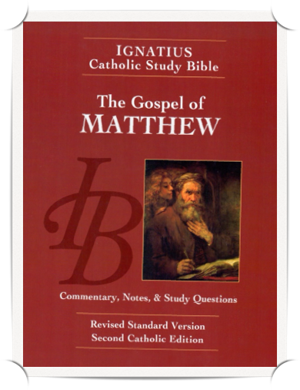
Homework: Lesson 2
Read the Gospel According to Saint Matthew, chapters 1 & 2
pp. 17-21, including the notes.
As you read chapter 1 and the list of Jesus' ancestors, circle any names you recognize? Also, circle the names of women in the list.
Read the article "Is Matthew's Infancy Narrative Historical?" p. 20
Answer the questions for chapters 1 and 2 on page 73 in your booklet.

