Slide 1

Sunday Bible College
Chapter 26
The Conspiracy to kill Jesus
The Anointing at Bethany
Judas agrees to Betray Jesus
The Passover with the Disciples

Slide 2
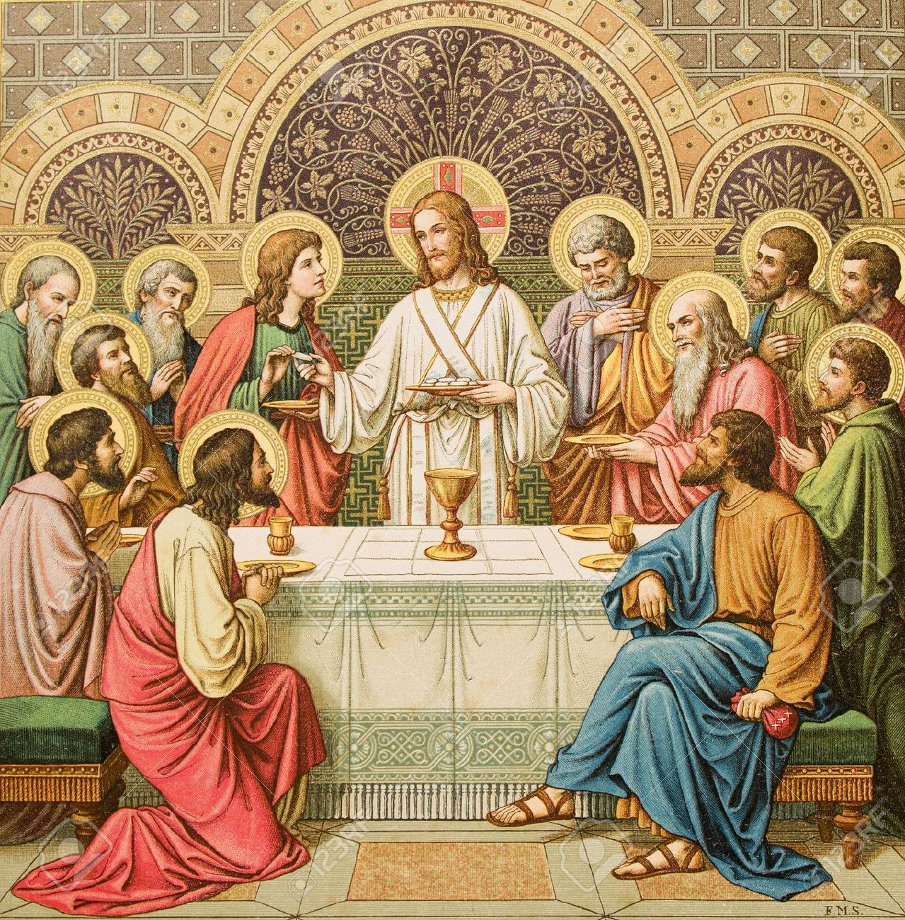
The Passover with the Disciples
¹⁷ Now on the first day of Unleavened Bread the disciples came to Jesus, saying, “Where will you have us prepare for you to eat the Passover?” ¹⁸ He said, “Go into the city to a certain man and say to him, ‘The Teacher says, My time is at hand. I will keep the Passover at your house with my disciples.’” ¹⁹ And the disciples did as Jesus had directed them, and they prepared the Passover.

Slide 3
The Passover with the Disciples
¹⁷ Now on the first day of Unleavened Bread the disciples came to Jesus, saying, “Where will you have us prepare for you to eat the Passover?” ¹⁸ He said, “Go into the city to a certain man and say to him, ‘The Teacher says, My time is at hand. I will keep the Passover at your house with my disciples.’” ¹⁹ And the disciples did as Jesus had directed them, and they prepared the Passover.

Slide 4
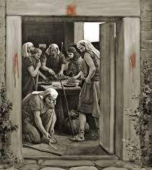
The Passover in Exodus 12
Read Exodus 12:1-15

Slide 5
The Passover in Exodus 12
Read Exodus 12:1-15

Slide 6
The Passover in Exodus 12
Kill a Lamb – a male without blemish
Blood – placed on the door post and lentil (beam above the door)
Take and eat the body – including the whole animal, roasted, without additions
Eat in readiness – loins girded, sandals on, standing (staff in hand), in haste.
Protects from Judgment
Everlasting Memorial Feast – Seven days of unleavened bread

Slide 7
Read Exodus 12:43-48
No foreigner may eat of it
To be eaten in homes
Strangers admitted (who are circumcised and therefore part of the covenant) are to be admitted into the home for the celebration of the Feast
Read Exodus 12:50

Slide 8
Back to The Passover with the Disciples
¹⁷ Now on the first day of Unleavened Bread the disciples came to Jesus, saying, “Where will you have us prepare for you to eat the Passover?” ¹⁸ He said, “Go into the city to a certain man and say to him, ‘The Teacher says, My time is at hand. I will keep the Passover at your house with my disciples.’” ¹⁹ And the disciples did as Jesus had directed them, and they prepared the Passover.

Slide 9
Back to The Passover with the Disciples
¹⁷ Now on the first day of Unleavened Bread the disciples came to Jesus, saying, “Where will you have us prepare for you to eat the Passover?” ¹⁸ He said, “Go into the city to a certain man and say to him, ‘The Teacher says, My time is at hand. I will keep the Passover at your house with my disciples.’” ¹⁹ And the disciples did as Jesus had directed them, and they prepared the Passover.

Slide 10
²⁰ When it was evening, he reclined at table with the twelve. ²¹ And as they were eating, he said, “Truly, I say to you, one of you will betray me.” ²² And they were very sorrowful and began to say to him one after another, “Is it I, Lord?” ²³ He answered, “He who has dipped his hand in the dish with me will betray me. ²⁴ The Son of Man goes as it is written of him, but woe to that man by whom the Son of Man is betrayed! It would have been better for that man if he had not been born.” ²⁵ Judas, who would betray him, answered, “Is it I, Rabbi?”
He said to him, “You have said so.”

Slide 11
²⁶ Now as they were eating, Jesus took bread, and after blessing it broke it and gave it to the disciples, and said, “Take, eat; this is my body.” ²⁷ And he took a cup, and when he had given thanks he gave it to them, saying, “Drink of it, all of you, ²⁸ for this is my blood of the covenant, which is poured out for many for the forgiveness of sins. ²⁹ I tell you I will not drink again of this fruit of the vine until that day when I drink it new with you in my Father's kingdom.”

Slide 12
“They were very sorrowful...one after another, ‘Is it I, Lord’”
They knew their own hearts and it terrified them. How many times had they already betrayed him in small and large ways?
Peter, James and John, (falling asleep, disbelief, opposition, selfish gain…)

Slide 13
Main Point: Jesus’ death is inevitable.
In deed, it is the reason for the incarnation. All that has come before, both in Jesus’ life and in the whole history of the world, has lead to this Passover sacrifice.

