Slide 1

Sunday Bible College
Chapter 26
The Conspiracy to kill Jesus
The Anointing at Bethany
Judas agrees to Betray Jesus
The Passover with the Disciples

Slide 2

Example of Insolent Behavior in a Curate

Slide 3
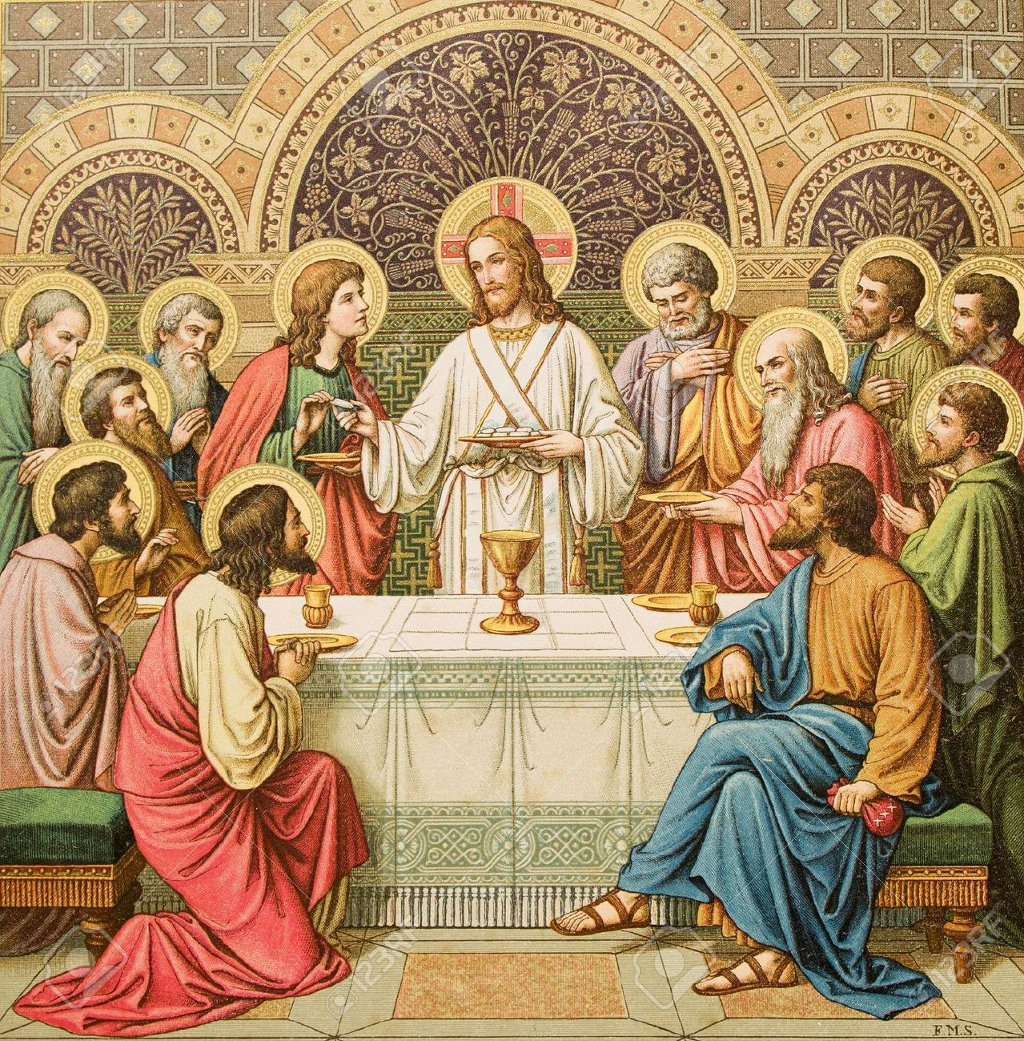
The Passover with the Disciples
¹⁷ Now on the first day of Unleavened Bread the disciples came to Jesus, saying, “Where will you have us prepare for you to eat the Passover?” ¹⁸ He said, “Go into the city to a certain man and say to him, ‘The Teacher says, My time is at hand. I will keep the Passover at your house with my disciples.’” ¹⁹ And the disciples did as Jesus had directed them, and they prepared the Passover.

Slide 4
The Passover with the Disciples
¹⁷ Now on the first day of Unleavened Bread the disciples came to Jesus, saying, “Where will you have us prepare for you to eat the Passover?” ¹⁸ He said, “Go into the city to a certain man and say to him, ‘The Teacher says, My time is at hand. I will keep the Passover at your house with my disciples.’” ¹⁹ And the disciples did as Jesus had directed them, and they prepared the Passover.

Slide 5
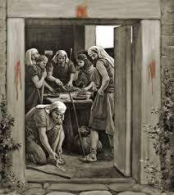
The Passover in Exodus 12
Read Exodus 12:1-15

Slide 6
The Passover in Exodus 12
Read Exodus 12:1-15

Slide 7
The Passover in Exodus 12
Kill a Lamb – a male without blemish
Blood – placed on the door post and lentil (beam above the door)
Take and eat the body – including the whole animal, roasted, without additions
Eat in readiness – loins girded, sandals on, standing (staff in hand), in haste.
Protects from Judgment
Everlasting Memorial Feast – Seven days of unleavened bread

Slide 8
Read Exodus 12:43-48
No foreigner may eat of it
To be eaten in homes
Strangers admitted (who are circumcised and therefore part of the covenant) are to be admitted into the home for the celebration of the Feast
Read Exodus 12:50

Slide 9
Back to The Passover with the Disciples
¹⁷ Now on the first day of Unleavened Bread the disciples came to Jesus, saying, “Where will you have us prepare for you to eat the Passover?” ¹⁸ He said, “Go into the city to a certain man and say to him, ‘The Teacher says, My time is at hand. I will keep the Passover at your house with my disciples.’” ¹⁹ And the disciples did as Jesus had directed them, and they prepared the Passover.

Slide 10
Back to The Passover with the Disciples
¹⁷ Now on the first day of Unleavened Bread the disciples came to Jesus, saying, “Where will you have us prepare for you to eat the Passover?” ¹⁸ He said, “Go into the city to a certain man and say to him, ‘The Teacher says, My time is at hand. I will keep the Passover at your house with my disciples.’” ¹⁹ And the disciples did as Jesus had directed them, and they prepared the Passover.

Slide 11
²⁰ When it was evening, he reclined at table with the twelve. ²¹ And as they were eating, he said, “Truly, I say to you, one of you will betray me.” ²² And they were very sorrowful and began to say to him one after another, “Is it I, Lord?” ²³ He answered, “He who has dipped his hand in the dish with me will betray me. ²⁴ The Son of Man goes as it is written of him, but woe to that man by whom the Son of Man is betrayed! It would have been better for that man if he had not been born.” ²⁵ Judas, who would betray him, answered, “Is it I, Rabbi?”
He said to him, “You have said so.”

Slide 12
²⁶ Now as they were eating, Jesus took bread, and after blessing it broke it and gave it to the disciples, and said, “Take, eat; this is my body.” ²⁷ And he took a cup, and when he had given thanks he gave it to them, saying, “Drink of it, all of you, ²⁸ for this is my blood of the covenant, which is poured out for many for the forgiveness of sins. ²⁹ I tell you I will not drink again of this fruit of the vine until that day when I drink it new with you in my Father's kingdom.”

Slide 13
“They were very sorrowful...one after another, ‘Is it I, Lord’”
They knew their own hearts and it terrified them. How many times had they already betrayed him in small and large ways?
Peter, James and John, (falling asleep, disbelief, opposition, selfish gain…)

Slide 14
Main Point: Jesus’ death is inevitable.
In deed, it is the reason for the incarnation. All that has come before, both in Jesus’ life and in the whole history of the world, has lead to this Passover sacrifice.

Slide 16
Peter’s Denial Fortold
Verses 30-35
Sang a hymn
Went to the mount of olives, between Bethany (home of Lazarus) and Jerusalem
You will all fall away because of me
See Isaiah 8:13-14 and 1 Peter 2:8

Slide 17
Peter’s Denial Fortold
What does Peter’s response tell us about human nature?
Our pride often means more to us than our lives
And we value our life more than we value love.

Slide 18
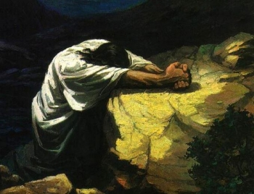
Jesus Prays in Gethsemane
Matthew 26:36-46

Slide 19
Jesus Prays in
Gethsemane
The Call To Prayer
In the hour of greatest crisis, Jesus calls his disciples to prayer.
Matthew 26:36-46

Slide 20
Jesus Prays in
Gethsemane
The Call To Prayer
In the hour of greatest crisis, Jesus calls his disciples to prayer.
Rejoice always,
pray without ceasing,
give thanks in all circumstances;
for this is the will of God in
Christ Jesus for you.
1 Thessalonians 5:16-18
Matthew 26:36-46

Slide 21
Jesus Prays in
Gethsemane
The Position of Prayer
Jesus commanded his disciples to sit
But he went “went a little further” and
“fell on his face.”
(Lift holy hands, kneel, stand, weep…but we are never commended by example or command to approach God in expressionless monotone.)
Matthew 26:36-46

Slide 22
Jesus Prays in
Gethsemane
Excursion: The Position of Prayer
in Scripture we are commended to pray
Lifting holy hands,
kneeling
Standing in awe
Weeping
Laughing
Shouting
With our faces to the ground
…but we are never commended by example or command to approach God in expressionless monotone.
Matthew 26:36-46

Slide 23
“He began to be sorrowful and
troubled” v 37
Here we see a profound revelation of Jesus’ full humanity. His distress is real and keenly felt.
Jesus Prays in
Gethsemane
The Disposition of Jesus’ Prayer
Matthew 26:36-46

Slide 24
Jesus Prays in
Gethsemane
The Content of Jesus’ Prayer
^{v39}“My Father, if it be possible, let this chalice pass from me; nevertheless, not as I will, but as you will.”
^{v42}“My Father, if this cannot pass unless
I drink it, your will be done.”
^{v44} He went away and prayed for the third time, saying the same words again.
Matthew 26:36-46

Slide 25
Jesus Prays in
Gethsemane
The Content of Jesus’ Prayer
^{v39}“My Father, if it be possible, let this chalice pass from me; nevertheless, not as I will, but as you will.”
^{v42}“My Father, if this cannot pass unless
I drink it, your will be done.”
^{v44} He went away and prayed for the third time, saying the same words again.
Matthew 26:36-46

Slide 26
Jesus Prays in
Gethsemane
The Content of Jesus’ Prayer
^{v39}“My Father, if it be possible, let this chalice pass from me; nevertheless, not
as I will, but as you will.”
^{v42}“My Father, if this cannot pass unless
I drink it, your will be done.”
^{v44} He went away and prayed for the
third time, saying the same words again.
Matthew 26:36-46

Slide 27
Jesus Prays in
Gethsemane
The Content of Jesus’ Prayer
“Prayer does not merely consist in
asking for things from God but, more importantly, obtaining
the grace to identify God’s will
and strength bear our cross.”
Didache Study Bible notes p.1307
Matthew 26:36-46

Slide 28
Jesus Prays in
Gethsemane
The Content of Jesus’ Prayer
“Prayer does not merely consist in
asking for things from God but, more importantly, obtaining
the grace to identify God’s will
and strength bear our cross.”
Didache Study Bible notes p.1307
Matthew 26:36-46

Slide 29
Jesus Prays in
Gethsemane
The Content of Jesus’ Prayer
“Prayer does not merely consist in
asking for things from God but, more importantly, obtaining
the grace to identify God’s will
and strength bear our cross.”
Didache Study Bible notes p.1307
Matthew 26:36-46

