Slide 1

Matthew 26:47-75
Betrayal, Arrest, & Peter’s denial

Slide 2
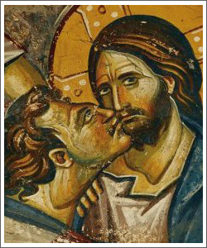
Judas Betrays Jesus
St. Matthew 26:47-56

Slide 3
Judas Betrays Jesus
The Sign used to identify Jesus to the guards was a kiss.
Only one of the twelve could get close enough to betray in this way.
Consider the intimacy of this betrayal.
St. Matthew 26:47-56

Slide 4
Judas Betrays Jesus
Jesus asks, “Friend, why are you here?”
Jesus clearly knew the answer to the question, so why did he call Judas “Friend”?
St. Matthew 26:47-56

Slide 5
Judas Betrays Jesus
Who got his ear cut off in the scuffle? The slave of the high priest!
The High priest’s weren’t brave enough to do their own dirty work but ordered their underlings to do it.
(How does this mirror the events in the world today?)
St. Matthew 26:47-56

Slide 6
Judas Betrays Jesus
Did this lessen the guilt of the Priest’s?
Trivia (how many ways have the Sadducees already tried to lesson their guilt in the death of Jesus?
St. Matthew 26:47-56

Slide 7
Judas Betrays Jesus
Did this lessen the guilt of the Priest’s
Trivia (how many ways have the Sadducees already tried to lesson their guilt in the death of Jesus?
Hint: they aren’t done trying!
St. Matthew 26:47-56

Slide 8
Judas Betrays Jesus
Did this lessen the guilt of the Priest’s
Trivia (how many ways have the Sadducees already tried to lesson their guilt in the death of Jesus?
Hint: they aren’t done trying!
St. Matthew 26:47-56

Slide 9
Judas Betrays Jesus
Jesus’ Response
To Betrayal
1. Put away your sword
  Vengeance is mine saith the Lord. Deut. 32:35 & Romans 12:19
  The wrath of man does not produce the righteousness of God.
  James 1:20
St. Matthew 26:47-56

Slide 10
Judas Betrays Jesus
Jesus’ Response
To Betrayal
2. Do you think I can not appeal to my Father…
  And he will at once send me more than twelve legion of Angels?
  12 Legion = ~70,000 Angels!
  How well do you think the clubs of the crowd would have stood against that force?
St. Matthew 26:47-56

Slide 11
Judas Betrays Jesus
Jesus’ Response
To Betrayal
3. But how, then, would the Scriptures be fulfilled?
Notice the Scriptures are the constant source of authority for Jesus. He uses the Scripture’s as if they are God’s direct answer to his prayer and God’s direct guide for his life.
St. Matthew 26:47-56

Slide 12
Judas Betrays Jesus
Jesus’ Response
To Betrayal
3. Why didn’t you sieze me when I taught you in the Temple?
This was not really an attempt to call out the cowardice of the soldiers but to underscore…
St. Matthew 26:47-56

Slide 13
Judas Betrays Jesus
Jesus’ Response
To Betrayal
All this was written that the Scriptures might be fulfilled.
St. Matthew 26:47-56

Slide 14
Judas Betrays Jesus
Then all the disciples
deserted him
and fled.
St. Matthew 26:47-56

Slide 15
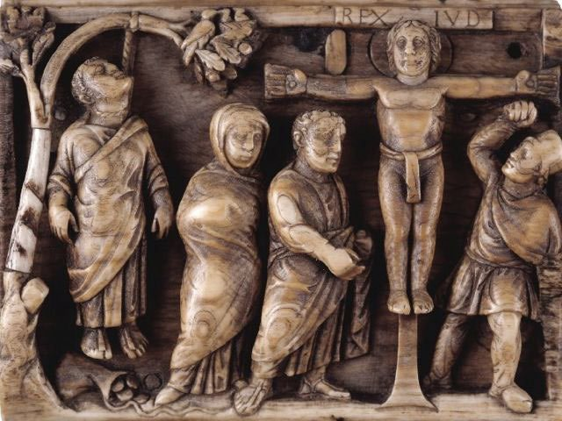
Judas Betrays Jesus
Medieval Art

Slide 16
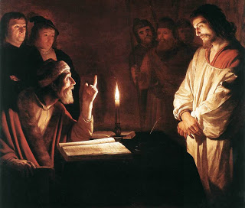
Jesus before the High Priest
St. Matthew 26:57-68

Slide 17
Jesus before the High Priest
Caiaphas
High Priest from Ad 18-36
Presided over the Sanhedrin – the Supreme Court of the Jewish people., which was made up of 71 members.
St. Matthew 26:57-68

Slide 18
Jesus before the High Priest
False Witnesses
Their attempts to find witnesses against Jesus, even false witnesses, demonstrates the extreme measures they took to absolve themselves of
their crimes.
St. Matthew 26:57-68

Slide 19
Jesus before the High Priest
I am able to
destroy this Temple
Note this is a distortion of Jesus’ words and message: See St. John 2:21.
Note also the leading questions asked of Jesus – any answer admits guilt.
St. Matthew 26:57-68

Slide 20
Jesus before the High Priest
I adjure you
by the living God
The high priest commits the ultimate act of blasphemy, breaking the
Second Law of Moses.
St. Matthew 26:57-68

Slide 21
Jesus before the High Priest
He has uttered blasphemy
Notice they convict Jesus and condemn him to death for the very crime they themselves had committed.
St. Matthew 26:57-68

Slide 22
Jesus before the High Priest
Wait a minute!
Back up please.
Let’s look at Jesus’ actual response.
St. Matthew 26:63-64
Then compare to
St. Matthew 26:57-68

Slide 23
Jesus before the High Priest
^{Matthew 26:64} Jesus said to him, “You have said so. But I tell you, from now on you will see the Son of Man seated at the right hand of Power and coming on the clouds of heaven.”
^{Hebrews12:1} …let us run with endurance the race that is set before us, ² looking unto Jesus, the author and finisher of our faith, who for the joy that was set before Him endured the cross, despising the shame, and has sat down at the right hand of the throne of God.
St. Matthew 26:57-68

Slide 24
Jesus before the High Priest
St. Matthew 26:57-68

