Slide 1
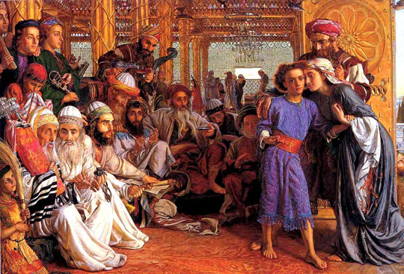
The Finding of the saviour in the Temple
By Pre-Raphaelite artist Holman Hunt, c. 1854-1860 (Birmingham City Museum)

Slide 2
St. Matthew 27:15-31
The Passion of Christ

Slide 3
St. Matthew 15-23
Now at the feast the governor was accustomed to release for the crowd any one prisoner whom they wanted. And they had then a notorious prisoner, called Barab′bas. So when they had gathered, Pilate said to them, “Whom do you want me to release for you, Barab′bas or Jesus who is called Christ?” For he knew that it was out of envy that they had delivered him up.

Slide 4
St. Matthew 15-23
Besides, while he was sitting on the judgment seat, his wife sent word to him, “Have nothing to do with that righteous man, for I have suffered much over him today in a dream.”

Slide 5
St. Matthew 15-23
Now the chief priests and the elders persuaded the people to ask for Barab′bas and destroy Jesus. The governor again said to them, “Which of the two do you want me to release for you?” And they said, “Barab′bas.” Pilate said to them, “Then what shall I do with Jesus who is called Christ?” They all said, “Let him be crucified.” And he said, “Why, what evil has he done?” But they shouted all the more, “Let him be crucified.”

Slide 6
St. Matthew 15-23
So when Pilate saw that he was gaining nothing, but rather that a riot was beginning, he took water and washed his hands before the crowd, saying, “I am innocent of this righteous man’s blood; see to it yourselves.” And all the people answered, “His blood be on us and on our children!” Then he released for them Barab′bas, and having scourged Jesus, delivered him to be crucified.

Slide 7
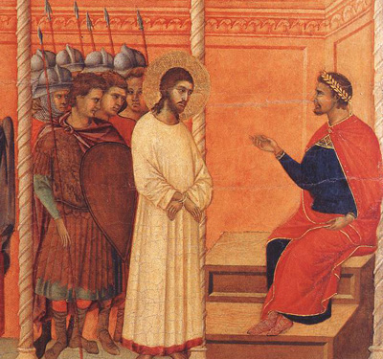
Jesus before Pilate

Slide 8
Jesus before Pilate
Historical Background
The Sanhedrin did not have power to assign death penalty
Pilate, as Roman Governor, exercised real power
Pilate’s goal was to keep the peace (he was already in trouble with Rome)
As a goodwill gesture, each year, Rome released a political prisoner

Slide 9
Jesus before Pilate
Refresh
Read St. Matthew 27:20-23

Slide 10
Jesus before Pilate
Two men stood before Pilate
Jesus barJoseph
&
Jashua barAbbas

Slide 11
Jesus before Pilate
Two men stood before Pilate
But “Jesus” is Greek for
Joshua barJoseph
&
Joshua barAbbas

Slide 12
Jesus before Pilate
Two men stood before Pilate
Joshua barJoseph
Means
Joshua = God will save
Bar = son of
Joseph = Yahweh who gives increase

Slide 13
Jesus before Pilate
Two men stood before Pilate
Joshua barAbbas
Means
Joshua = God will save
Bar = son of
Abbas = the father

Slide 14
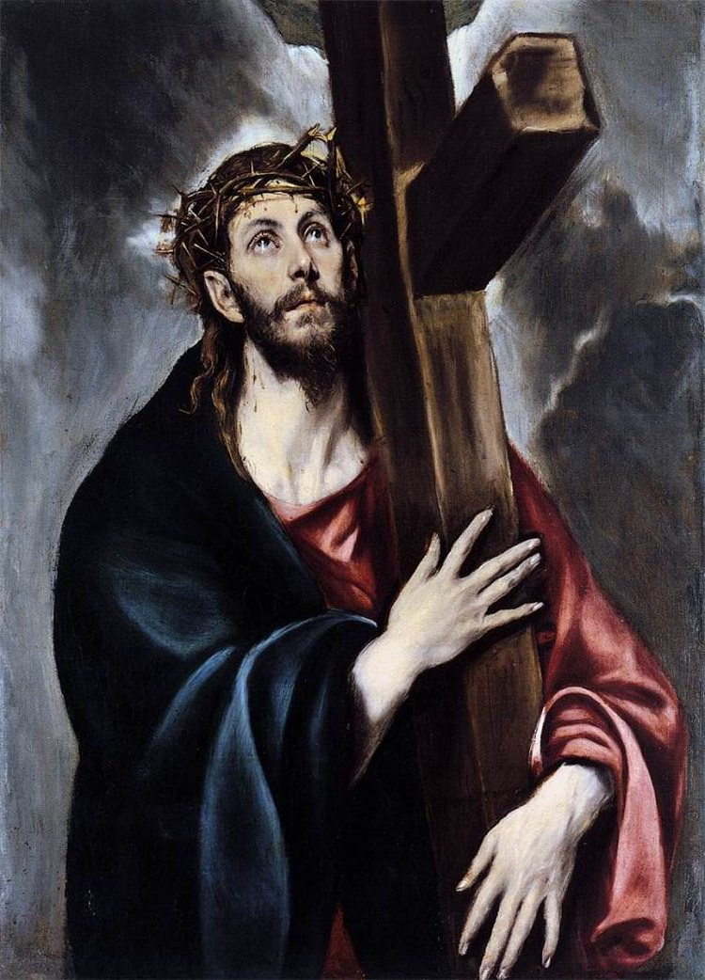
The Soldiers Mock Jesus
Christ Carrying the Cross
by El Greco, c. 1578, Spain

Slide 15
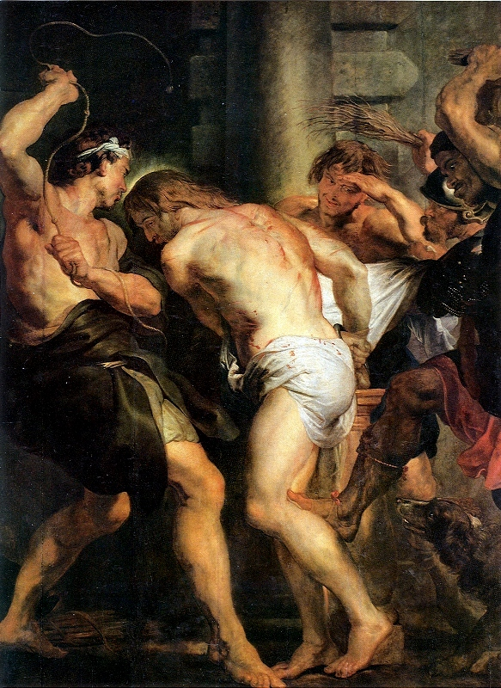
The Soldiers Mock Jesus
The Flagellation of Christ
By Peter Paul Ruebens, c. 1617
Hangs in the Antwerp Church of St. Peter, Netherlands

Slide 16
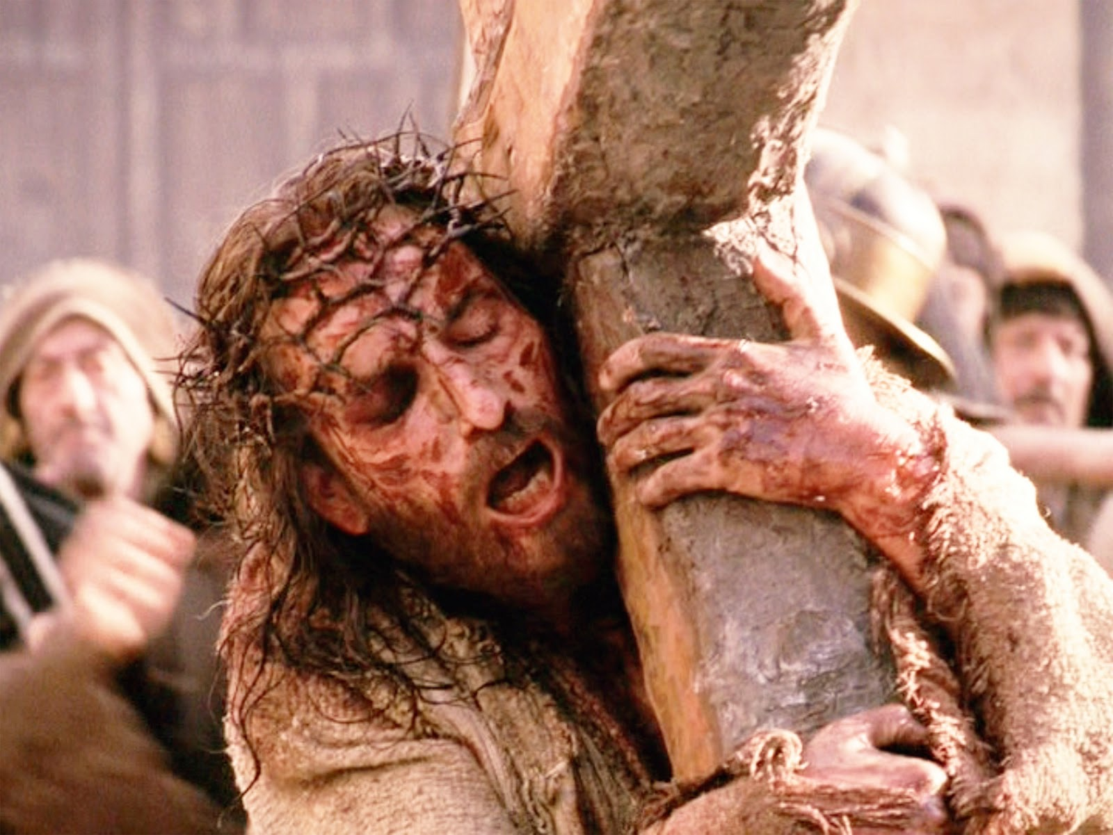
The Soldiers Mock Jesus
The Passion of the Christ
By Mel Gibson, film 2004

Slide 17
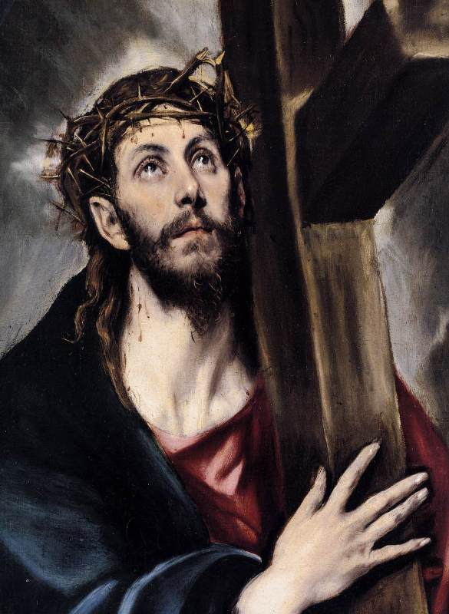
Which Icon Speaks to You?

Slide 18
The Soldiers Mock Christ
St. Matthew 27:27-31

Slide 19
The Soldiers Mock Christ
St. Matthew 27:27-31
Praetorium / Pavement
Herrod’s Palace taken over by Pilate, and the “patio” outside where Pilate held court.

Slide 20
The Soldiers Mock Christ
St. Matthew 27:27-31
Actions of the Soldiers
Stripped him
Robed him in Scarlett
Crowned him with thorns
Sceptered him with reeds
Beat him
Hailed / spat upon him
Dressed / led him away

Slide 21
The Soldiers Mock Christ
St. Matthew 27:27-31
Christ the Suffering Servant
Isaiah 53

Slide 22
The Soldiers Mock Christ
St. Matthew 27:27-31
Christ the Suffering Servant
Isaiah 53
V3 Despised / rejected
V4 for bearing our griefs
V5 He was wounded for our transgressions – Memorize!
V10 It was God’s Will

Slide 23
The Soldiers Mock Christ
St. Matthew 27:27-31
Christ the Suffering Servant
Isaiah 53
ESSENTIAL NOTE.
Jesus was not tortured by God the Father; rather, he willingly suffered the consequences of our sin, for our sake, because the Father loves us.

Slide 24
The Soldiers Mock Christ
St. Matthew 27:27-31
Christ the Suffering Servant
Now read and compare
1 Peter 2:21-25

Slide 25
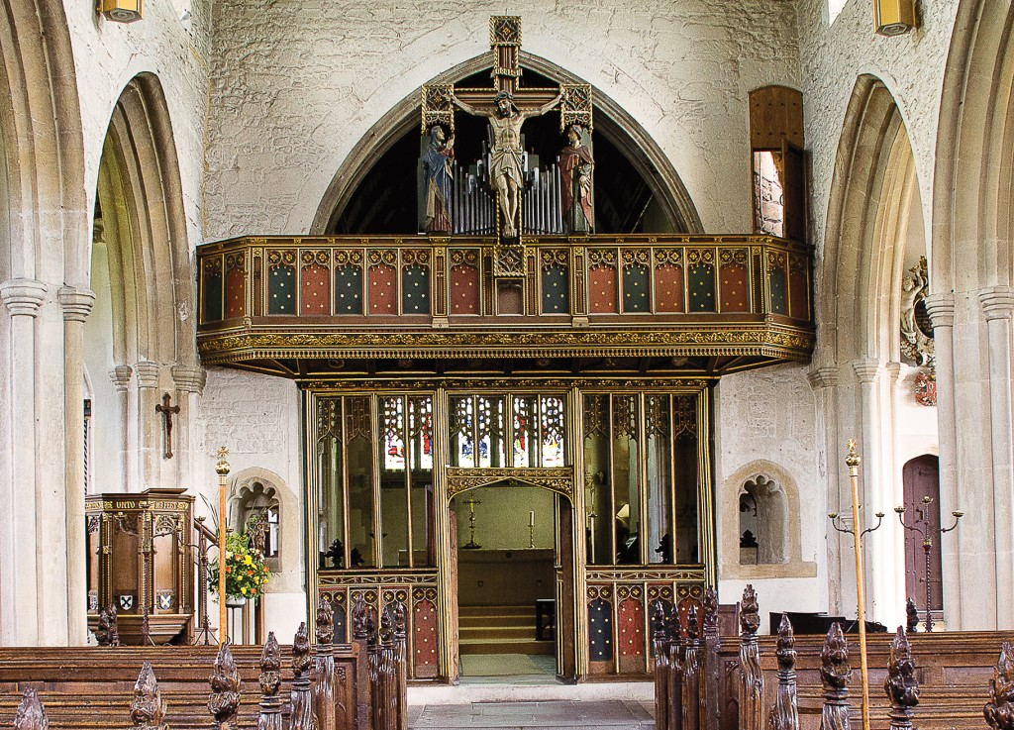
The crucifixion of Jesus
Rood Screen
St. Julian’s Anglican Church
Dedicated 1372
Bath, England

Slide 26
The crucifixion of Jesus
Rood Screen
St. Julian’s Anglican Church
Dedicated 1372
Bath, England

Slide 27
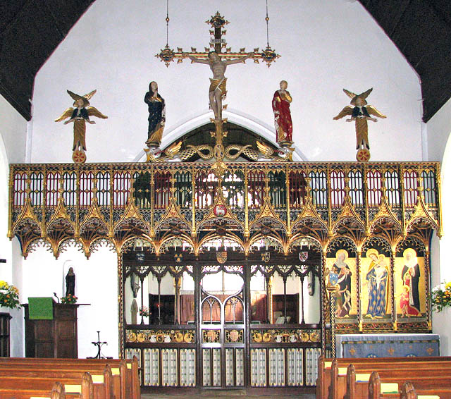
The crucifixion of Jesus
Rood Screen
St. Julian’s Anglican Church
Dedicated 1372
Bath, England

Slide 28
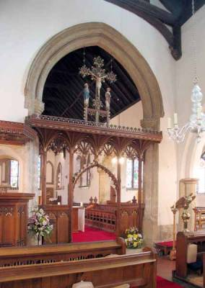
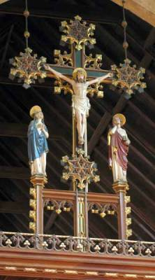
The crucifixion ofJesus
Rood Screen
St. Edmund’s Anglican Church
Dedicated 1910
Norfolk, England

Slide 29
The crucifixion of Jesus
St. Matthew 27:32
Simon of Cyrene
Cyrene was a Greek colony in North Africa (modern Libya)
Simon converted to Christ through this experience, and is featured in the Stations of the Cross
His son, Rufus, is mentioned in
Romans 16:13
Rood Screen
St. Edmund’s Anglican Church
Dedicated 1910
Norfolk, England

Slide 30
The crucifixion of Jesus
St. Matthew 27:33
Golgatha
An Aramaic term meaning “Skull”, which calls to mind the prophesy of Genesis 3:15
Lay “outside the walls”, fulfilling the prophesy of the OT Day of Atonement, Yom Kippur (Leviticus 16, esp. 29ff),
see Hebrews 13:10-11
Rood Screen
St. Edmund’s Anglican Church
Dedicated 1910
Norfolk, England

Slide 31
The crucifixion of Jesus
St. Matthew 27:34
Wine mingled with Gall
Gall: a mixture of herbs and myhrr which is a mild narcotic used as a painkiller.
Hebrews 12:1-2
Rood Screen
St. Edmund’s Anglican Church
Dedicated 1910
Norfolk, England

Slide 32
The crucifixion of Jesus
St. Matthew 27:35
They crucified him
Driving nails through his wrists and his feet
Crucifixion was so heinous it was reserved for the worst offenders – Roman citizens could not be crucified.
Death came slowly by blood loss and asphyxiation, and was often hastened by breaking the legs
Rood Screen
St. Edmund’s Anglican Church
Dedicated 1910
Norfolk, England

Slide 33
The crucifixion of Jesus
St. Matthew 27:35
Divided his garments
By the “casting of the die”
another “Station of the Cross)
Psalm 22: 18;
(a psalm quoted by Jesus before his death: St. Matt 27:46)
see also Jn 19:24
Rood Screen
St. Edmund’s Anglican Church
Dedicated 1910
Norfolk, England

Slide 34
The crucifixion of Jesus
St. Matthew 27:37
This is Jesus,
King of the Jews
See John 19:20-22
Notice, on the crucifix above the Altar in our Chapel, there is a sign which says INRI
Iesus Nazarenus
Rex Iudaeorum
Rood Screen
St. Edmund’s Anglican Church
Dedicated 1910
Norfolk, England

Slide 35
The crucifixion of Jesus
St. Matthew 27:40
If you are the Son of God,
come down from that cross!
Rood Screen
St. Edmund’s Anglican Church
Dedicated 1910
Norfolk, England

Slide 36
The crucifixion of Jesus
St. Matthew 27:40
If you are the Son of God,
come down from that cross!
Let him come down
and we will believe him!
Rood Screen
St. Edmund’s Anglican Church
Dedicated 1910
Norfolk, England

Slide 37
The crucifixion of Jesus
St. Matthew 27:40
If you are the Son of God,
come down from that cross!
Let him come down
and we will believe him!
He saved others, he can not save himself!
Rood Screen
St. Edmund’s Anglican Church
Dedicated 1910
Norfolk, England

Slide 38
The crucifixion of Jesus
St. Matthew 27:40
If you are the Son of God,
come down from that cross!
Let him come down
and we will believe him!
He saved others,
he can not save himself!
He trusts in God,
let God deliver him!
Rood Screen
St. Edmund’s Anglican Church
Dedicated 1910
Norfolk, England

Slide 39
The crucifixion of Jesus
St. Matthew 27:40
If you are the Son of God,
come down from that cross!
Let him come down
and we will believe him!
He saved others,
he can not save himself!
He trusts in God,
let God deliver him!
And the Robbers with him also reviled him in the same way!
Rood Screen
St. Edmund’s Anglican Church
Dedicated 1910
Norfolk, England

Slide 40
The crucifixion of Jesus
St. Matthew 27:45-56
The Death of Jesus
Rood Screen
St. Edmund’s Anglican Church
Dedicated 1910
Norfolk, England

Slide 41
The crucifixion of Jesus
St. Matthew 27:45-50
The Death of Jesus
Isaiah 50:6-9
Psalm 22
Rood Screen
St. Edmund’s Anglican Church
Dedicated 1910
Norfolk, England

Slide 42
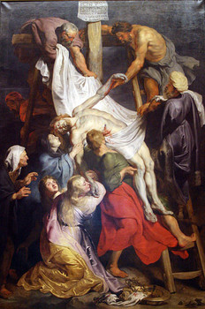
The burial of Jesus
'Descent from the Cross', 1697
Jean Jouvenet
Louvre, Paris

Slide 43
The burial of Jesus
St. Matthew 27:57-61
The Burial of Jesus
The Jews sought a hasty burial of Jesus because it was the eve of the Sabbath, and no work could be done after sunset. The body of Jesus would have to be left to decay on the cross.
“You will not let your holy One see corruption” Ps 16:10
'Descent from the Cross', 1697
Jean Jouvenet
Louvre, Paris

Slide 44
The burial of Jesus
Joseph of Arimathea
See St. Luke 23:50-56
A Disciple of Jesus
A rich man
A member of the Sanhedrin
A good and righteous man
Did not consent to the plot
against Jesus
Was looking for the Kingdom of God
'Descent from the Cross', 1697
Jean Jouvenet
Louvre, Paris

Slide 45
The burial of Jesus
Joseph of Arimathea
See St. Luke 23:50-56
Asked Pontius Pilate for the body
Took Jesus’ body down
Wrapped him in linen
Laid him in a new tomb, never used.
'Descent from the Cross', 1697
Jean Jouvenet
Louvre, Paris

Slide 46
The burial of Jesus
Joseph of Arimathea
See St. Luke 23:50-56
The “women from Galilee” helped Joseph of Arimathea
The Blessed Virgin Mary
Mary the mother of James and Joses (The other Mary)
The Wife of Zebedee
& “many others”
'Descent from the Cross', 1697
Jean Jouvenet
Louvre, Paris

Slide 47
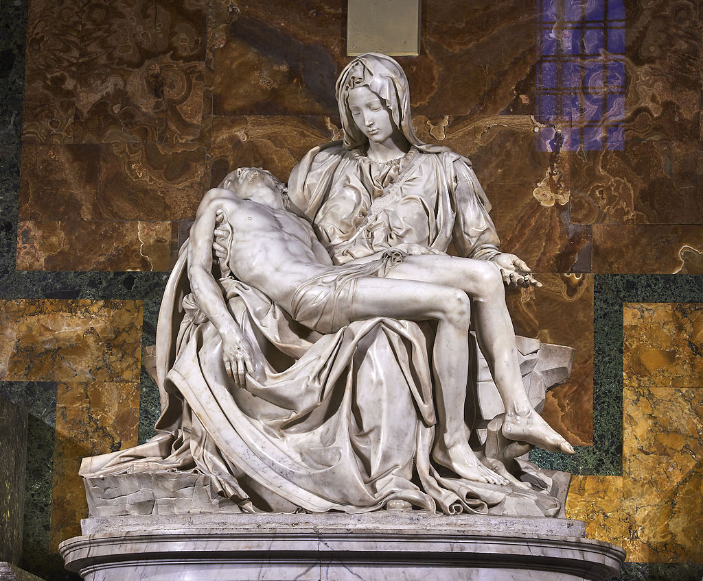
The burial of Jesus
The Pieta by Michaelangelo
Photo by Juan M Romero
'Descent from the Cross', 1697
Jean Jouvenet
Louvre, Paris

Slide 48
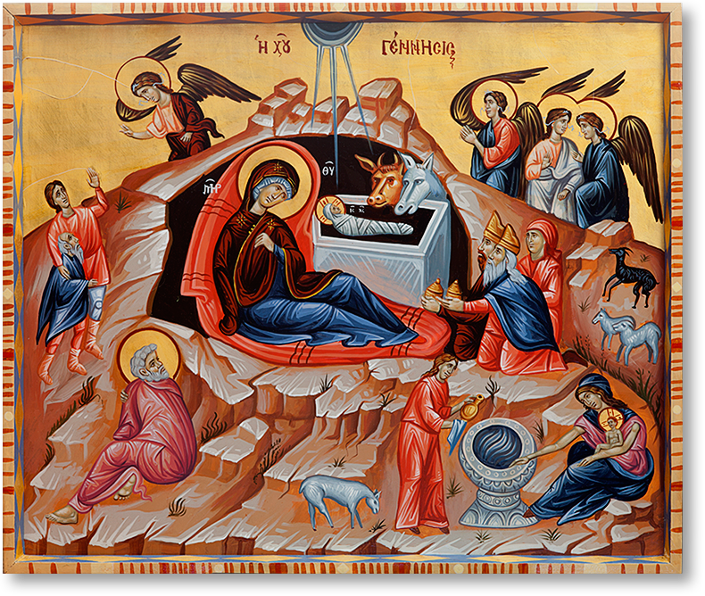
The burial of Jesus
Mary the mother of Jesus
and the “other Mary” remained outside his sealed tomb.
'Descent from the Cross', 1697
Jean Jouvenet
Louvre, Paris

Slide 49
Jesus before Pilate
Two men stood before Pilate
Joshua barAbbas
Means
Joshua = God will save
Bar = son of
Abbas = the father

