Slide 1

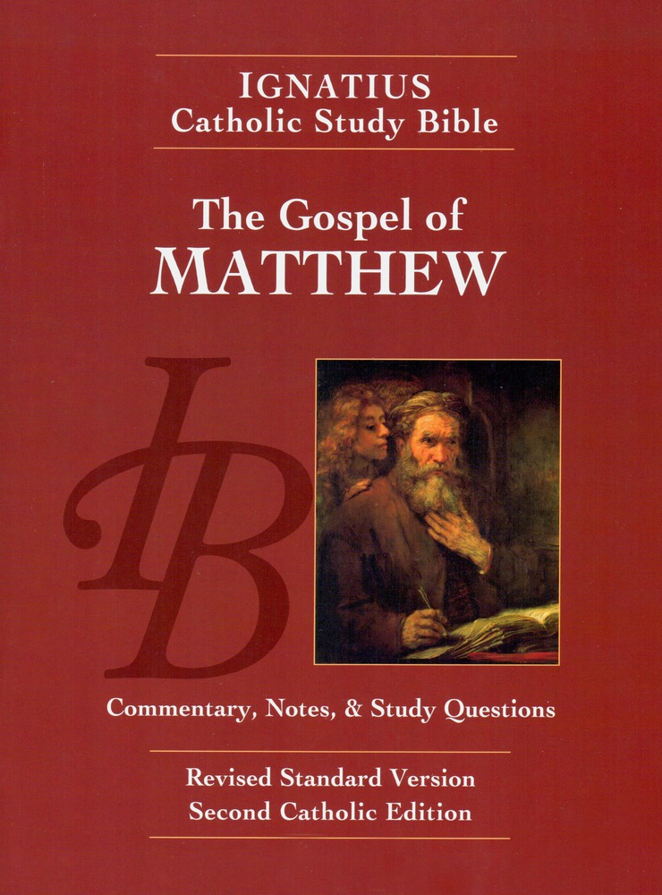
Sunday Bible College
Chapters 1 & 2
Holy Trinity
Anglican Church
Fernandina Beach, Florida

Slide 2
Homework Question 1:1
What is the purpose of Matthew's genealogy of Jesus?
The genealogy established Jesus' credentials as the heir to David and therefore the Messiah.
What does it mean to say that this background is "foundational"?
The rest of the Gospel is an elucidation of this theme.

Slide 3
The Genealogy of Chapter 1
It's purpose is to show that Jesus is an heir to King David.
Is intentionally calls us to remember the Genealogies of Genesis 2 and 5
There are 42 generations from Adam to Jesus, corresponding to the 42 encampments of the Israelites in the wilderness on their way to the promised land.
The list of Jesus' ancestors reads like a Who's who of Biblical characters.

Slide 4

What does this mean?
From the very first chapter, Matthew assumes a deep and extensive knowledge of the Old Testament.
KEY TRUTH: It is impossible to understand the fulness of the Gospel and the richness of the New Testament without reference to the Old Testament.

Slide 5
Examples of this
Key Truth
Tamar: Genesis 38 - a gentile widow who prostituted herself in order to get a child.
Rahab: Joshua 2 - a gentile harlot who lived in Jericho. She hid the Israelite spies and sided with Isreal when they invaded
Ruth: Ruth 3 - a Gentile widow who found redemption through a relative her married her.
Wife of Uriah - the gentile Bathsheba of 2 Samuel 11 - David had her husband killed so that he could marry her (she was already pregnant with his child.) She eventually gave birth to Solomon the great.

Slide 6
Homework Question 1:2
Even though Joseph is not the biological father of Jesus, he has responsibilities and excercises certain paternal rights when Jesus is born. What are these?
He names Jesus.
He is responsible for the safety and well being of the Holy Family
He gives rights of heredity to Jesus through adoption.

Slide 7
Homework Question 1:3
Matthew quotes Isaiah 7:14 and applies it to Jesus. Whose birth was Isaiah referring to? How has the name Emanuel been fulfilled in Jesus?
Isaiah was referring to Hezekiah, who became king and lead a great revival and return to holiness for a time in Israel.
Jesus is the Son of God. He is literally God dwelling in our midst. See John 1:14.

Slide 8
Homework Question 1:4
In the statement that "Joseph knew her not until she had bourne a son" , what does the word until mean?
See note on 1:25. He emphasizes that Joseph had no involvement in the pregnancy of Mary or the birth of Jesus.
Note: All the magisterial Reformers (Luther, Calvin, Zwingli) believed in the "perpetual virginity" of Mary, and therefore she had no children except Jesus.

Slide 9
The Infancy Narrative Matthew Chapter 2

Slide 10
Homework Question 2:1
What were the origins of Herod the Great?
Herod was appointed King of the Jews by the Roman senate to replace the failing leadership of the Hasmonean Dynasty of ruling pirests. Herod was not Jewish. He was an Edomite, descendants of Esau.
What Old Testament prophecy caused Herod to be "troubled"?
Numbers 24:17-18 "A Star shall come forth out of Jacob, and a scepter shall rise out of Israel... Edom shall be dispossessed. "

Slide 11
Homework Question 2:2
The Three Gifts of the Magi have been understood as having symbolic and spiritual significance.How do St. Iraneaus and St. Gregory the Great understand their meaning?

Slide 12
Homework Question 2:2
St. Iraneas and the Allegorical meaning.
Gold = a symbol of royalty, represents the Kingship of Jesus
Frankincense = used in the worship of God, demonstrates the divinity of Jesus
Myrrh = anointing oil for consecrating priests and for embalming the dead, demonstrates the mortality and therefore the humanity of Jesus

Slide 13
Homework Question 2:2
St. Gregory the Great and the Moral meaning.
These treasures signify the gifts we present to Christ in our daily lives.
Gold = Christ's wisdom which shines in us
Frankincense = incense is the prayer and adoration we offer him. Rev. 8:3-4
Myrrh = represents our daily self sacrifice
Romans 12:1

Slide 14
Homework Question 2:3
Matthew quotes Hosea 11:1 with reference to the Holy Family's return from Egypt. What is the link Maathew is making between that event and Israelite History.
Hosea looks back to the escapre from Egypt in the days of Moses, when God rescues his "first-born son Israel" from bondage to Pharoah and sets him free to worship and live in the promised land. Matthew points this forward to Jesus, the only begotten Son whom God sets free from the oppression of Herod and delivers him safe and free to worship and lead the people to the eternal Land of Promise.

Slide 15
Homework Question 2:4
Topical Essay: Is Matthews Infancy Narrative Historical?
What's at stake? Is the birth of Jesus a historical event which actually occurred as described, or is this a religious myth intended to teach spiritual truths which may not have been actual historical events.
What are the five reasons for defending Matthew's narrative as historical?
It is written in the style of history and not myth
Matthew presents Jesus as the historical fulfillment of O.T. history
Jesus' life determines the story, and the OT quotes simply illustrate (but do not determine or script his life.
The events described in 1-2 cohere with other historical works

Slide 16
Homework Question 2:4
What are the five reasons for defending Matthew's narrative as historical?
1. It is written in the style of history and not myth
2. Matthew presents Jesus as the historical fulfillment of O.T. history
3. Jesus' life determines the story, and the OT quotes simply illustrate
4. The events described in 1-2 cohere with other historical works
5. The Church has always considered the narratives historical.

Slide 17
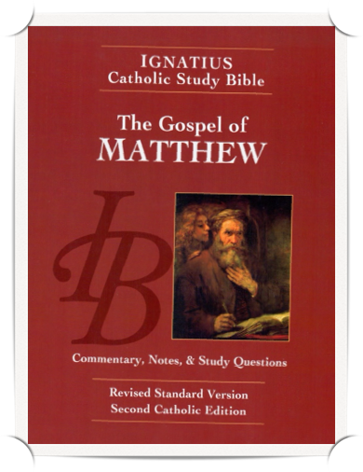
Homework: Ch.s 3 & 4
Read the Gospel According to Saint Matthew, chapters 3 & 4
pp. 21-24, including the notes.
Read the Word Study "Righteousness" p. 22
Answer the questions for chapters 3 & 4 on page 74 in your booklet.

