Slide 1

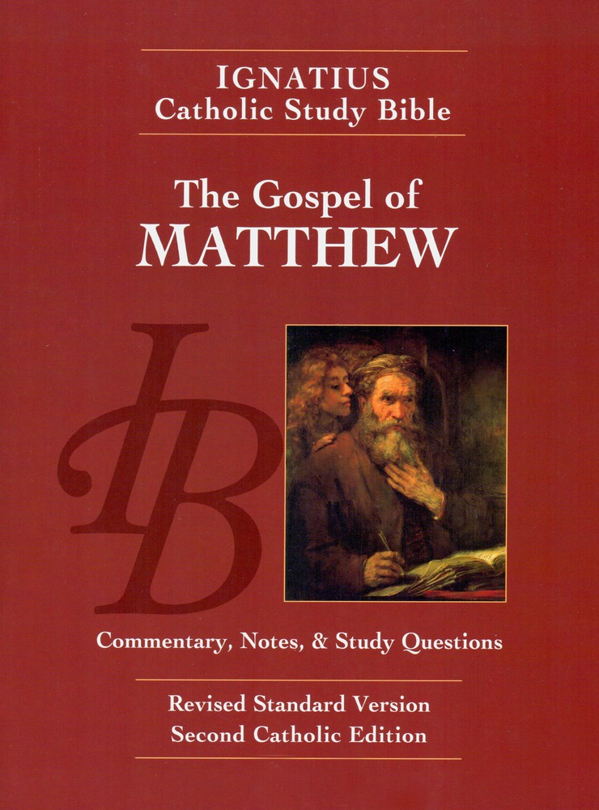
Sunday Bible College
Chapters 3 & 4
Holy Trinity
Anglican Church
Fernandina Beach, Florida

Slide 2
Outline of Chapters 3-4
BOOK 1
The Narrative Chapters 3-4
I. The Beginning of Jesus' Public Ministry
A. The Ministry of St. John the Baptist
1. The Baptism of Jesus
2. The Temptation in the Wilderness
B. Jesus Begins to Preach
1. Jesus Calls the First Disciples
2. The Message of Jesus (Repent)
The Discourse Chapters 5-7
II. The Sermon on the Mount

Slide 3
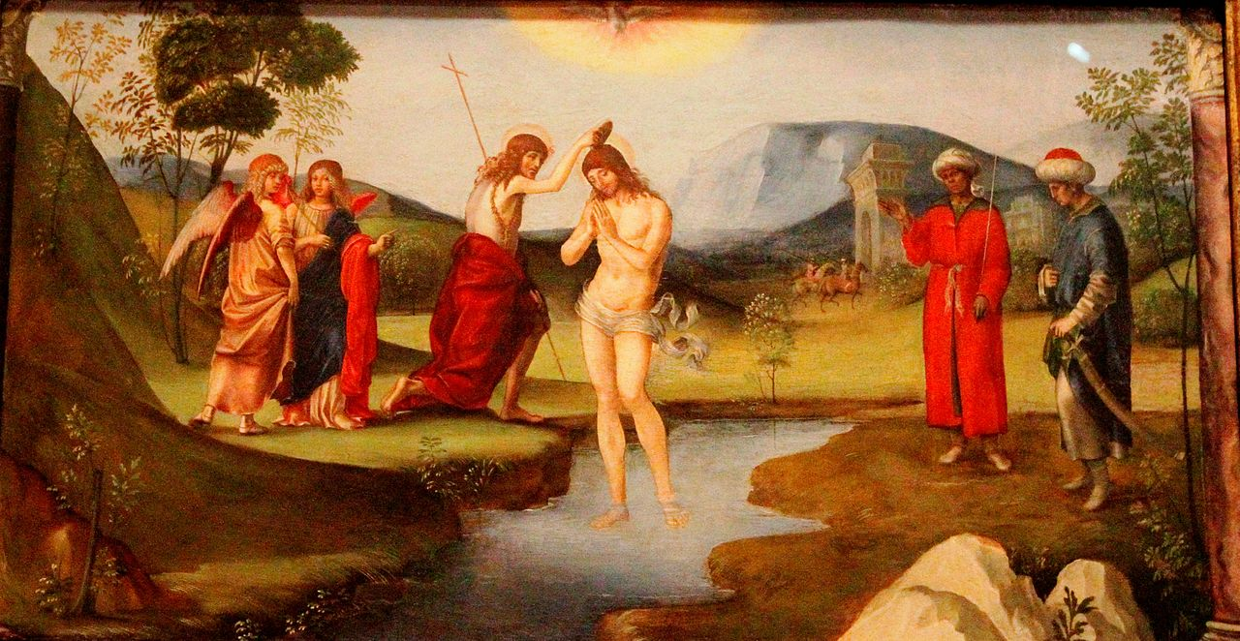

St. Matthew Chapter 3
Available through
amazon.com
iPhone App
Android App
audible.com

Slide 4
Question 3:1
Why does Matthew prefer the expression "the kingdom of heaven" over the expression "the kingdom of God"?
In a jewish context this expression emphasizes that the kingdom is not a political empire, but is the kingdom of heaven overcoming the world.

Slide 5
Question 3:2
Which two Old Testament events in the Jordan river prefigured the saving power of Baptism?
Joshua 3:14ff
The waters of the Jordan parted so that the Israelites entered the promised land on dry ground. (Just as the Red Sea parted so that they left Egypt on dry land.)
2 Kings 5:14ff
Naaman, commander of the Syrian army, was cleansed of leprosy when he dipped seven times in the Jordan on the word of Elisha.

Slide 6
Question 3:3
Although Jesus is sinless and has no need for repentance, He submits to John's baptism. Why?
Two main reasons:
To identify with the human race which he came
to save.
To sanctify Baptism, making it a sacrament for the New Covenant in which, according to Aquinas:
-the soul is cleansed
-grace of the Holy Spirit is imparted
-recipient is adopted as a child of God

Slide 7
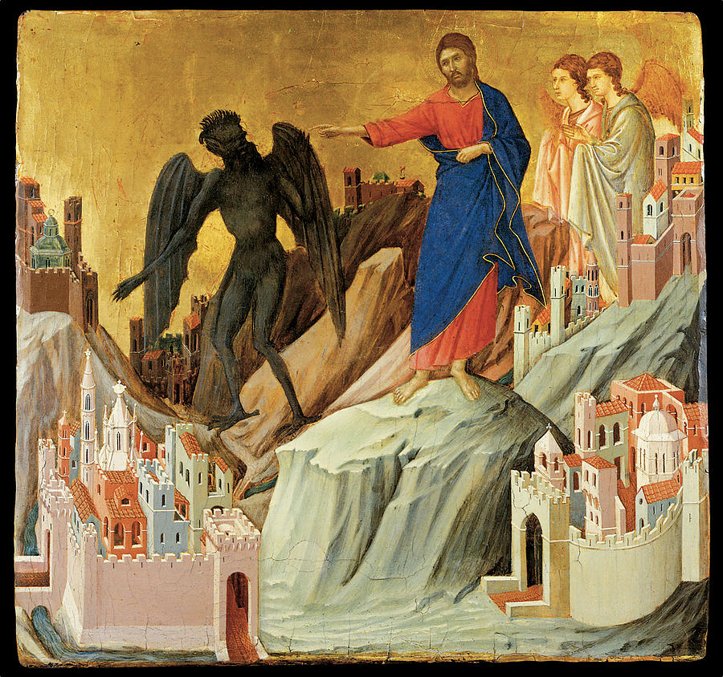
St. Matthew Chapter 4
Available through: amazon.com iPhone App
Android App audible.com

Slide 8
Question 4:1a
Looking at Deuteronomy 6-8, in what ways does the temptation of Jesus fulfill Deuteronomy?
Deuteronomy 6:13 It is The Lord your God you shall fear. Him you shall you serve and by his name you shall swear.
Deuteronomy 6:16 You shall not put The Lord your God to the test, as you tested him at Massah [Exodus 17:2-7 - Massah means testing. It is the name Moses gave to the place where Israel doubted God concerning water in the desert and so God brought water from a rock.]
Deuteronomy 8:3 And He humbled you and let you hunger and fed you with manna, which you did not know, that he might make you know that man does not live by bread alone, but man lives by every word that comes from the mouth of the LORD.

Slide 9
Question 4:1b
What virtue does the Church see in Jesus' behavior? How?
Jesus is the true and faithful Son. Israel, called the son of God, was tested in the desert, but they sinned, falling into idolatry and rebelling against the Lord. Jesus was faithful to God in all things and so proved his perfect Sonship.
Jesus is the perfect example. We are to follow him in faithfulness. Earthly life is a probabtionary period during which we face the wilderness trials. Like Christ, we will make it to heaven if we chose the food of God's will and the humility demonstrated by Christ.

Slide 10
Question 4:2
In as much as Jesus was divine and could not sin, what was the point in tempting him?
It was Satan's way of testing the Sonship of Jesus. Each of the various temptations offered by Satan attacked a particular aspect of the Messiah's identity. When Jesus had withstood all these temptations, Satan knew that Jesus was the Messiah, and that his defeat was imminent.

Slide 11
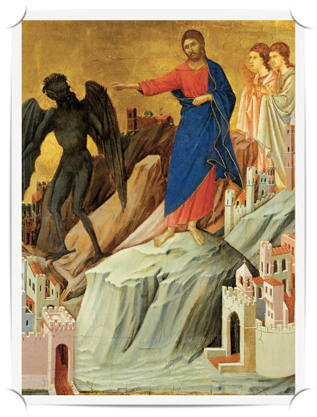
Cool Facts about Christ in the Dessert
40 Days
Number of days Moses fasted before Mount Sinai.
Number of days Elijah fasted in the wilderness before God spoke to him on the Mountain.
Number of Days Jesus Fasted before Sermon on the Mount.
Who visited Jesus at the Transfiguration on the Holy Mountain? Moses and Elijah. Jesus is the New Moses and the New Elijah.

Slide 12
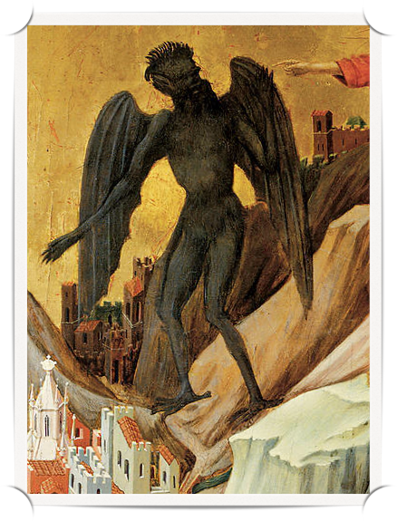
Cool Facts about Christ in the Dessert
Three Temptations
Parallel the temptations which the Israelites faced in the desert, but failed. Jesus is undoing the disobedience of Israel.
Parallel the temptations of every human being:
1 John 2:16 - the desire of the flesh, the desire of the eyes, the pride of life... Jesus is undoing the sinfulness of Mankind.

Slide 13
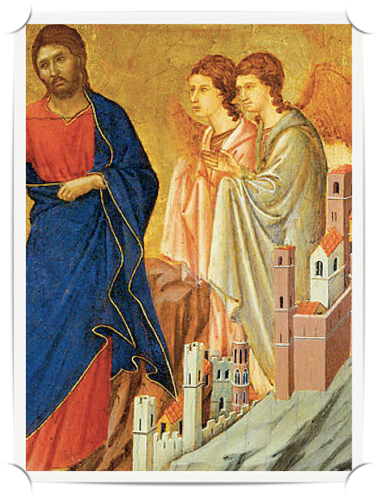
Cool Facts about Christ in the Dessert
Angels
Count the Angels in this Gospel so far.
Angels spoke to Joseph before the birth.
Angels warned the wise men about Herod
Angels told Joseph to return to Palestine
Angels warned Joseph not to go to Bethlehem
Angels ministered to Jesus after his ordeal in the desert.

Slide 14

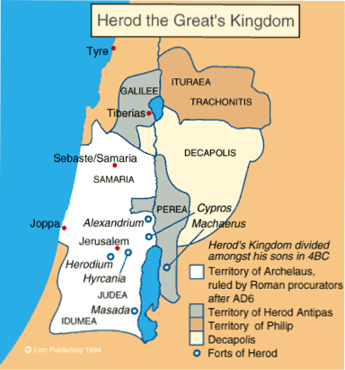
Question 4:3
Since most prophets were reputed to come out Judea, why did Jesus choose Galilee as the focus of his early ministry?
Again, it was to fulfill the prophesy
of Scripture. See Isaiah 9:1-2
In the latter time, [God] has made glorious the way of the sea, the Land beyond the Jordan, Galilee of the [Gentiles.]
This northern province had a long history, which left them disenfranchised and known as Israelites, as opposed to the Jews or Judeans of the Southern Kingdom.

Slide 15
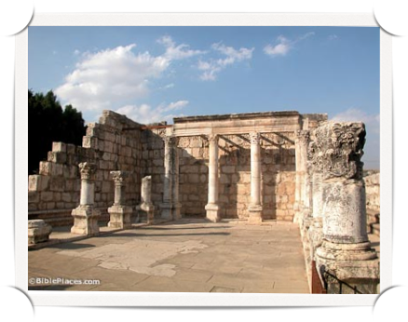
Question 4:4
Matthew says that Jesus taught in Synagogues. What was the importance of the Synagogue for Jews, as distinct from the Temple in Jerusalem?
Most sacrifices were made at the Temple in Jerusalem. However, it was not necessary to make more than three sacrifices per year at the Temple. During the rest of the year, Jews worshipped and were catechized in the local Synagogue.
NOTE: the first half our Liturgy is very similar to the liturgy of the Synagogue.

Slide 16
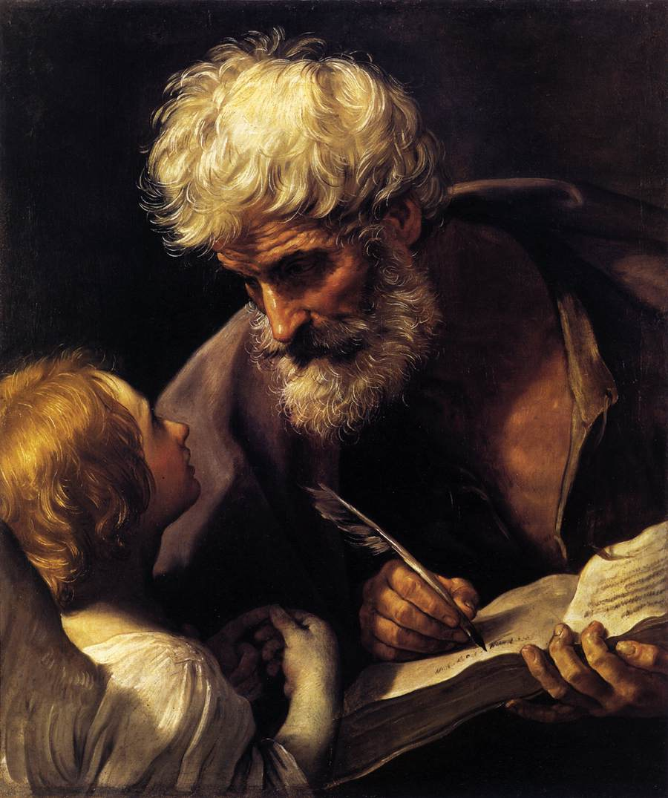
St. Matthew Chapter 3

Slide 17
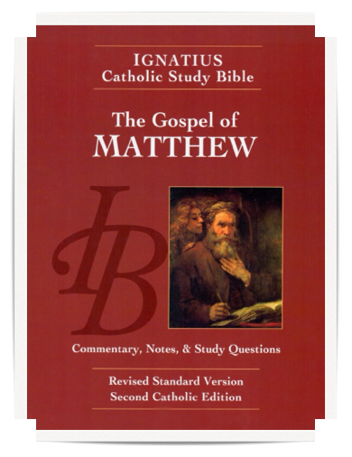

Homework: Ch.s 5-7 A
Read the Gospel According to Saint Matthew, chapters 5-7
pp. 24-30, including the notes.
Read the Word Study "Blessed"
on p. 24
Answer the questions for chapters 5-7 on page 75-76 in your booklet, paying closest attention to the "For understanding" questions. We will do the "For Application" questions the following week.

