Slide 1

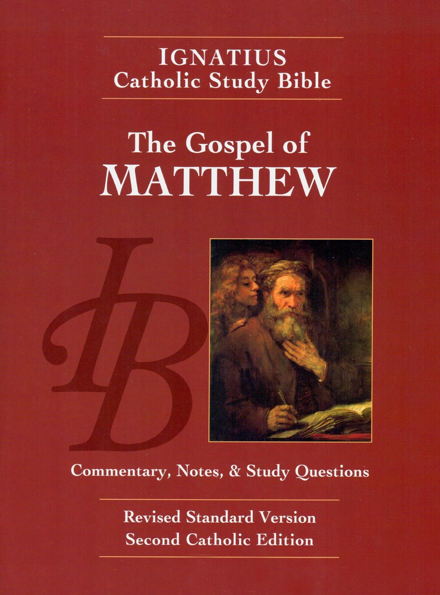
Sunday Bible College
Chapters 5-7
Part A
The Sermon
on the Mount
Holy Trinity
Anglican Church
Fernandina Beach, Florida

Slide 2
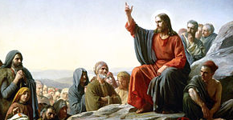
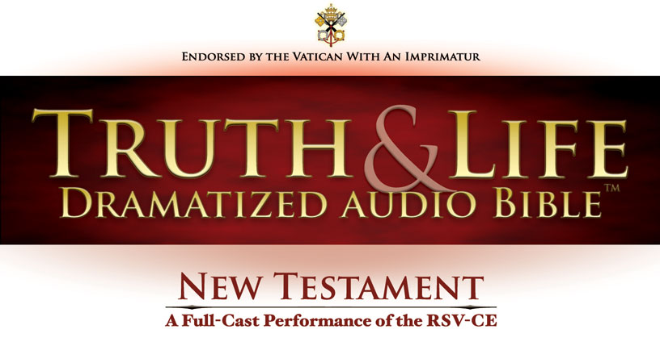
St. Matthew Chapter 5
Available through
amazon.com
iPhone App
Android App
audible.com

Slide 3
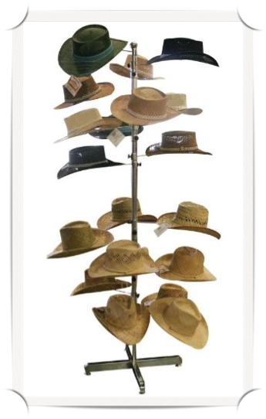
First, A Hook for Your Hat
Chapters 5-7 are presented as a Sermon. The thesis statement of the sermon is contained in the Beatitudes, 5:3-11. The rest of chapters 5-7 are the workings out of the principal lessons of the Beatitudes.
Therefore, the key to understanding this long section is to grasp the depth and meaning of just nine verses.

Slide 4
For Understanding 5:1
5:3-12 Reflect on and discuss how the first seven Beatitudes might correspond to the seven gifts of the Holy Spirit. (See Isaiah 11:2)
St. Augustine's insights on the 7 Gifts of the Spirit and the "7" Beatitudes*.
The early Church saw the Gifts of the Spirit as the guide or standard for the Christian life. St. Augustine believed the 7 Gifts and the "7" Beatitudes were related. NOTE: He saw the beatitudes as a ladder, leading ever upward toward the high calling of Christ, to Sonship of God in heaven. *Although St. Matthew lists 9 Beatitudes, St. Augustine believed the last two, on persecution, were not beatitudes but commentary, therefore there are "7" in Augustine's thought.

Slide 5
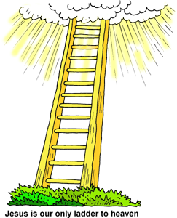
5:1 Continued
Peacemakers - Wisdom, the summit of X'tian life "They shall be called Sons of God."
Pure in heart- Understanding
Merciful - Counsel
Hunger for righteousness - Fortitude (might)
Meekness - piety
Mourning - knowledge
Poor in Spirit - Fear of God, beginning of X'tian life

Slide 6

A More Helpful Approach
Poor in spirit - those who recognize their need of God and the desperation of their situation without Him.
Those who mourn - not because they are bereaved but because they understand the depravity of this world and life in it.
The meek, those who do not insist on their own will or desires but instead simply do the will of God. Not lead by passions but by the direction of God's word.
Those who hunger / thirst for righteousness. They desire the righteousness of God as a starving man desires nourishment.
The merciful - patient and understanding toward sinners, generous and diligent toward the needs if the unfortunate.
The pure in heart - unmixed in motive, they desire only obedience to God.
The peacemakers - not merely peaceable, these are willing to sacrifice and work to bring about peace, especially through preaching the Gospel of peace.
The persecuted for Jesus sake - who through no fault of their own suffer because of Jesus name and for the sake of His ministry to mankind.

Slide 7
For Understanding 5:2
5:17 If the Old Testament Covenant had not been abolished, what does the New Covenant do? Why are the laws of animal sacrifice no longer followed? What happened to the Old Covenant version of the moral law?
(Greek: πλεροω: to fulfill or to fill up) The New Testament both includes and concludes the Old Covenant. It both perfects it and transforms it.
The Sacrificial Laws expired because they were always symbolic and not efficacious. The sacrifice of the New Covenant is sacramental and efficacious.
The Moral Law was retained and refined.

Slide 8
For Understanding 5:3
5: 21-30 What new dimensions does Jesus add to the commandments not to kill murder* and not to commit adultery?
*Note: the proper translation is murder, not kill. There is an important distinction. Soldiers are free of guilt when they kill enemy combatants in a just war. A man is free of guilt if he kills an intruder who threatens harm to his family. No one is ever free of guilt if they murder another human being.
Jesus introduces the element of desire as a basis for guilt. The Old Testament Law encompassed only action. The New Testament Law of Christ goes to the heart, judges the heart. In this way, the New Testament requirements are even more restrictive than the O.T.

Slide 9
For Understanding 5:4
5:38-42 What point does Jesus make about the Law of retaliation ("an eye for an eye")? What was the purpose of that law? What is Jesus' response to it?
The purpose of the Law was to limit retribution so that the punishment fit the crime without exceeding it.
Jesus makes the point that the Law can be misused as a call to seek vengeance, which is not the Laws purpose.
Jesus therefore removes the vengeance angle from the Law by calling for mercy instead of retribution.

Slide 10
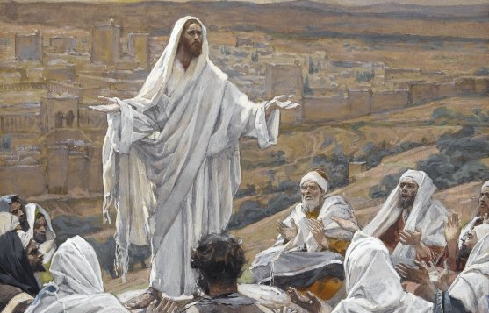
St. Matthew Chapter 6
Available through
amazon.com
iPhone App
Android App
audible.com

Slide 11
For Understanding 6:1
6:7-8 If Jesus is not condemning memorized and repeated prayer, what is he condemning?
He is not arguing against these practices in themselves, he warns against doing them for public esteem.

Slide 12
For Understanding 6:2
6:9-13 Consider the structure of the Lord's Prayer. Why is called the "model of prayer"?
It teaches us how to pray, both in specific words and also in the structure which God approves. First, we give glory to God and second we address our human need.

Slide 13
For Understanding 6:3
6:22-23 Read the annotation for these verses. how do the verses fit into Jesus' remarks on attitudes toward money?
Jesus would have us aware that wealth and accumulation of wealth presents real and present dangers to the individual.
Jesus would have us know that the preventative to these dangers is generosity / hospitality.

Slide 14
For Understanding 6:4
6:29-30 In using this rabbinic mode of arguing, what point is Jesus making? What is the anagogical significance of this passage?
God's care for the lesser things of life proves his concern for the greater needs of our souls.
Anagogically: (Anagogical: the spiritual interpretation of a literal statement or event.) God's care to provide clothing for the body demonstrates his greater concern to cloth our souls with glory.

Slide 15
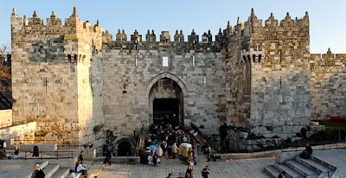
St. Matthew Chapter 7
Available through
amazon.com
iPhone App
Android App
audible.com

Slide 16
For Understanding 7:1
7:1-6 What kind of judgment does Jesus forbid in this passage? According to the note, what kind of judgment does he require elsewhere in this passage?
We are to avoid judging another's faults since we are incapable of exercising just judgment.
However, we ought to exercise critical discernment, lest we profane what is holy and embrace what is false.

Slide 17
For Understanding 7:2
7:13-14 On what is the comparison of the wide and narrow gate based? What was the significance of the gates in the Temple?
In the city walls, the main gates were wide and tall enough for loaded wagons to pass while narrower gates were only large enough for one person at a time to pass.
The Temple had a series of gates intended to restrict access to only those who were authorized to enter.

Slide 18
For Understanding 7:3
7:21-23 If working signs and wonders in Jesus name is not itself a safeguard against his condemnation what is? What is the relation of sanctifying grace to this passage?
Miracles are born of charismatic graces, which may be intended for the benefit of others, and not the one performing the miracle.
Sanctifying grace enables the recipient to live in obedience to God, making him or her fit for heaven, i.e. to live in the presence of God.

Slide 19
For Understanding 7:4
7:24-27 When this passage is understood from a moral perspective, how does the wise man build and maintain the house of his soul? How does the foolish man fail to build and maintain his?
Solomon built the Temple upon a great foundation stone and on high ground and of the best materials (cedar, stone, metal)
The soul must be built on a solid foundation (the word of God, the person and work of Christ). And it must be maintained through effective procedures such as prayer, fasting, works of charity, etc.

Slide 20
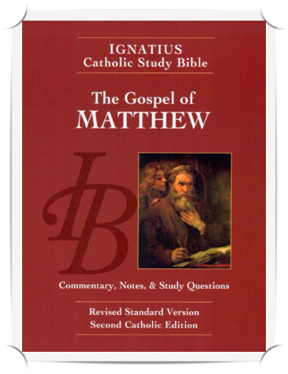
Homework: Ch.s 5-7 B
Re-read the Gospel According to Saint Matthew, chapters 5-7
pp. 24-30, including the notes.
Answer the questions labeled "For application" for chapters 5-7 on pages 75-76 in your booklet.

