Slide 1

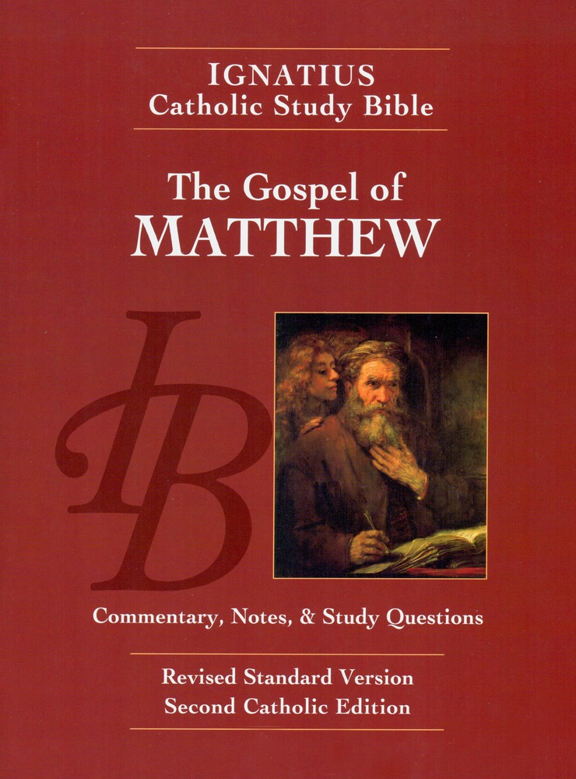
Sunday Bible College
Chapters 6:1-34
The Sermon
on the Mount
Holy Trinity
Anglican Church
Fernandina Beach, Florida

Slide 2

Rosemary's Questions
Which Laws apply and which are no longer applicable?
What does Jesus mean by what he says in Matt 5:18-20?
Answer: See Matthew 22:36-40

Slide 3
Rosemary's Questions
You shall love the Lord your God with all your heart, and with all your soul and with all your mind. This is the great and first commandment. And the second is like it, You shall love your neighbor as yourself. On these two commandments depend all the Law and the Prophets.
The Great Commandment: Matthew 22:38-40,
BCP p. 87 / p. 69
This Law of love was and remains the standard by which we judge all other laws and their usefulness in our time. It is the Law of Love which Jesus came to complete and perfect.

Slide 4
Matthew 6
Concerning Almsgiving
Read verses 1-4
Key phrase, "Your father who sees in secret will reward you."
Why do hypocrites give? To be seen giving.
BTW What is a hypocrite? An Ancient Greek actor wearing a mask to play a role.
Jesus is not condemning public worship, but the hypocrisy of pretending worship for the sake of self-promotion.

Slide 5
Matthew 6
Concerning Prayer
Read verses -14
And when you pray, you must not be like the Hypocrites...
Empty phrases and many words:
"Juswanna" Prayers,
"O Lord Father God" prayers
"Our Bodies to thy service" prayers
The Our Father teaches us both to direct and to express the inward dispositions of the heart. Jesus is saying, take off your mask, stop acting like a prayer warrior and just pray.

Slide 6
Matthew 6
Concerning Fasting
Read verses 16-18
Hypocrites are those who fast in a big showy way to be seen fasting. The hypocrite wants to hear, "Look how spiritual he is, he fasts so much he's just skin and bones."
Jesus encourages Fasting, but with the correct attitude of the heart. The right disposition is key.
Your Father who sees in secret will reward you in secret.

Slide 7
Spiritual Disciplines
Almsgiving, Prayer and Fasting
So far in chapter 6, Jesus has addressed the three main spiritual disciplines expected of all believers: Almsgiving, Prayer, and Fasting. These are each necessary disciplines for all believers.
The common thread is: the great enemy of spiritual discipline is hypocrisy - playing the role for pride sake.
The key to Spiritual Discipline and growth is the attitude of the heart. A heart that is tuned to God and looks to Him for reward will find it.

Slide 8
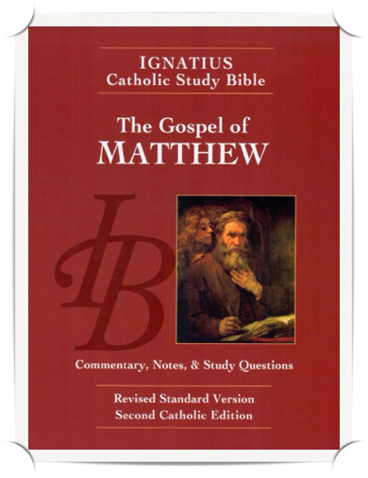
Homework: Ch.s 6
Re-read the Gospel According to Saint Matthew chapters 6 & 7 pp. 27-30, including the notes.
Answer the questions labeled "For application" for chapters 6 and 7 on pages 75-76 in your booklet.

