Slide 1

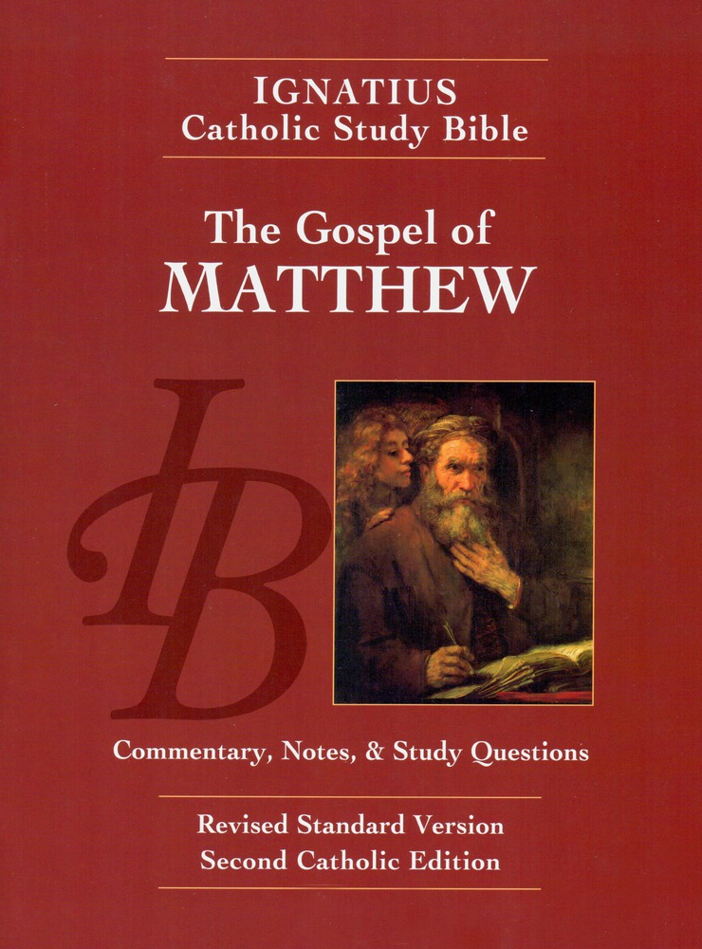
Sunday Bible College
Chapters 6:1-34
The Sermon
on the Mount
Holy Trinity
Anglican Church
Fernandina Beach, Florida

Slide 2

Rosemary's Questions
Which Laws apply and which are no longer applicable?
What does Jesus mean by what he says in Matt 5:18-20?
Answer: See Matthew 22:36-40

Slide 3
Rosemary's Questions
You shall love the Lord your God with all your heart, and with all your soul and with all your mind. This is the great and first commandment. And the second is like it, You shall love your neighbor as yourself. On these two commandments depend all the Law and the Prophets.
The Great Commandment: Matthew 22:38-40,
BCP p. 87 / p. 69
This Law of love was and remains the standard by which we judge all other laws and their usefulness in our time. It is the Law of Love which Jesus came to complete and perfect.

Slide 4
Matthew 6
Concerning Almsgiving
Read verses 1-4
Key phrase, "Your father who sees in secret will reward you."
Why do hypocrites give? To be seen giving.
BTW What is a hypocrite? An Ancient Greek actor wearing a mask to play a role.
Jesus is not condemning public worship, but the hypocrisy of pretending worship for the sake of self-promotion.

Slide 5
Matthew 6
Concerning Prayer
Read verses -14
And when you pray, you must not be like the Hypocrites...
Empty phrases and many words:
"Juswanna" Prayers,
"O Lord Father God" prayers
"Our Bodies to thy service" prayers
The Our Father teaches us both to direct and to express the inward dispositions of the heart. Jesus is saying, take off your mask, stop acting like a prayer warrior and just pray.

Slide 6
Concerning Fasting
6:16-18
Hypocrites are those who fast in a big showy way to be seen fasting. The hypocrite wants to hear, "Look how spiritual he is, he fasts so much he's just skin and bones."
Jesus encourages Fasting, but with the correct attitude of the heart. The right disposition is key. His solitary fasting in the wilderness is our example.
The key fasts are defined in the Book of Common Prayer p. lix or '28 p. li: Ash Wednesday*, Good Friday*, 40 Days of Lent, 12 Ember days at the seasons, All Fridays (except between Christmas and Epiphany)
Your Father who sees in secret will reward you in secret.

Slide 7
Lessons from Jesus' Fast
Excursus
What marks of Jesus' fasting aught to mark our own fasts
His fasting was an act prompted by the Spirit.
He fasted for spiritual benefit.
He fasted to defeat the influence of Satan in his life.
As he abstained from food he feasted on the Scriptures.

Slide 8
Spiritual Disciplines
Almsgiving, Prayer and Fasting
So far in chapter 6, Jesus has addressed the three main spiritual disciplines expected of all believers: Almsgiving, Prayer, and Fasting. These are each necessary disciplines for all believers.
The common thread is: the great enemy of spiritual discipline is hypocrisy - playing the role for pride sake.
The key to Spiritual Discipline and growth is the attitude of the heart. A heart that is tuned to God and looks to Him for reward will find it.

Slide 9
Concerning Treasures
6:19-21
Wealth is not a vice and poverty is not a virtue!
Several of the greatest believers of all time were insanely wealthy: Job, Abraham, David, Hezekiah.
Wealth is a catalyst which exposes inner dispositions of the heart.
"Where your treasure is, there will your heart be also."
It can expose pride, jealousy, vainglory, contempt, coveteousness
Wealth also exposes thankfulness, generosity, wisdom,
self-discipline
KEY TRUTH: Be proactive and intentional about what treasure you seek.

Slide 10
The Sound Eye
6:22-23
This is a tough saying but in context it makes sense. Jesus has been talking about being honest about the consequences of our inner life (dispositions of the heart), now he tells us how to cultivate an inner life which is pleasing to God.
Old Computer Phrase: GIGO Garbage In / Garbage Out
Jesus' point, our souls are like mirrors reflecting a glory that is not our own but belongs to God whose image we bear. If God's glory shines into the eyes of our souls, his glory will clear our souls of darkness and reflect back as goodness. If on the other hand, we close our eyes (souls) to God's brightness then there will be only darkness (death and wickedness) in our souls and reflecting outwards.

Slide 11
Serving Two Masters
6:24
Eve could not serve both God and Satan!
Neither can we!
How many ways do we try to divide our lives between that which belongs to God and that which belongs to the world.
How many times do we try to divide our allegience between the Kingdom of God and the United States of America?

Slide 12
Do Not Be Anxious
6:25-34
Anxiety is excessive worry about how to meet daily needs in the future. It is prolonged precisely because it concerns daily needs.
Why is anxiety so wrong?
O ye of little faith! God provides for the smallest and most insignificant things. And yet you believe that he can not or will not provide for you?
St. Peter learned this lesson well. Read I Peter 5:7

Slide 13
Recap of Chapter 6
What we learned
The three great Spiritual exercises: Almsgiving, Prayer, Fasting. The enemy of these is hypocrisy. The key to benefiting from these disciplines is cultivating genuine faith by turning toward God.
Treasures / Wealth usually provides a window into a person's heart. We store our treasures in secure places, and we set our eyes on desirable things.
Therefore, we are called to be honest about two things: First, if we want God to be in our heart we have to set our eyes on the light of his countenance. Second, we must be singularly devoted, never divided. God is our Master.
The answer to anxiety is "detachment from the world" through trust in God for all things necessary.

Slide 14
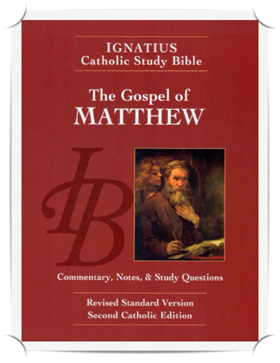
Homework: Ch.s 6
Re-read the Gospel According to Saint Matthew chapters 6 & 7 pp. 27-30, including the notes.
Answer the questions labeled "For application" for chapters 6 and 7 on pages 75-76 in your booklet.

