Slide 1

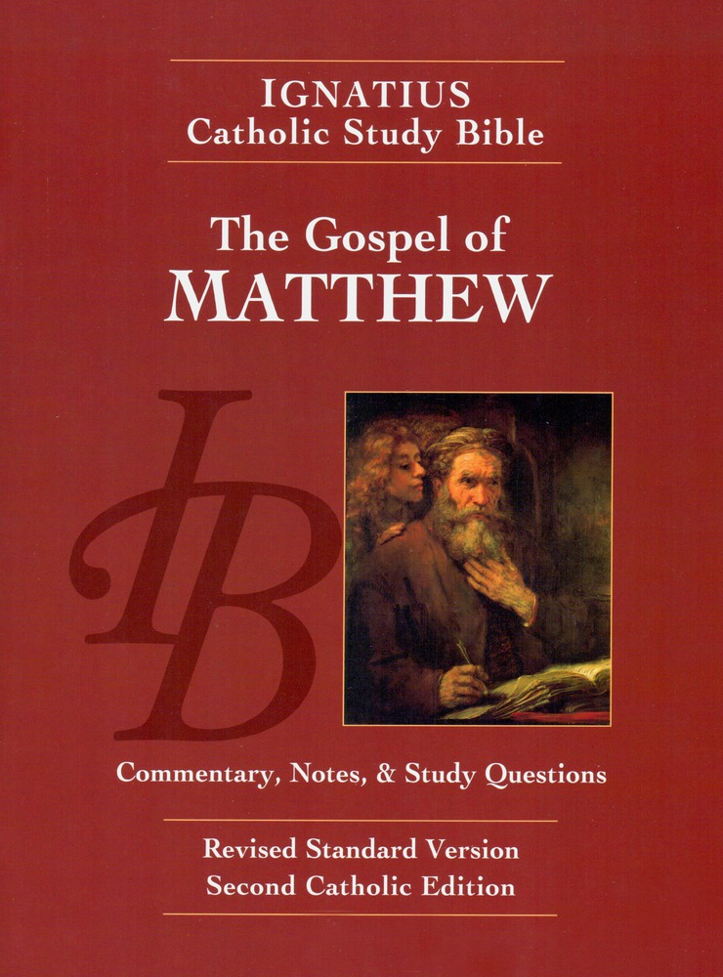
Sunday Bible College
Chapter 7
The Sermon
on the Mount
Holy Trinity
Anglican Church
Fernandina Beach, Florida

Slide 2

Judging Others
7:1-5
We are forbidden to condemn others.
We can not know the heart (motives, relationship with God) of others and therefore our judgments are not trustworthy. God alone knows the heart (Proverbs 21:2, Luke 16:15)
Nevertheless, we are commanded to exercise discernment. Otherwise, we might profane what is holy or embrace that which is false. Matt. 7:6, 15-19, 1 Thess. 5:21

Slide 3
Profaning the Holy
7:6
What is holy? Anything consecrated for worship. The building, the utensils and furnishings, the sacrifices, and the people who had come to worship. (Exodus 29:37)
What is profane? Not devoted to worship or glory of God; irreligious, secular, or irreverent.
NOTE: If people are made in the image of God for his worship and he has set us apart for this purpose, if we should profane another person by condemning them wrongfully, we would profane that which is holy, a person set apart for worship.

Slide 4
Ask, Seek, Knock
7:7-12
Jesus teaches perseverance in prayer. Keep on asking.
God gives good things. (Note, when we ask for things that are not good, he will not give. He only gives good. He always gives the good, not withholding.)
The Golden Rule (v12) This is an application of God's actions toward us. God treats us as he would have us treat him. We ought to follow his example and so be godly, holy.

Slide 5
The Narrow Gate
7:13-14
"Christianity has not been tried and found wanting. It has been found difficult and left untried." G. K. Chesterton, What's Wrong With The World.
See Matthew 19:16-26. The Rich Young Man

Slide 6
False Prophets
7:15-20
What is a Prophet? Someone who speaks for God.
A FALSE PROPHET claims to speak for God when God has not spoken.
How to tell the difference? Discernment. We have to learn what "good fruit" tastes like and what "evil fruit" looks and smells like? NOTE: its not always obvious... Examples: Success and wealth do not indicate goodness. Poverty and rejection do not indicate evil.

Slide 7
Concerning Self-Deception
7:21-23
"The man who lies to himself and listens to his own lie comes to a point that he can not distinguish the truth within him, and so loses all respect for himself and for others. And having no respect, he ceases to love." Fyodor Dostoyevsky, The Brothers Karamazov (IMHO the greatest Christian novel by the greatest Christian novelist, ever! A must read.)
Hell is the inability to love or be loved.

Slide 8
Hearers and Doers
7:1-5
Problem: In America, we have reached a point that we equate knowledge with goodness. People are doomed to poverty and to failure by ignorance. Education will lead to decreased crime and increased please. Simply knowing more facts is considered good and a virtue.
Jesus turns this notion upside down. Knowledge for knowledge sake is WORTHLESS. Unless we act on the words of Christ we are doomed.
Loo up St. James 2:24
In Christ we are called, prepared and empowered to DO his good will.

Slide 9
The END
of the Sermon on the Mount

Slide 10
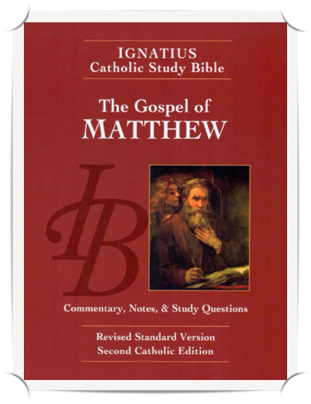
Homework: Ch. 8
Re-read the Gospel According to Saint Matthew chapters 8 pp. 30-31, including the notes.
Answer the questions labeled "For understanding" for chapter 8 on pages 76 in your booklet.

