Slide 1


Sunday Bible College
Chapter 9
Miracles of Jesus
& the Twelve Apostles
Holy Trinity
Anglican Church
Fernandina Beach, Florida

Slide 2

Jesus Heals a Paralytic
9:1-8
Jesus offers forgiveness of sins to a man who is paralyzed. Was sin the cause of his paralysis? (We don't know: Maybe or not.
Jesus forgives because this is the real reason for his incarnation, to reconcile sinners to God the Father.
It is easier to say, You are forgiven. So jesus demonstrated his authority by doing the harder thing, the thing that could be verified so that those who heard would accept his authority to forgive.
The crowd who heard responded by worshipping God.

Slide 3
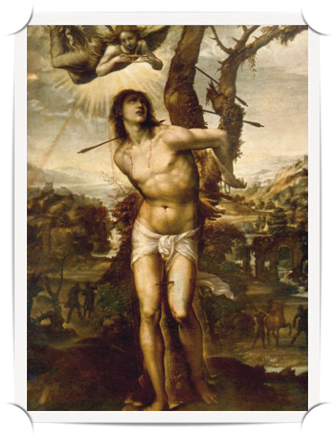
Excursus #1:
Toward a Theology of Suffering
Collosians 1:24-29
2 Corinthians 11:23-29
1 Peter 4:12-13
James 1:2-5
2 Corinthians 12:7-10

Slide 4
Why Christians Suffer
Sometimes we suffer as a consequence of sin.
Somtetime sin has nothing to do with suffering, rather we suffer for the sake of our own souls (as Pual suffered to maintain humility.)
Sometimes we suffer for the sake of others (as Paul suffered for the sake of the Collosians.)
Sometimes we suffer for the sake of Christ, to share in His sufferings that we might know the power of His resurrection.
When we suffer, we should repent of any sin which might be the root of our suffering.
When we suffer, we should consider the possibility that the suffering is for good, and in accordance with Christ's will for our life, and, therefore, offer our sufferings as a sacrifice for his glory.

Slide 5
The Call of Matthew
9:9-13
Matthew and his friends are called tax collectors and sinners. In history, the Church has often said that some careers were not appropriate for Christians. Greek acting, abortionist, prostitution, sorcery, necromancy, medium / psychic... Why would these careers be unacceptable for a Christian? Because in the normal course of doing your job you would be required to commit mortal sin.
What does it mean, "I desire mercy and not sacrifice."?See Hosea 6:6

Slide 6
The Question about Fasting
9:14-17
The disciples of John ask a narrow question about one aspect of the faith: fasting.
Jesus answers with a conceptual treatise: What he is bringing into the world will not fit into the old wineskins of the Old Testament. There will need to be a New Testament to fit the New Wine of the Kingdom of God.
The New Covenant brings new ways of doing things. (new Traditions)

Slide 7
A Girl Restored to Life
& a Woman Healed
9:18-26
A healing within a healing
Notice how the observers start off laughing at Jesus but then marvel at him and spread his fame abroad.
What were they astonished by? When they told people about Jesus, what did they say?
Was this an accurate description of Jesus' ministry?

Slide 8
Jesus Heals Two Blind Men
9:27-31
"Son of David" - A title used 8 times in Matthew.

Slide 9
Jesus Heals a Mute Man
9:32-34

Slide 10
The Harvest is Plentiful
9:35-38

Slide 11
The Twelve Apostles
10:1-4

Slide 12

Homework
On December 21, The Fourth Sunday in Advent, we will have a special presentation of the proposed changes to the chancel. The Matthew Study will resume an the 1st Sunday after Christmas.

